Slide 1
My Ebenezer
From Sinner to Saint…
a work in progress

Slide 2
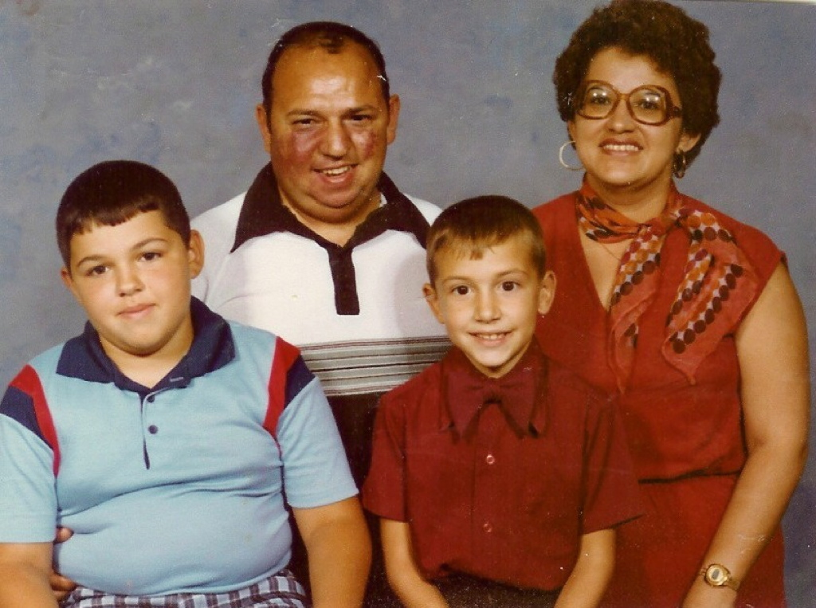

Slide 3
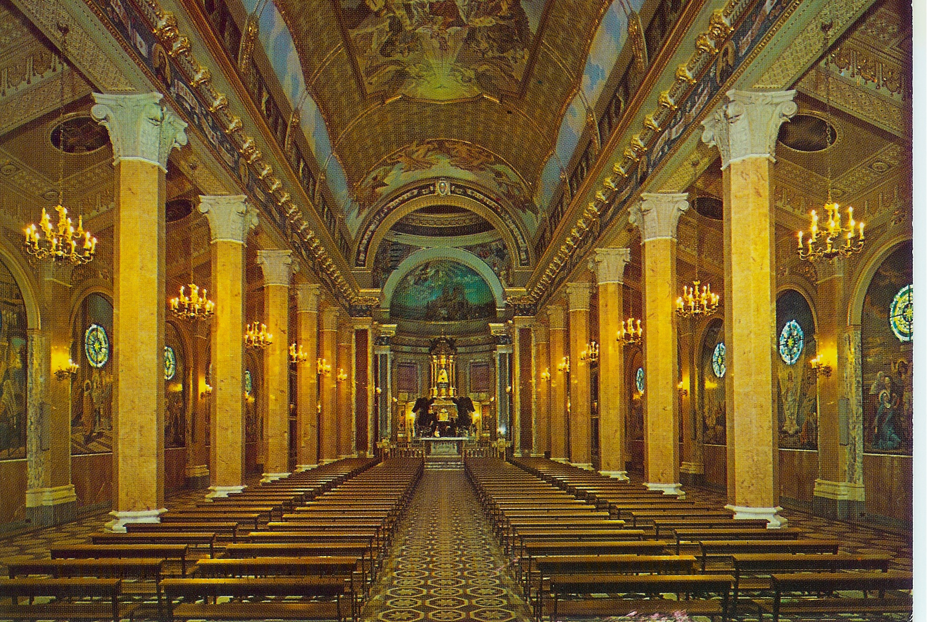

Slide 4
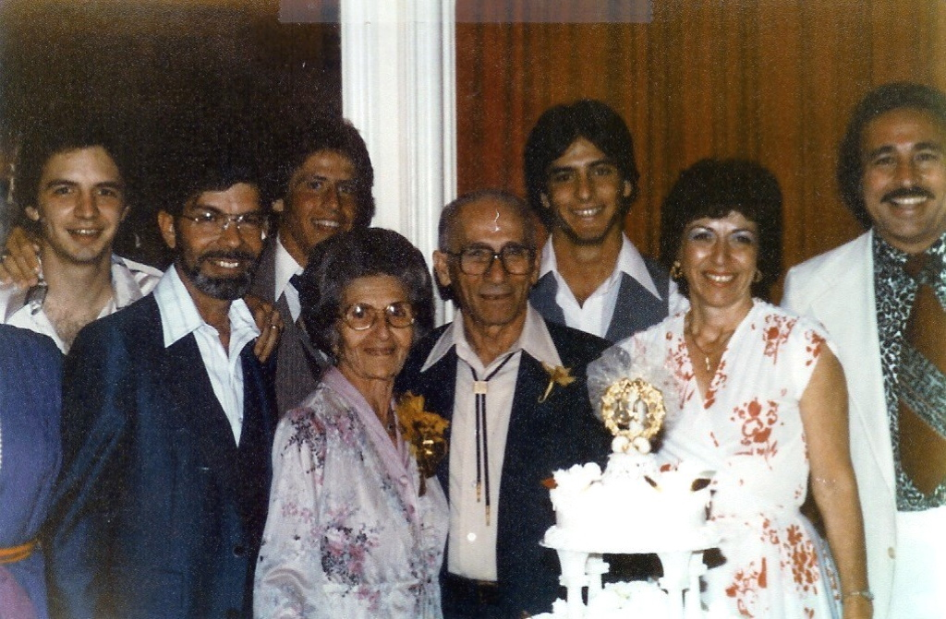

Slide 5
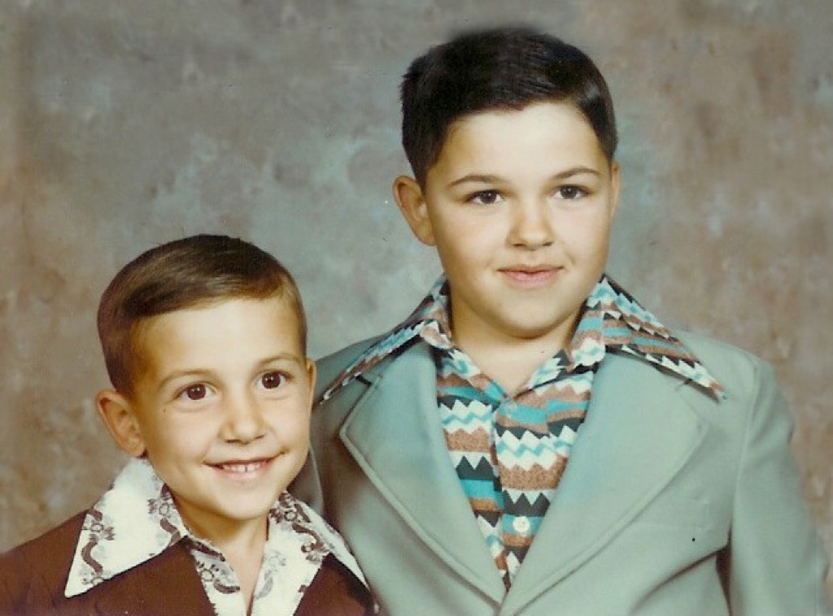

Slide 6
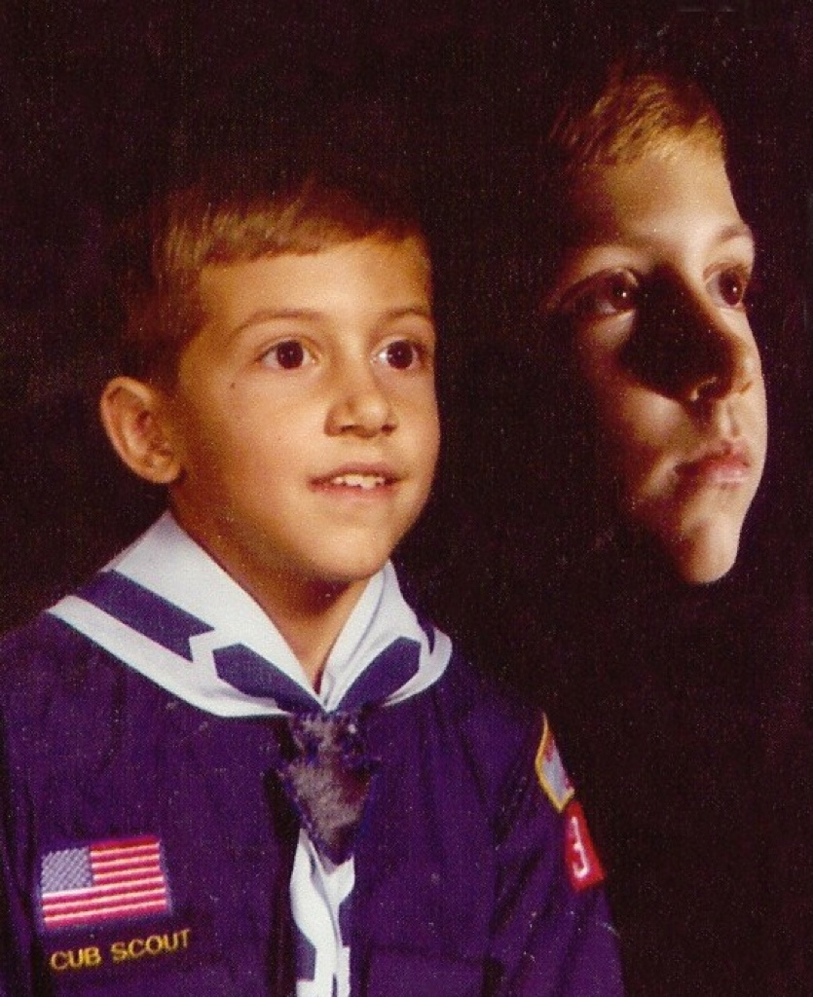

Slide 7
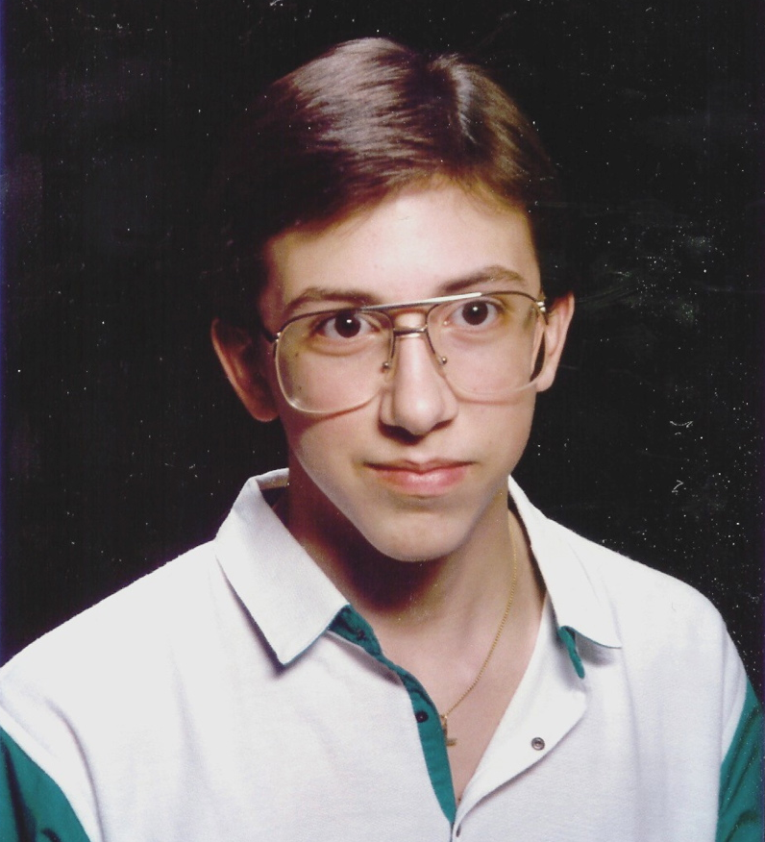

Slide 8
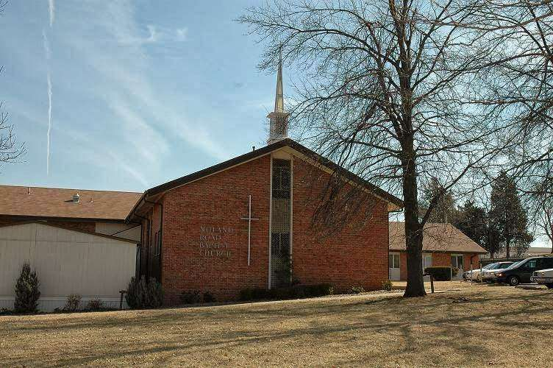

Slide 9
Revelation 3:5
“He who overcomes shall be clothed in white garments, and I will not BLOT OUT his name from the Book of Life; but I will confess his name before My Father and before His angels.”

Slide 10
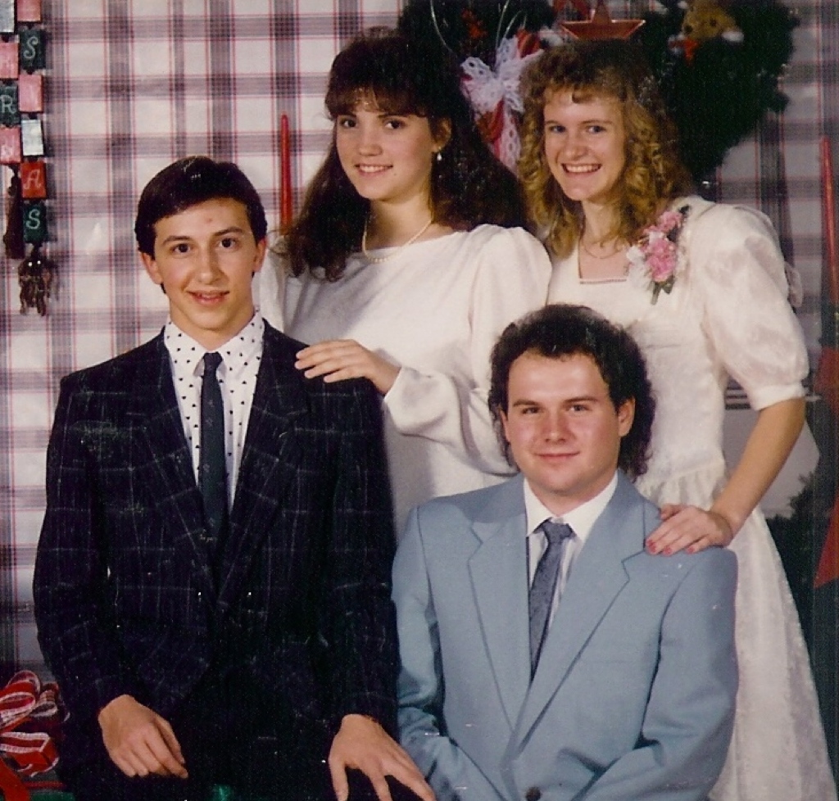

Slide 11
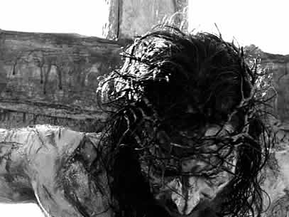

Slide 12
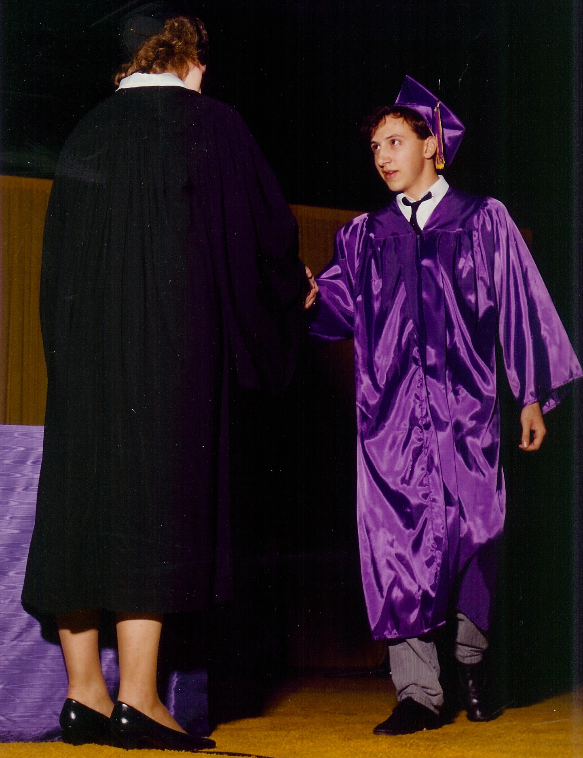

Slide 13
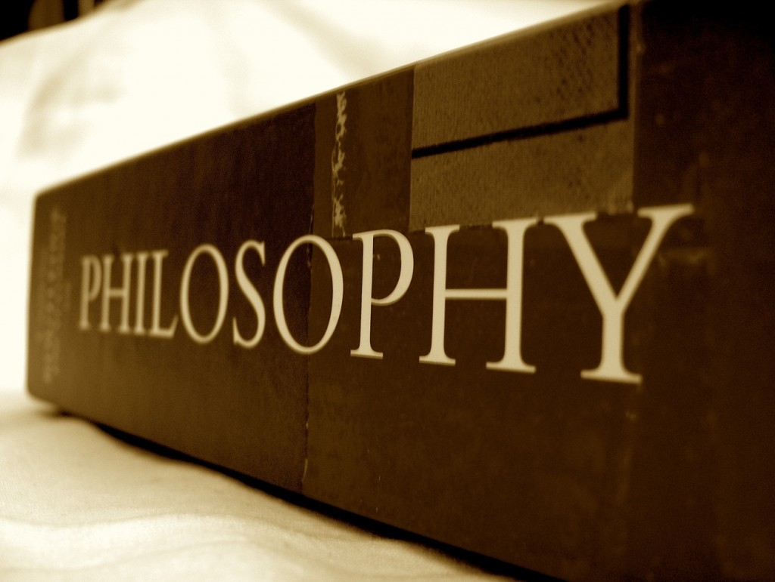

Slide 14
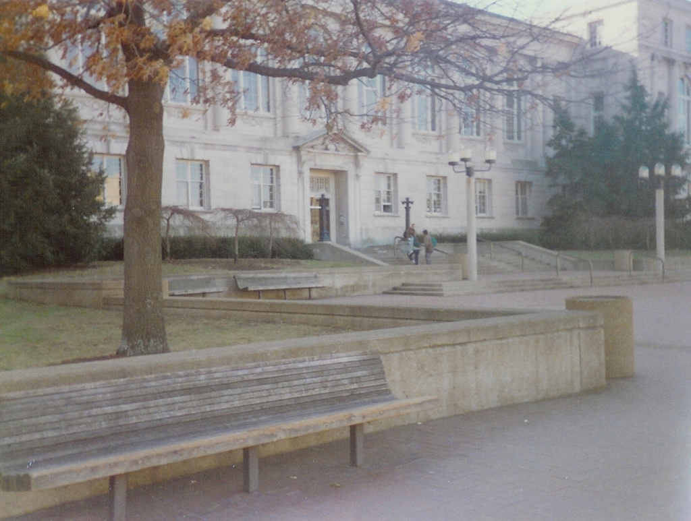

Slide 15
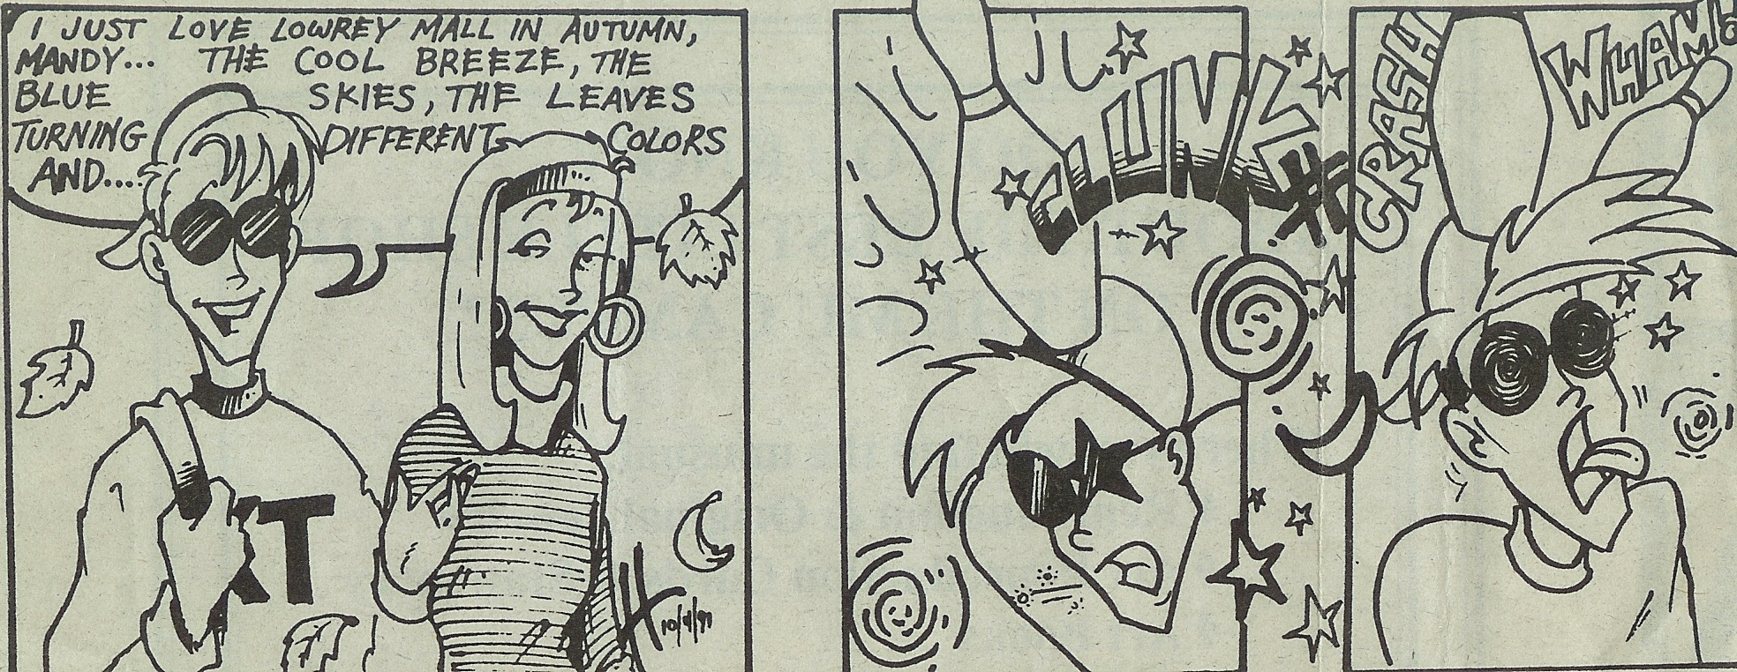
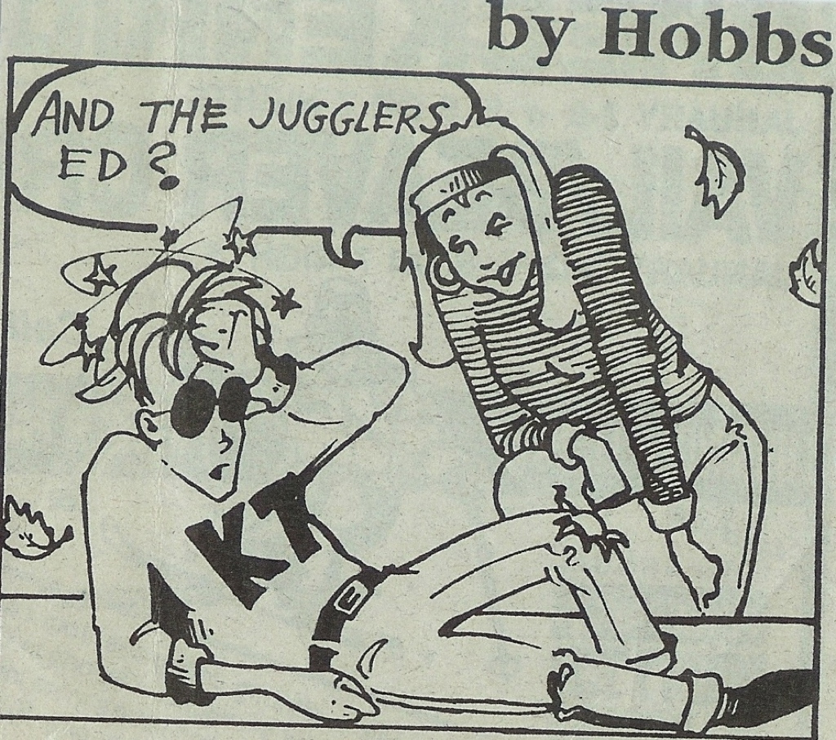

Slide 16
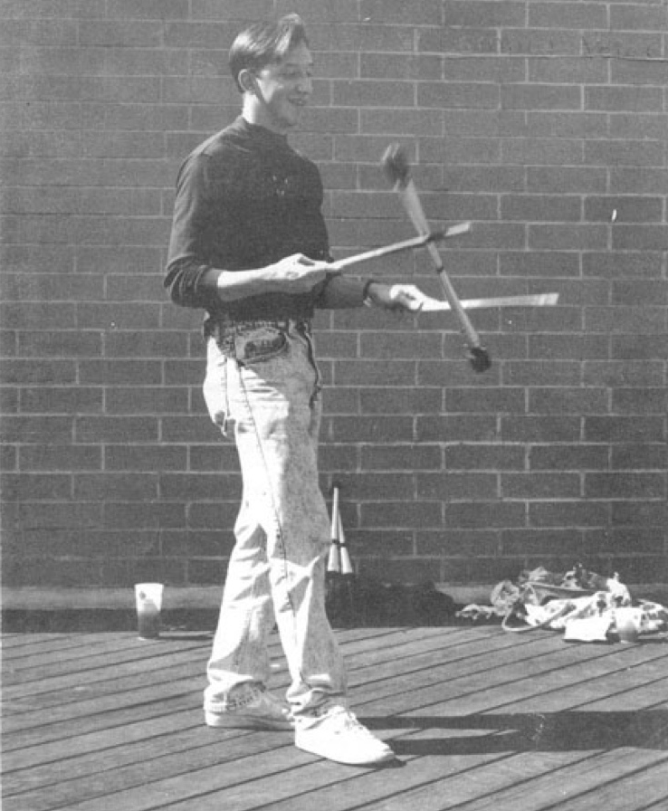
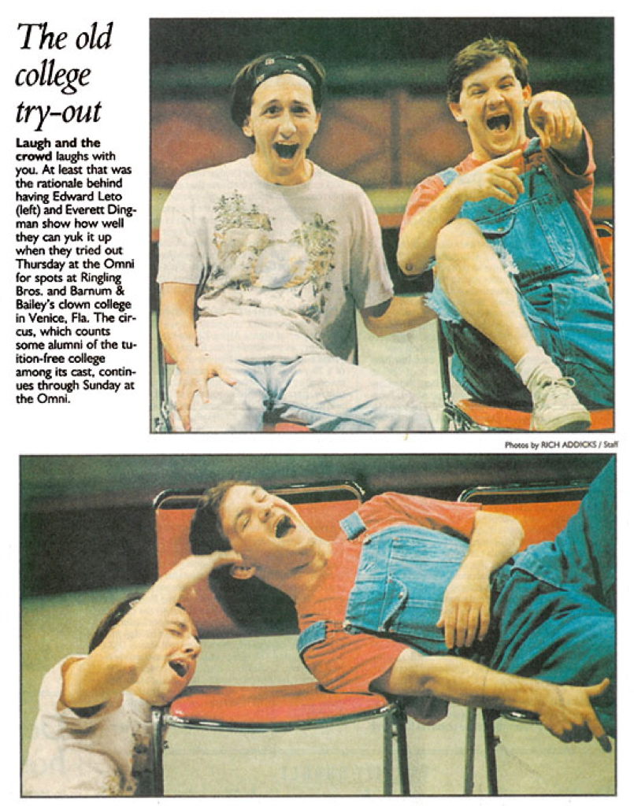

Slide 17
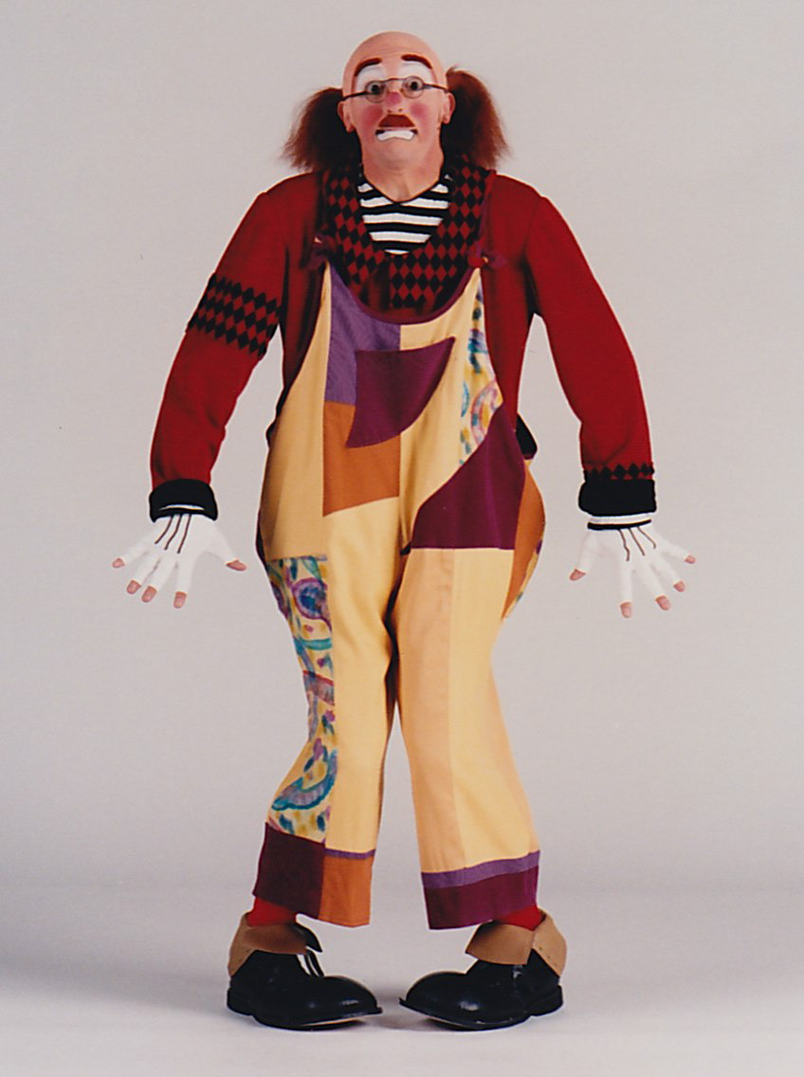
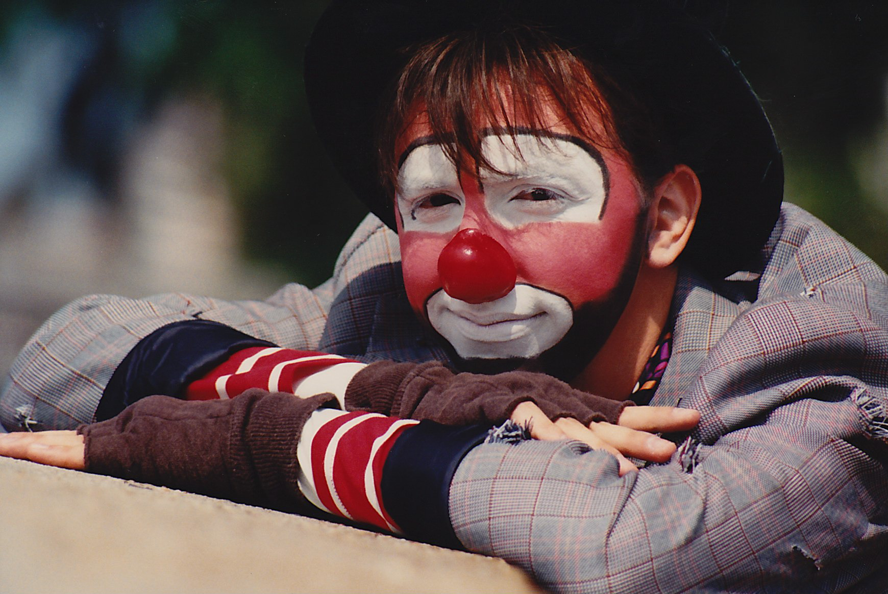

Slide 18
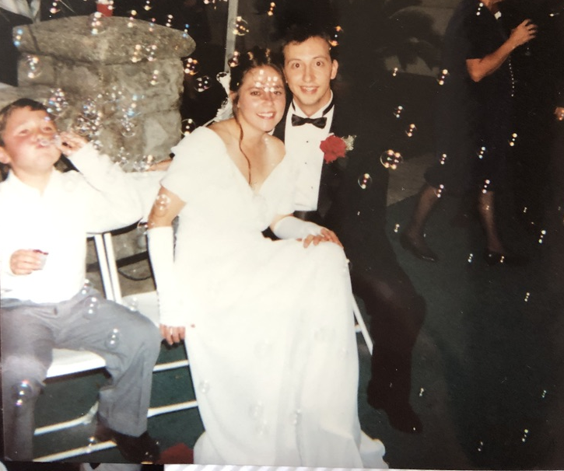

Slide 19
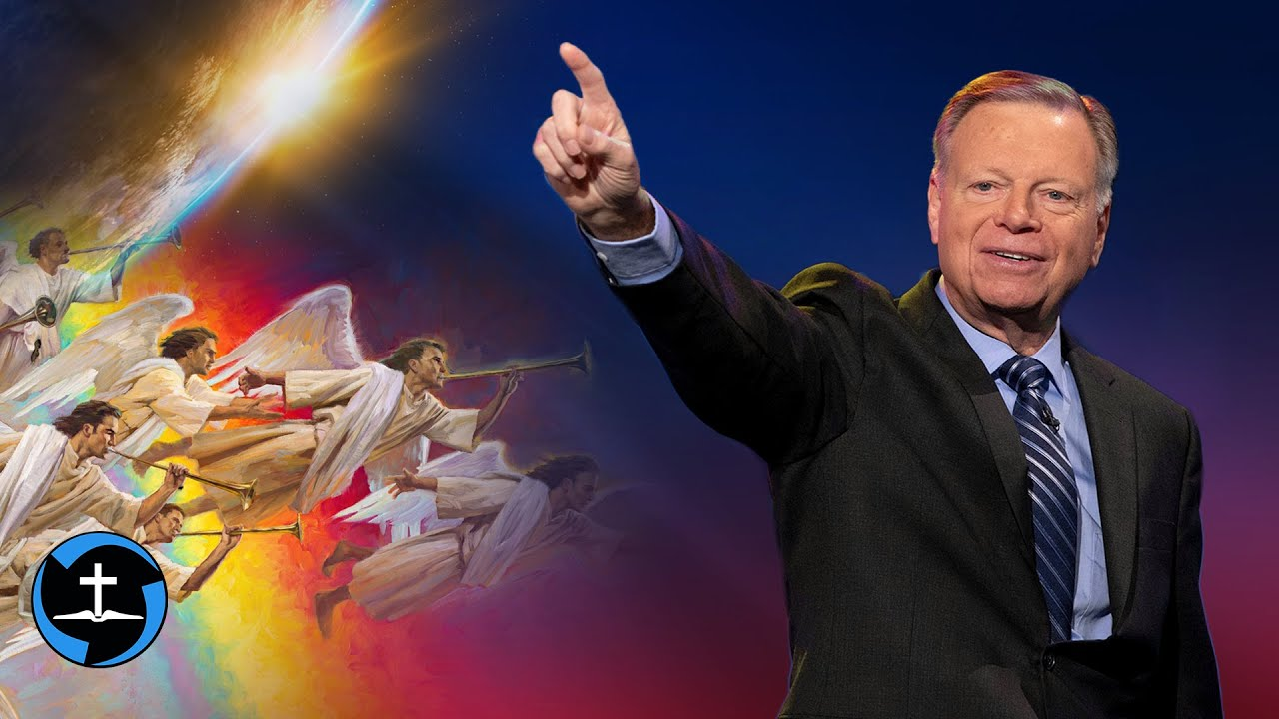

Slide 20
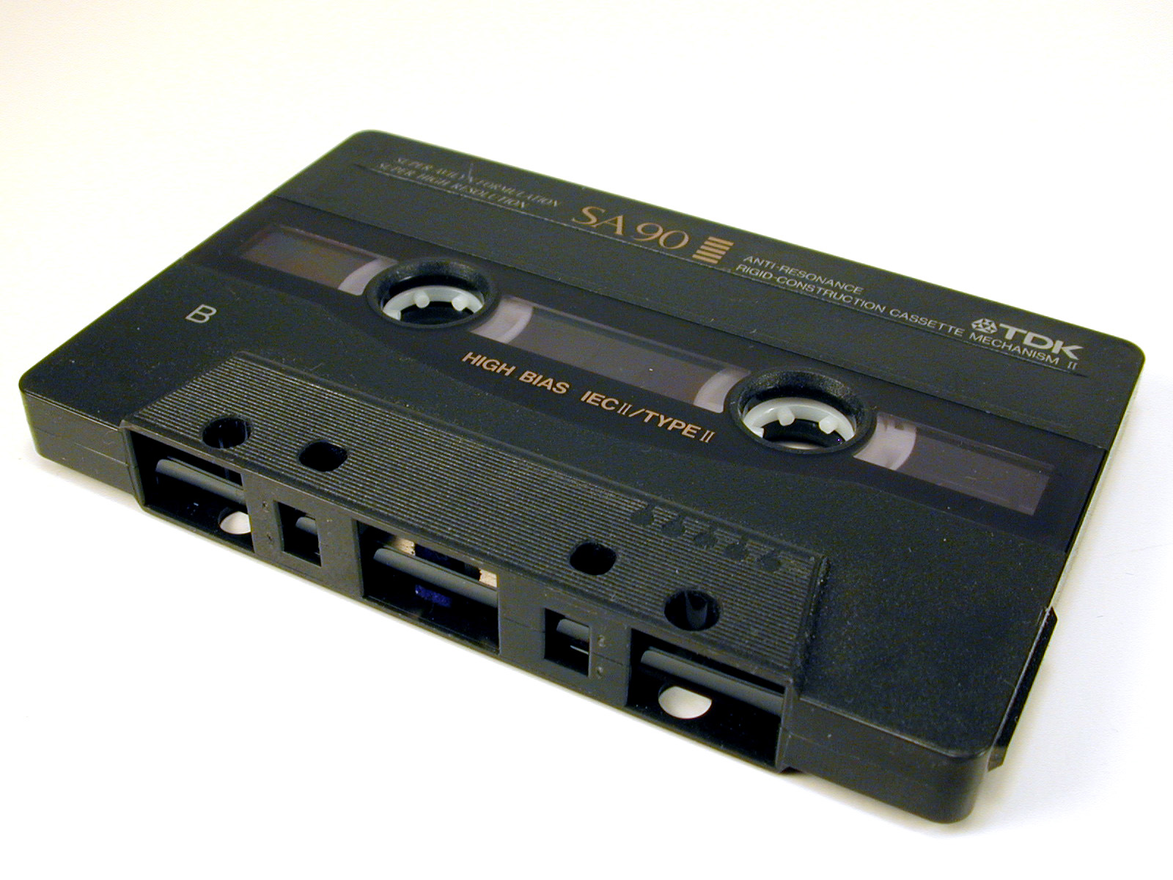

Slide 21
”The Book Of Life”

Slide 22
Philippians 4:3
“And I urge you also, true companion, help these women who labored with me in the gospel, with Clement also, and the rest of my fellow workers, whose names are in the Book of Life.”

Slide 23
Revelation 13:8
“All who dwell on the earth will worship him, whose names have not been written in the Book of Life of the Lamb slain from the foundation of the world.”

Slide 24
Revelation 17:8
“The beast that you saw was, and is not, and will ascend out of the bottomless pit and go to perdition. And those who dwell on the earth will marvel, whose names are not written in the Book of Life from the foundation of the world, when they see the beast that was, and is not, and yet is.”

Slide 25
Revelation 20:12
“And I saw the dead, small and great, standing before God, and books were opened. And another book was opened, which is the Book of Life. And the dead were judged according to their works, by the things which were written in the books.”

Slide 26
Revelation 20:15
“And anyone not found written in the Book of Life was cast into the lake of fire.”

Slide 27
Revelation 21:27
“But there shall by no means enter it anything that defiles, or causes an abomination or a lie, but only those who are written in the Lamb’s Book of Life.”

Slide 28
Revelation 22:19
“and if anyone takes away from the words of the book of this prophecy, God shall TAKE AWAY his part from the Book of Life, from the holy city, and from the things which are written in this book.”

Slide 29
Revelation 3:5
“He who overcomes shall be clothed in white garments, and I will not BLOT OUT his name from the Book of Life; but I will confess his name before My Father and before His angels.”

Slide 31
The Gospel was different
and therefore,
The God of Salvation was different.

Slide 32
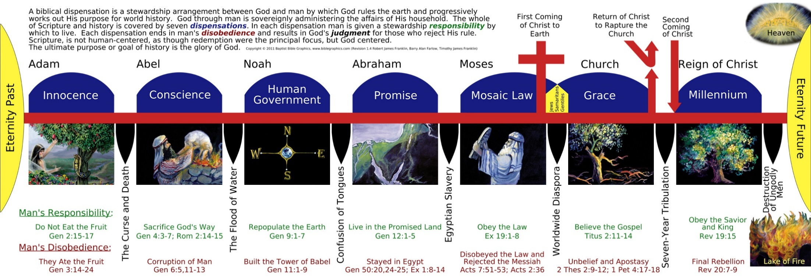
Popular Belief of Dispensationalism
Notes:
The popular belief of Dispensationalism teaches 7 “Dispensations” from Creation to the Millennial Reign of Christ.

Slide 33
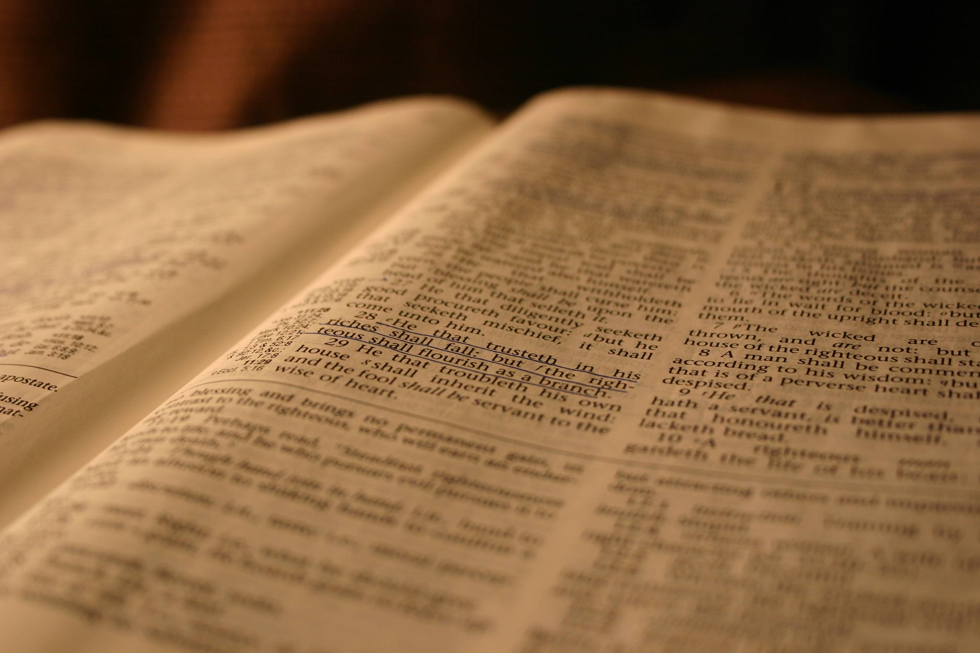

Slide 34
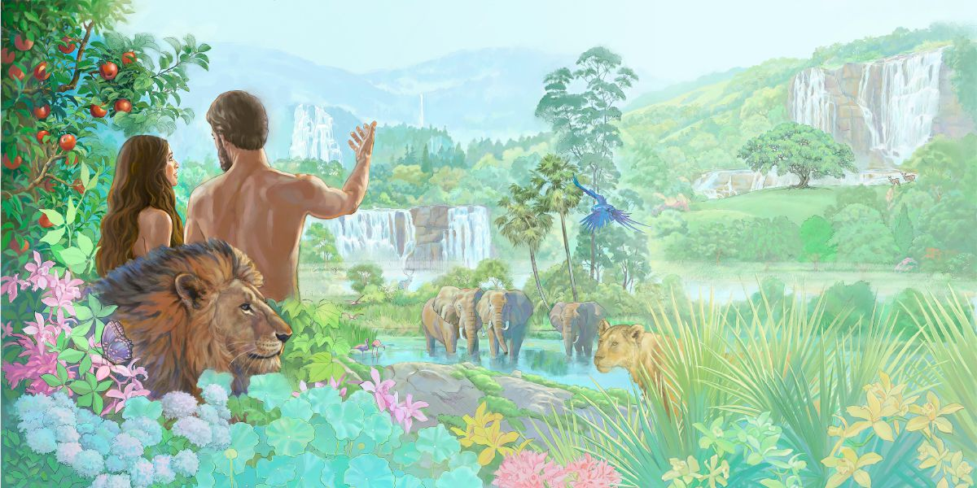

Slide 35
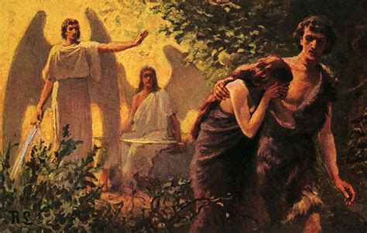

Slide 36
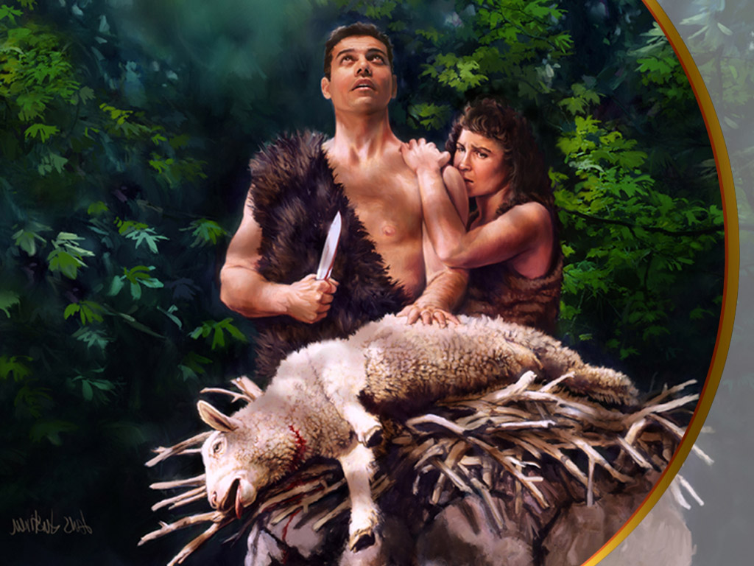
Notes:
Following God’s instruction, Adam brought the pure, spotless lamb.
Adam watched the innocent lamb die and his heart was broken.

Slide 37
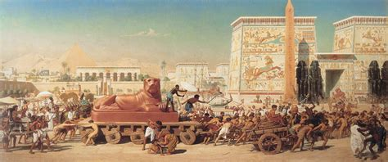

Slide 38
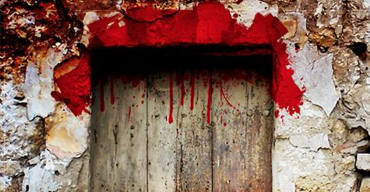

Slide 39
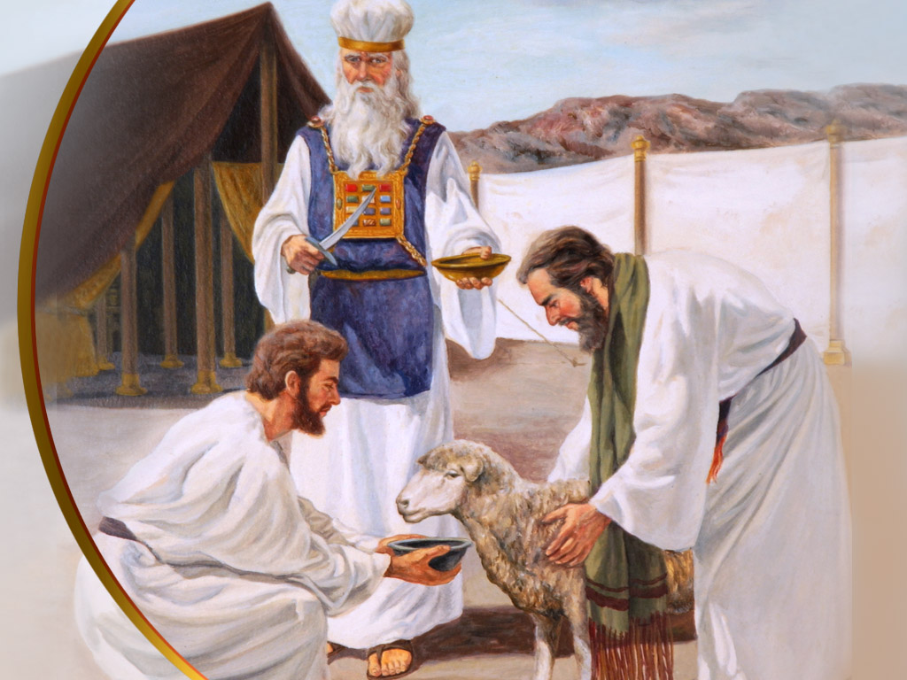

Slide 41
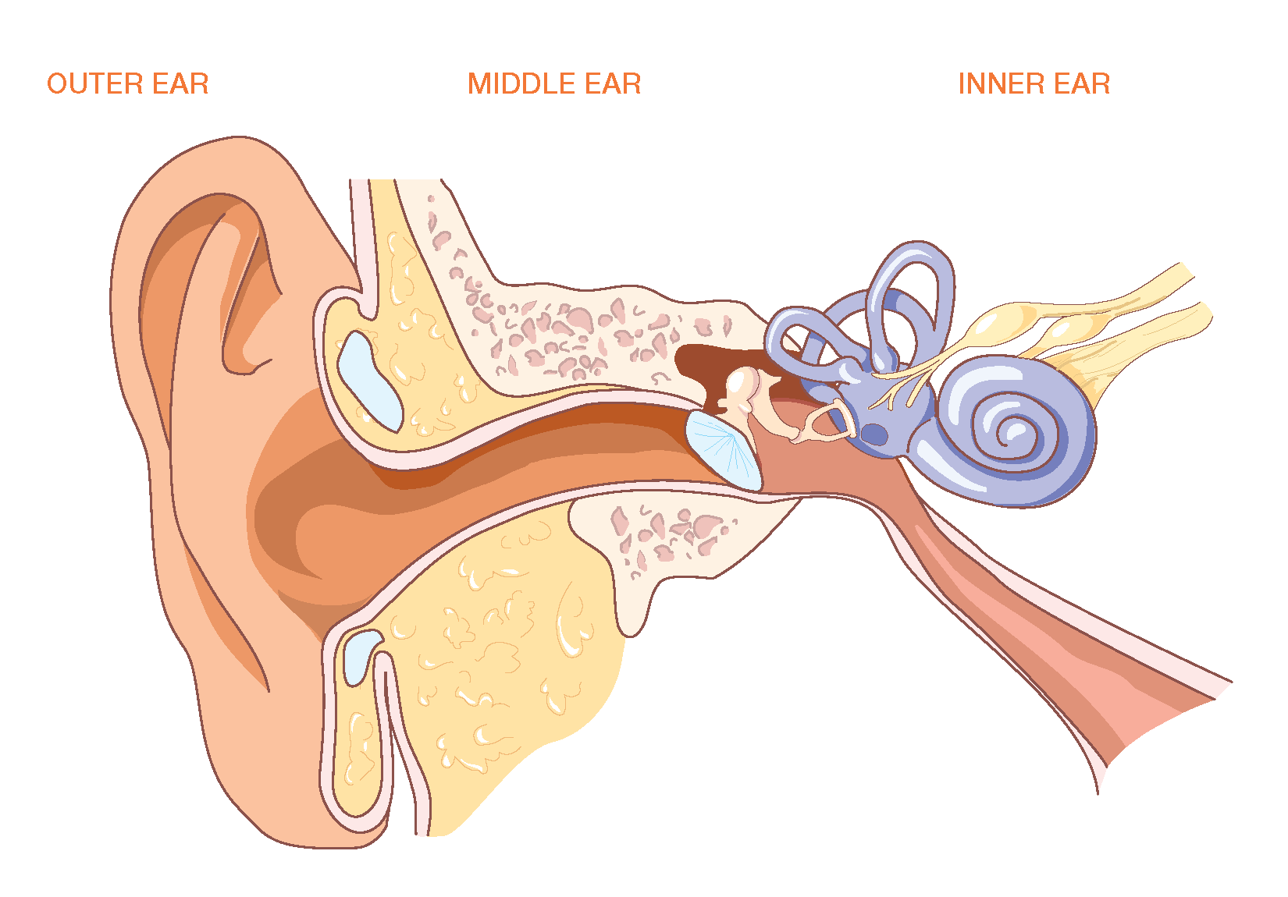

Slide 42
