Slide 2
JESUS, Lord At Thy Birth

Slide 3
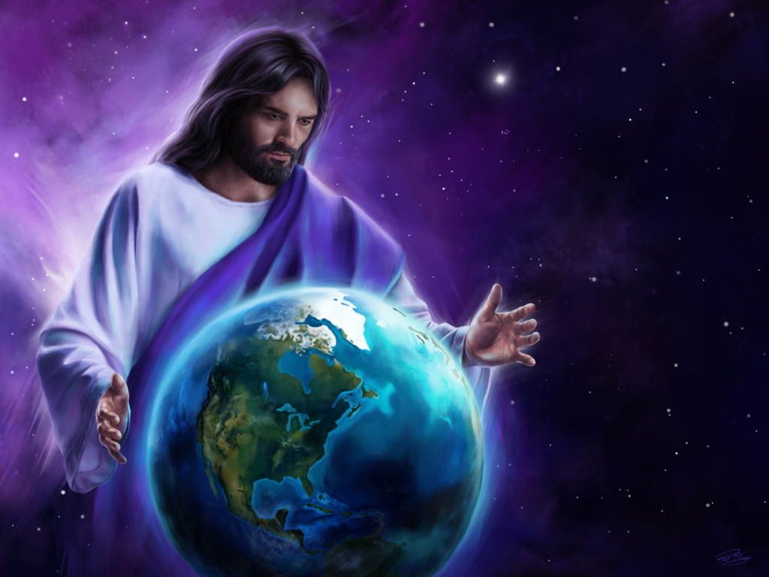

Slide 4
Genesis 1:1-2
In the beginning God created the heavens and the earth. The earth was without form, and void;
and darkness was on the face of the deep.
And the Spirit of God was hovering over the face of the waters.

Slide 5
Genesis 1:26-28
Then God said,
“Let Us make man in Our image, according to Our likeness; let them have dominion over the fish of the sea, over the birds of the air, and over the cattle, over all the earth and over every creeping thing that creeps on the earth.”

Slide 6
Genesis 1:26-28
So God created man in His own image;
in the image of God He created him;
male and female He created them.
Then God blessed them, and God said to them,

Slide 7
Genesis 1:26-28
“Be fruitful and multiply;
fill the earth and subdue it;
have dominion over the fish of the sea,
over the birds of the air,
and over every living thing that moves on the earth.”

Slide 8
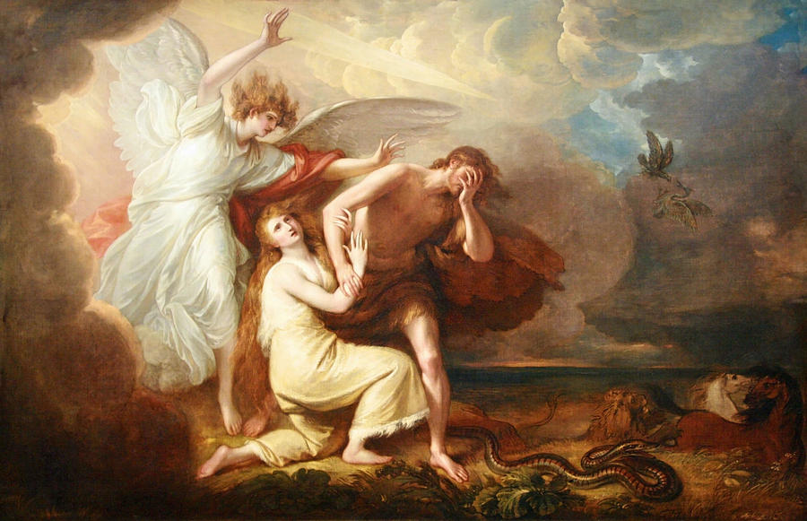

Slide 9
Genesis 3:14-15
So the Lord God said to the serpent:
“Because you have done this,
You are cursed more than all cattle,
And more than every beast of the field;
On your belly you shall go,
And you shall eat dust All the days of your life.

Slide 10
Genesis 3:14-15
And I will put enmity Between you and the woman,
And between your seed and her Seed;
He shall bruise your head,
And you shall bruise His heel.”

Slide 11
Genesis 3:17-19
Then to Adam He said,
“Because you have heeded the voice of your wife, and have eaten from the tree of which I commanded you, saying, ‘You shall not eat of it’:
“Cursed is the ground for your sake;
In toil you shall eat of it All the days of your life.

Slide 12
Genesis 3:17-19
Both thorns and thistles it shall bring forth for you, and you shall eat the herb of the field.
In the sweat of your face you shall eat bread till you return to the ground, for out of it you were taken; for dust you are, and to dust you shall return.”

Slide 13
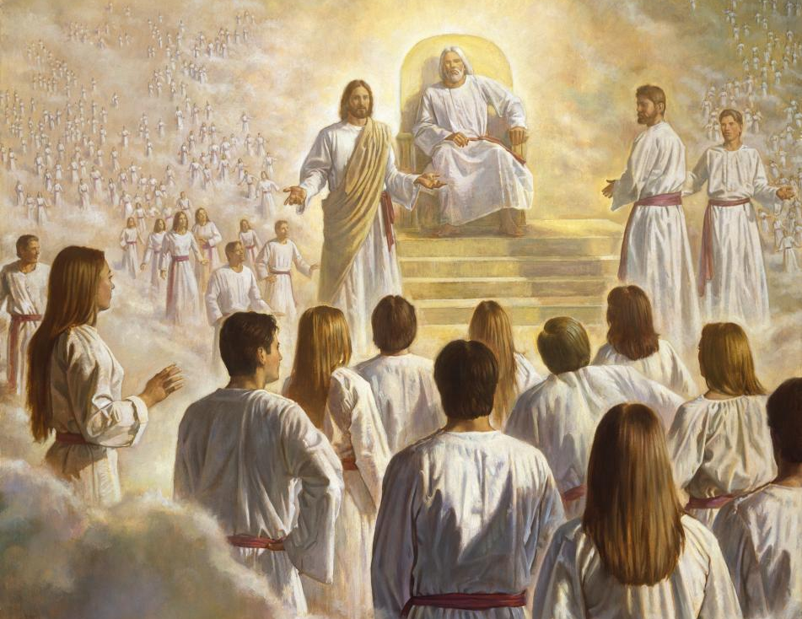

Slide 14
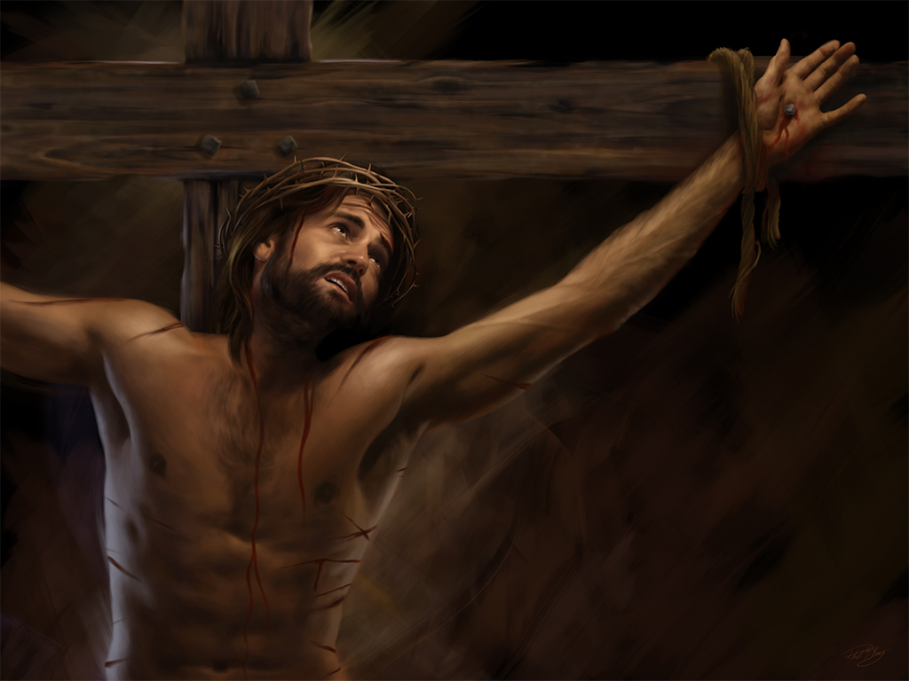

Slide 15
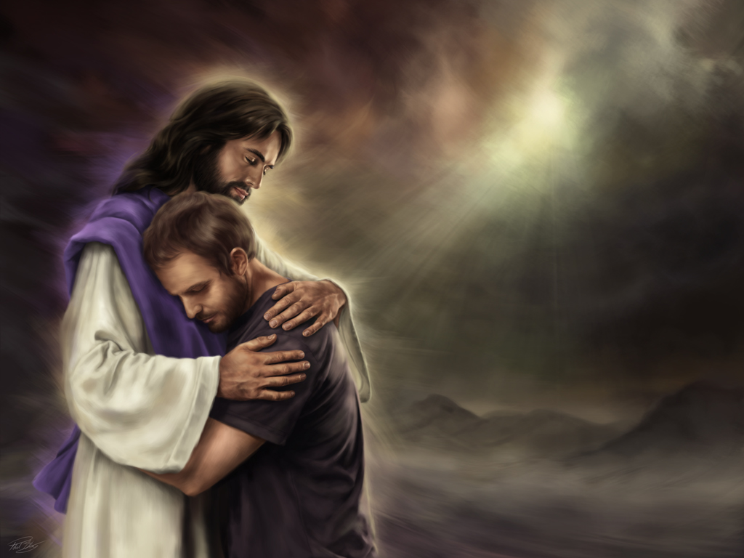

Slide 16
John 3:16-17
For God so loved the world that He gave His only begotten Son, that whoever believes in Him should not perish but have everlasting life.
For God did not send His Son into the world to condemn the world, but that the world through Him might be saved.

Slide 17
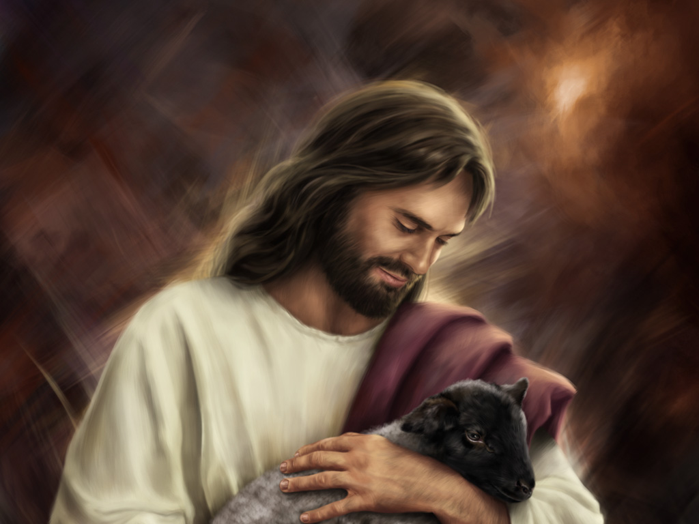

Slide 18
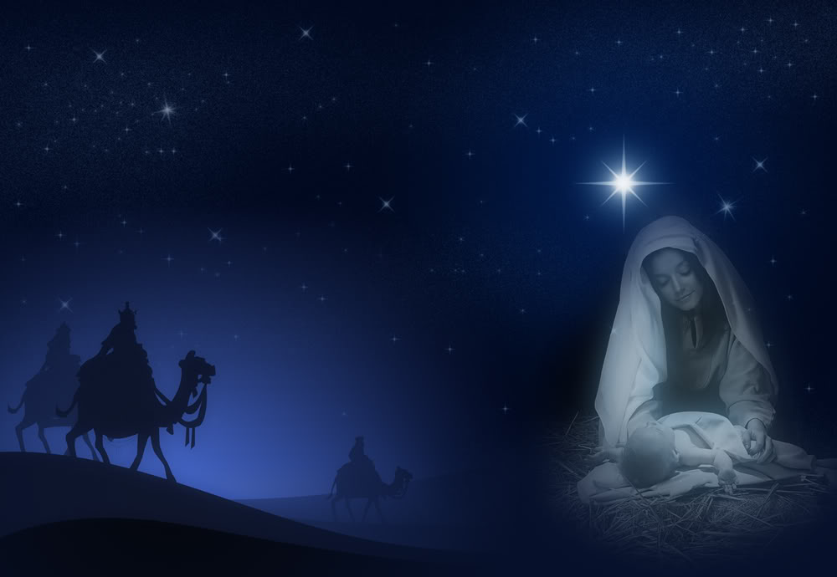
Silent Night,
Holy Night

Slide 19
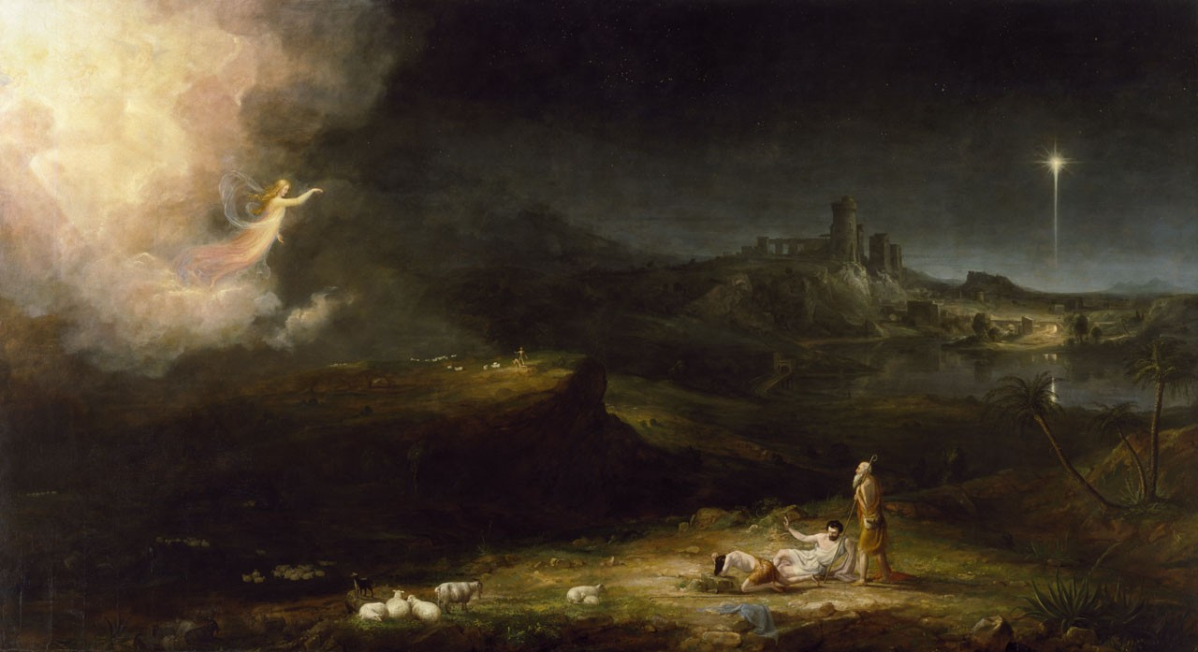

Slide 20
Luke 2:11-14
For there is born to you this day in the city of David a Savior, who is Christ the Lord.
And this will be the sign to you:
You will find a Babe wrapped in swaddling cloths, lying in a manger.”

Slide 21
Luke 2:11-14
And suddenly there was with the angel a multitude of the heavenly host praising God and saying:
“Glory to God in the highest,
And on earth peace, goodwill toward men!”

Slide 22
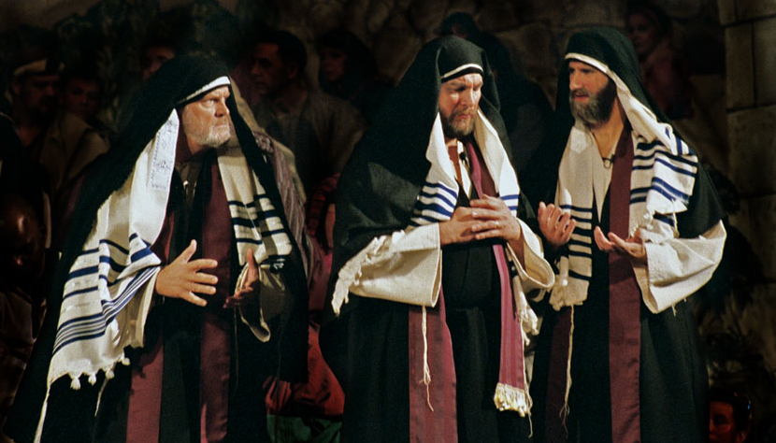

Slide 23
Matthew 2:1-3
Now after Jesus was born in Bethlehem of Judea in the days of Herod the king, behold, wise men from the East came to Jerusalem, saying,
“Where is He who has been born King of the Jews? For we have seen His star in the East and have come to worship Him.”

Slide 24
Matthew 2:1-3
When Herod the king heard this,
he was troubled, and all Jerusalem with him.

Slide 25
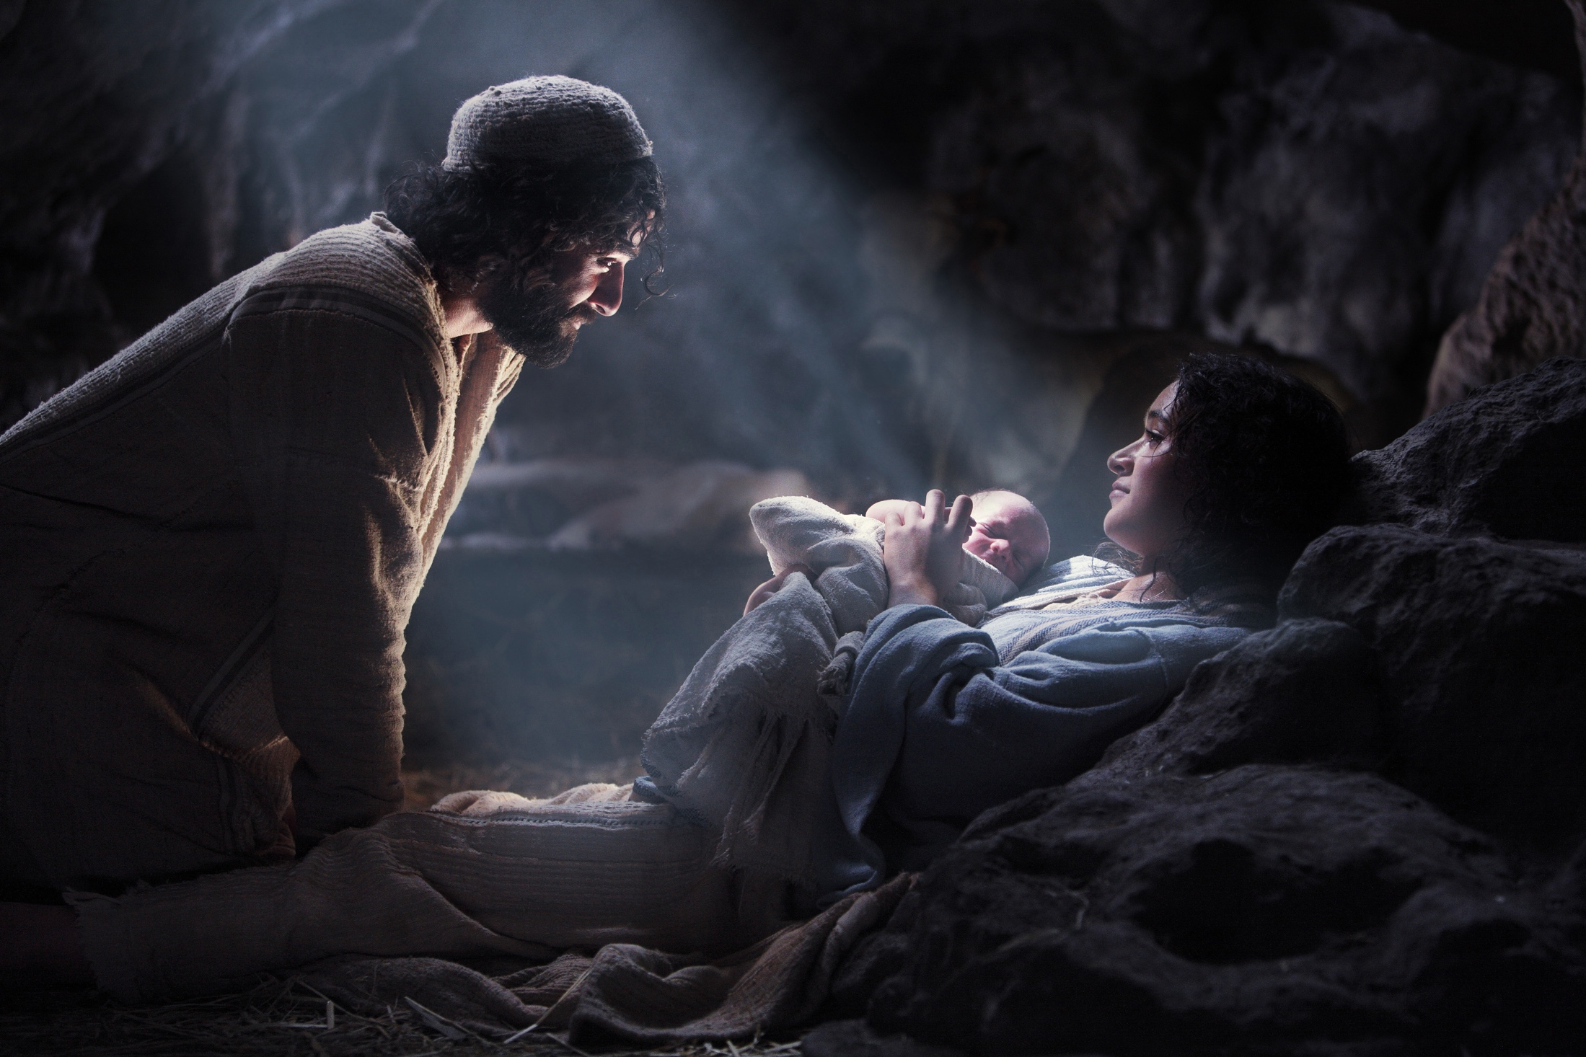

Slide 26
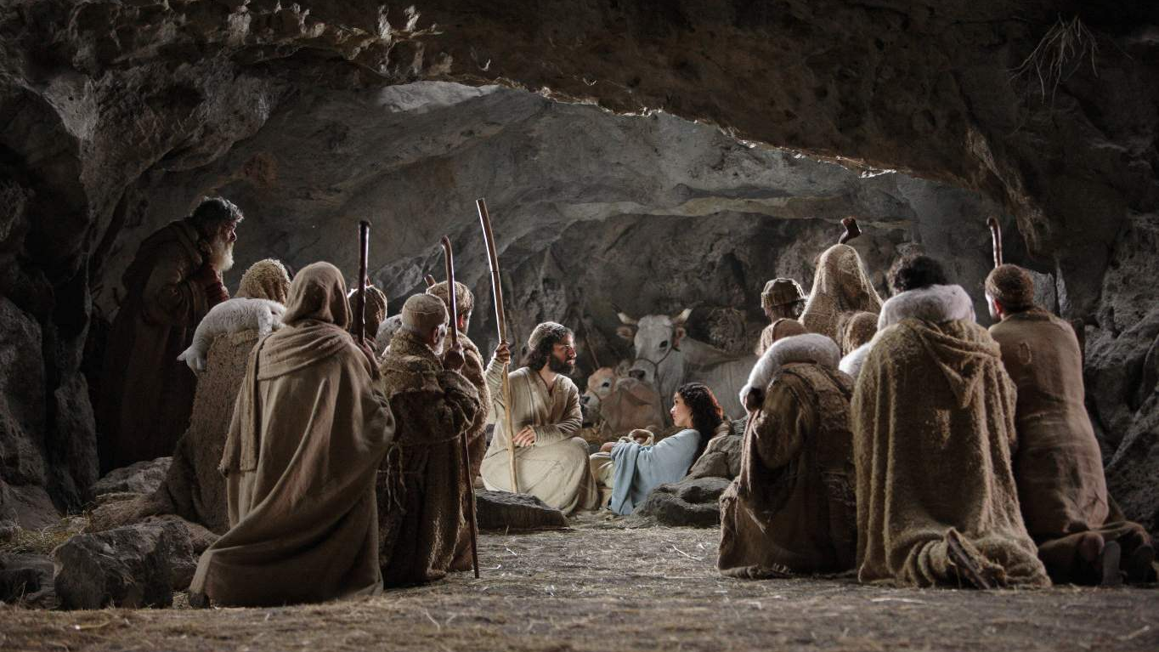

Slide 27
Matthew 1:22-23
So all this was done that it might be fulfilled which was spoken by the Lord through the prophet, saying:
“Behold, the virgin shall be with child, and bear a Son, and they shall call His name Immanuel,”
which is translated, “God with us.”

Slide 29
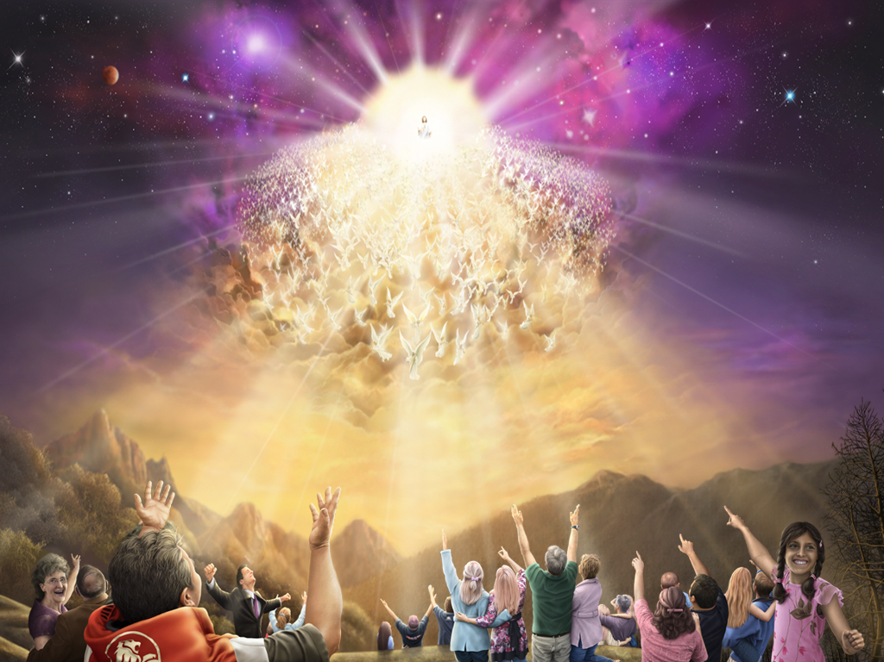

Slide 30
Acts 1:11
“Men of Galilee, why do you stand gazing up into heaven? This same Jesus, who was taken up from you into heaven, will so come in like manner as you saw Him go into heaven.”

Slide 31
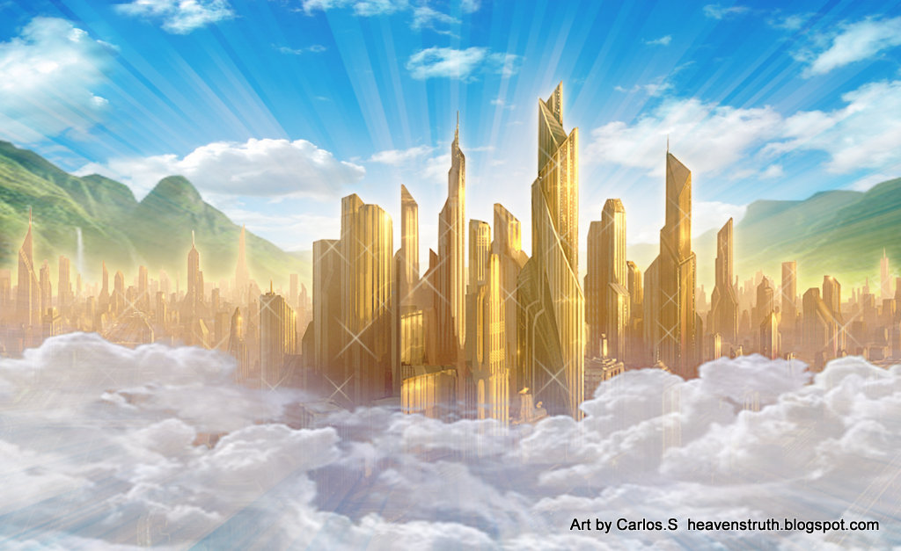

Slide 32
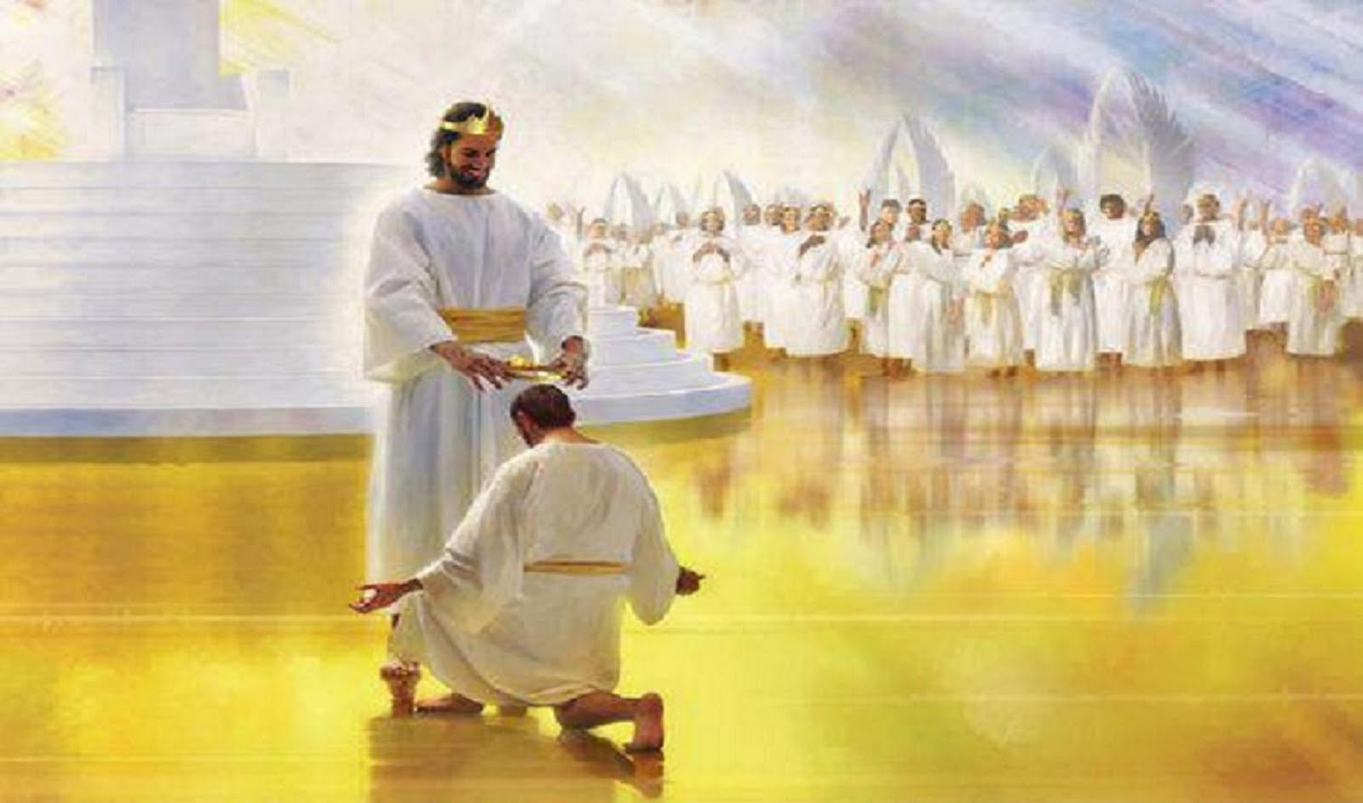

Slide 33
John 14:1-3
“Let not your heart be troubled; you believe in God, believe also in Me. In My Father’s house are many mansions; if it were not so, I would have told you. I go to prepare a place for you. And if I go and prepare a place for you, I will come again and receive you to Myself; that where I am, there you may be also.

Slide 34
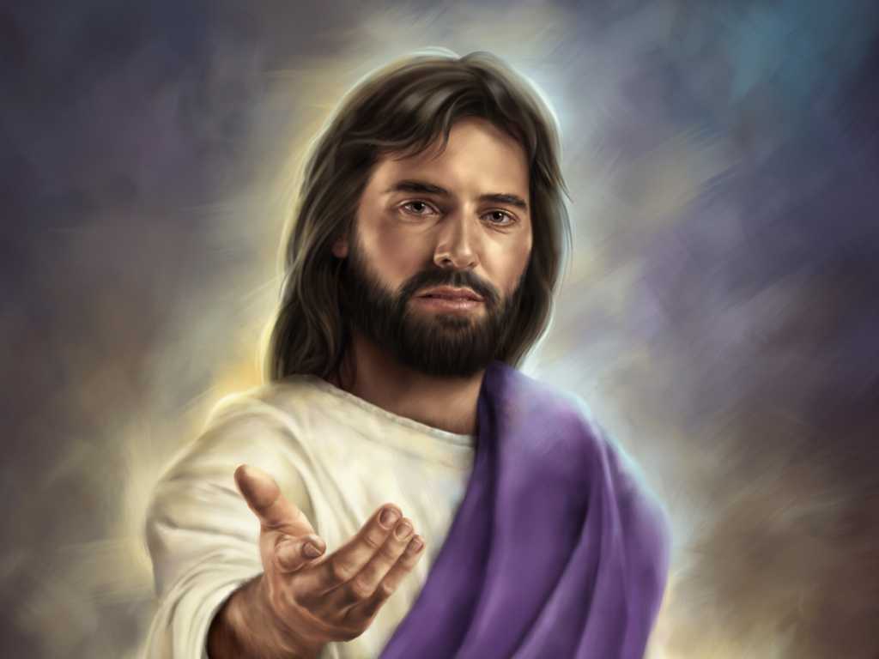

Slide 35
Acts 16:30-31
And he brought them out and said,
“Sirs, what must I do to be saved?”
So they said, “Believe on the Lord Jesus Christ, and you will be saved, you and your household.”

