Slide 1
Finding the Truth
True Christ

Slide 2
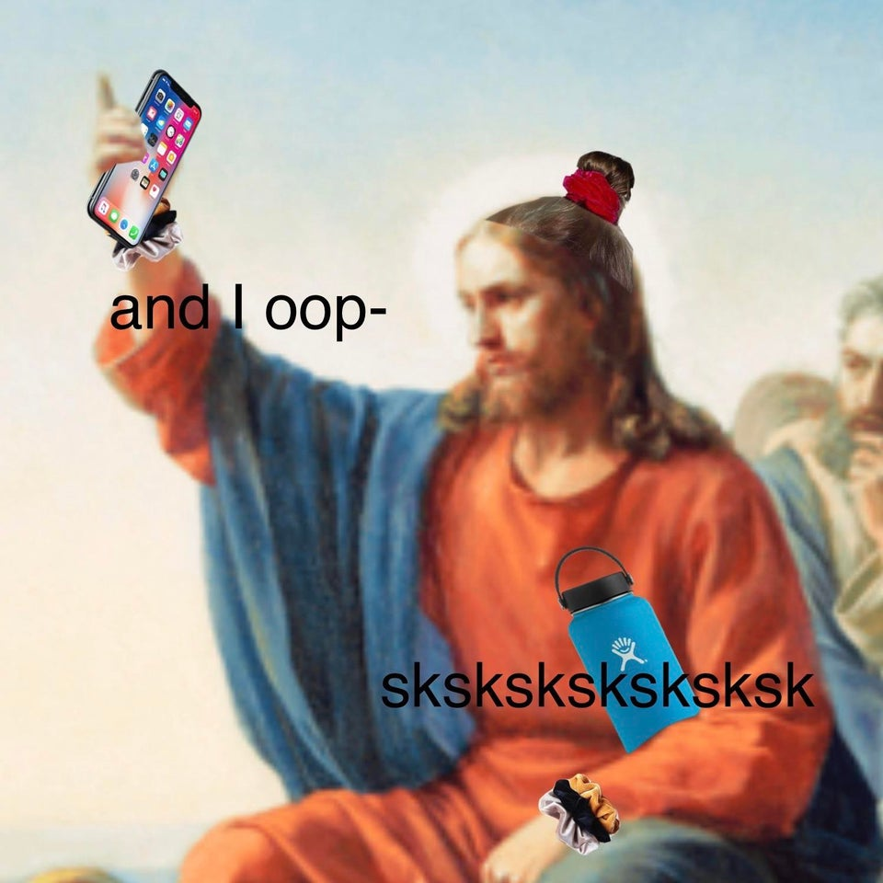
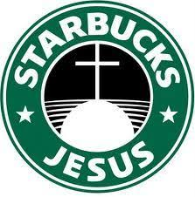

Slide 4
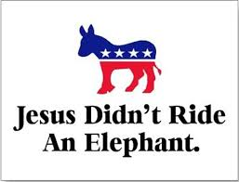

Slide 5
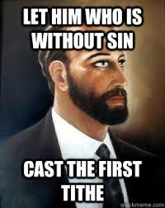

Slide 6
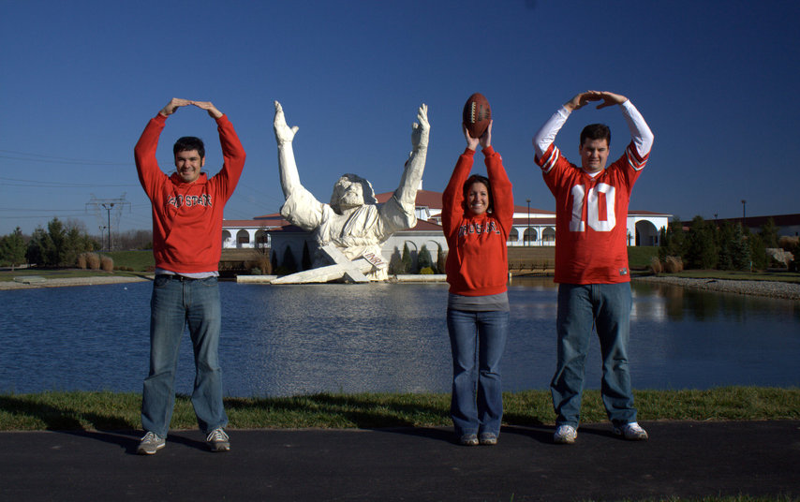

Slide 7
Who is Jesus?

Slide 8
33 Pilate then went back inside the palace, summoned Jesus and asked him, “Are you the king of the Jews?” 36 Jesus said, “My kingdom is not of this world. If it were, my servants would fight to prevent my arrest by the Jewish leaders. But now my kingdom is from another place.”

Slide 9
37 “You are a king, then!” said Pilate. Jesus answered, “You say that I am a king. In fact, the reason I was born and came into the world is to testify to the truth. Everyone on the side of truth listens to me.” 38 “What is truth?” retorted Pilate. With this he went out again to the Jews gathered there and said, “I find no basis for a charge against him.
John 18:33; 36-38

Slide 11
6 For to us a child is born, to us a son is given, and the government will be on his shoulders And he will be called Wonderful Counselor, Mighty God, Everlasting Father, Prince of Peace. 7 Of the greatness of his government and peace there will be no end. He will reign on David’s throne and over his kingdom, establishing and upholding it with justice and righteousness, from that time on and forever. The zeal of the Lord Almighty will accomplish this.
Isaiah 9:5-7

Slide 12
“The days are coming,” declares the Lord, “when I will raise up for David a righteous Branch, a King who will reign wisely and do what is just and right in the land.
Jeremiah 23:5

Slide 13
Messiah(s) Cont’d
“An angel of the Lord appeared in a dream to Joseph in Egypt saying ‘Rise take the child and his mother and go to Israel” Matthew 2:19-20
“But Jesus said to them, “A prophet is not without honor except in his hometown” Matthew 13:57
Sermon on the Mount
“Moreover, there came out of Egypt about this time to Jerusalem, one that said he was a prophet, and advised the multitude of the common people to go along with him to the Mount of Olives… … He said he would show them how the walls of Jerusalem would fall down”
Antiquities 20.8.6
Notes:
There were many more cases. And in each case, the rebellion had terrible consequences for the Jews. Each time the Romans came in and massacred the people. New Messiah, new massacre
Jesus, to the religious leaders, was just another trouble maker about to bring the wrath of Rome down on them

Slide 15
Confirmation Bias

Slide 16
If something sounds true—meaning, it seems to fit what we already believe—we believe it to be true without corroborating. It is the widespread epidemic of confirmation bias that has given us the relatively new phenomenon known as “fake news.”
- Jared Wilson. The Gospel Coalition

Slide 17
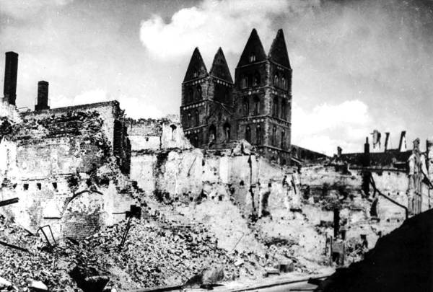

Slide 18
But there’s a spiritual component at play here too. The reason we fall into confirmation bias politically is not essentially a political problem. It is a human problem, which is to say, it is a sin problem—which is to say, it is a problem of self-interest and self-worship. The truth is, you and I are prone to conducting our entire lives along the narratives constructed from confirmation bias.

Slide 19
That we are the center of the universe. That our happiness is what is most important in life and that our preferences are—or ought to be—the laws of the land. So whatever fits this bias is “true.” And whatever does not is simply ignored.
- Jared Wilson. The Gospel Coalition

