Slide 1
John 1

Slide 2
In the beginning was the Word, and the Word was with God, and the Word was God. 2 He was with God in the beginning. 3 Through him all things were made; without him nothing was made that has been made. 4 In him was life, and that life was the light of all mankind.
John 1:1-4

Slide 4
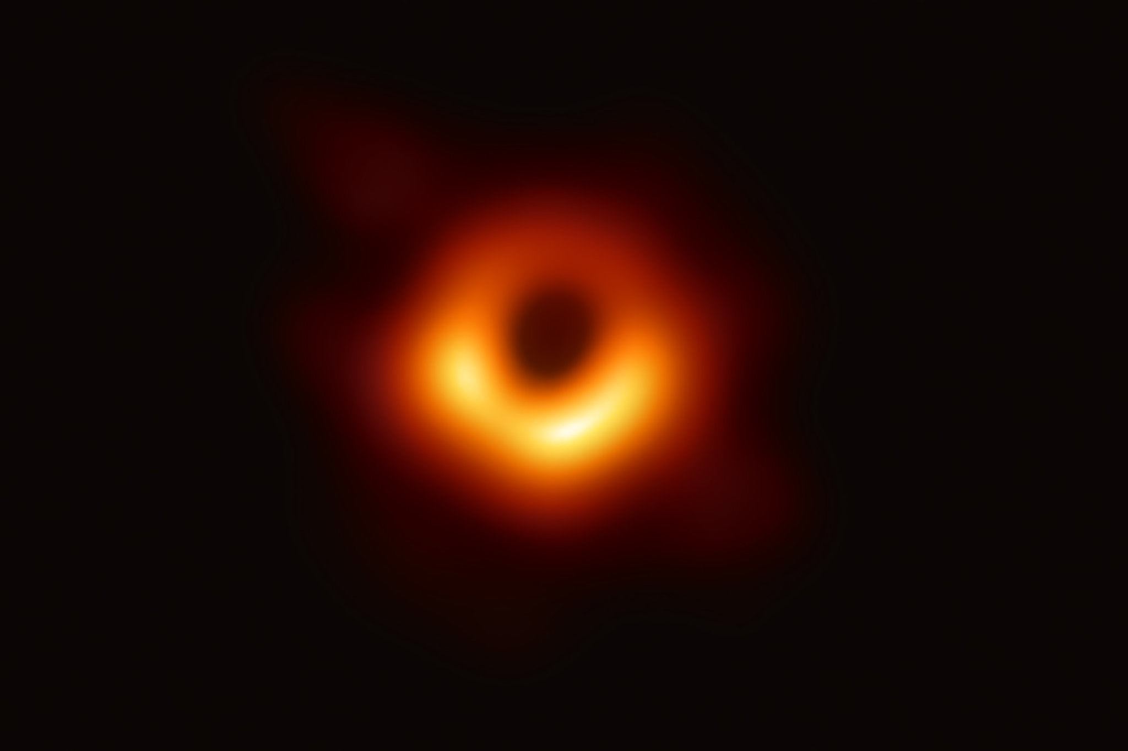

Slide 6
5 The light shines in the darkness, and the darkness has not overcome it.
5 The light shines in the darkness, and the darkness has not understood it.
John 1:5

Slide 8
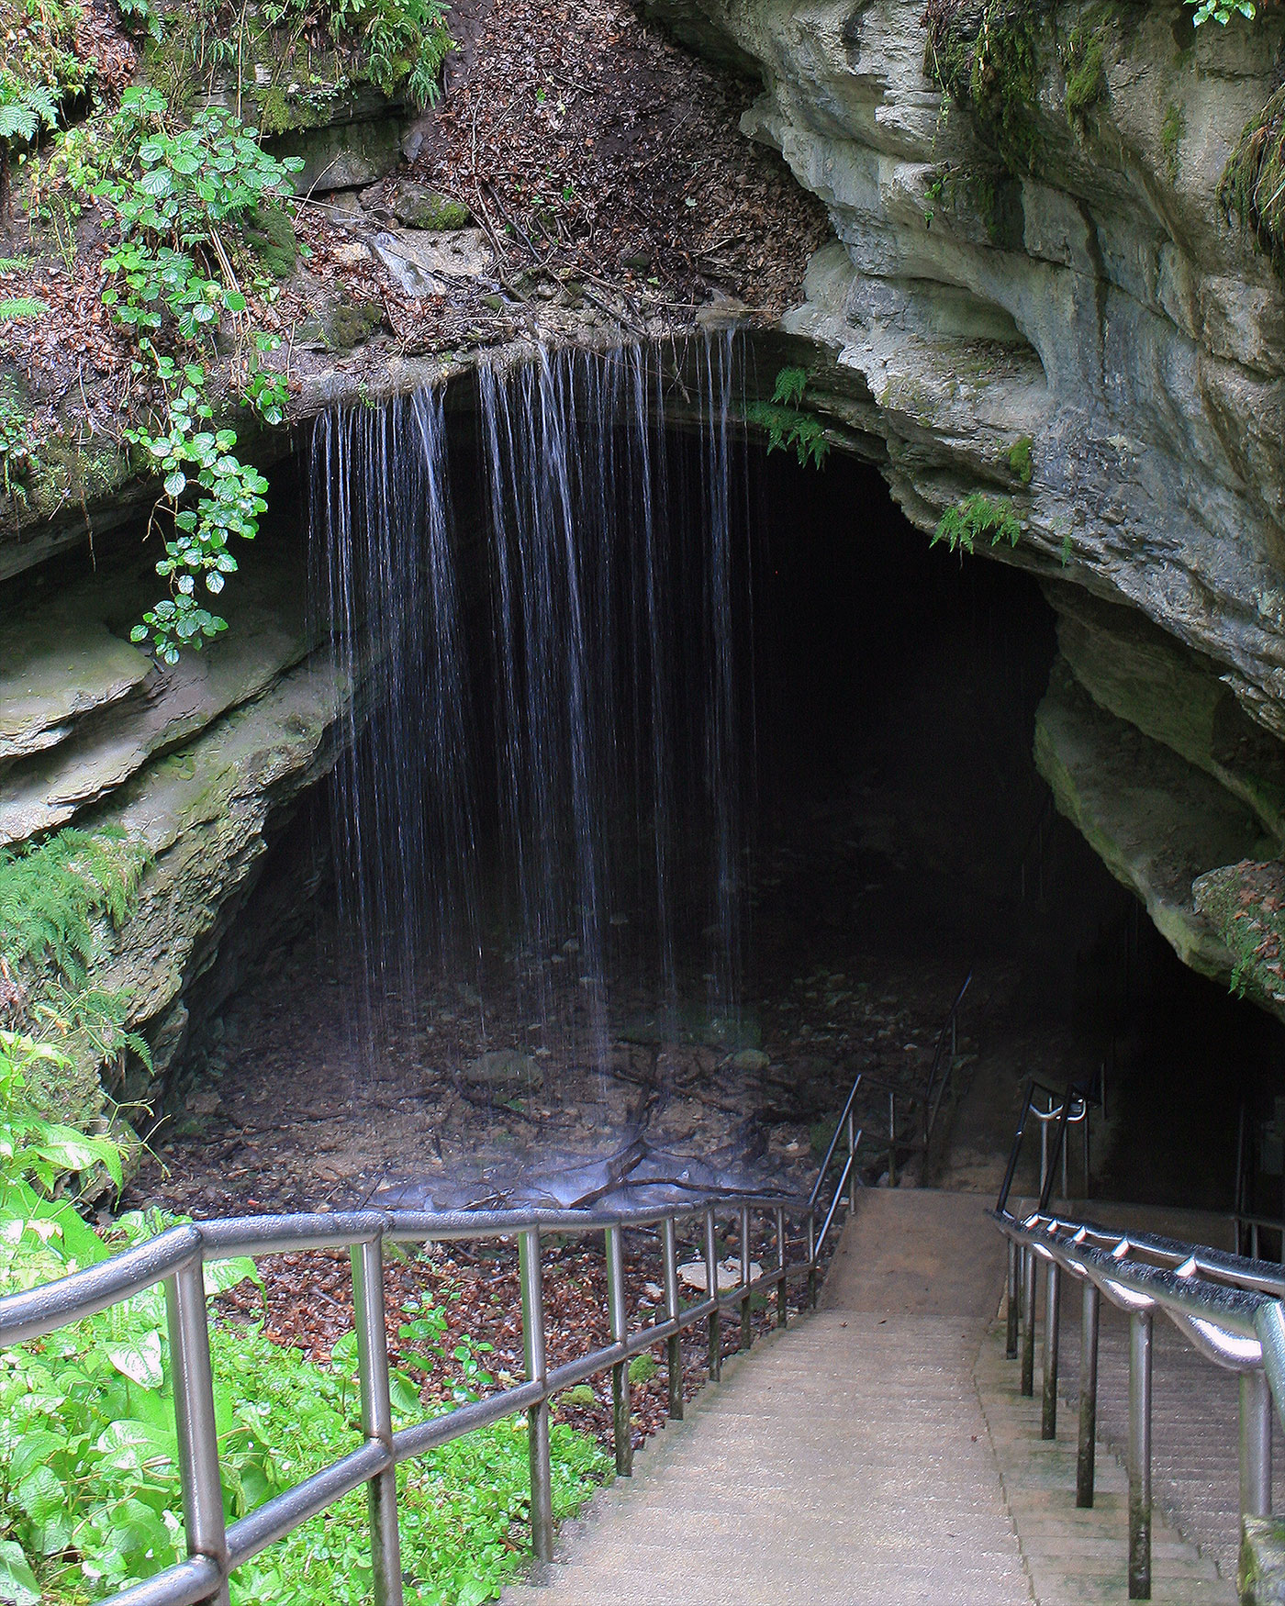
Source: https://www.nps.gov/articles/nps-geodiversity-atlas-mammoth-cave-national-park-kentucky.htm

Slide 9
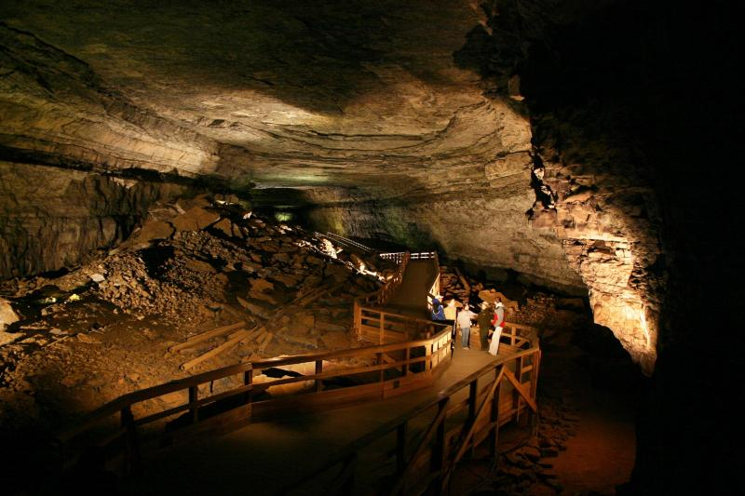
Source: https://www.doi.gov/blog/mammoth-cave-explore-worlds-longest-cave
Source: https://www.nps.gov/articles/nps-geodiversity-atlas-mammoth-cave-national-park-kentucky.htm

Slide 11
9 The true light that gives light to everyone was coming into the world. 10 He was in the world, and though the world was made through him, the world did not recognize him. 11 He came to that which was his own, but his own did not receive him.
John 1:9-11

Slide 12
12 Yet to all who did receive him, to those who believed in his name, he gave the right to become children of God— 13 children born not of natural descent, nor of human decision or a husband’s will, but born of God.
John 1:12-13

Slide 14
14 The Word became flesh and made his dwelling among us. We have seen his glory, the glory of the one and only Son, who came from the Father, full of grace and truth.
John 1:14

Slide 15
16 Out of his fullness we have all received grace in place of grace already given. 17 For the law was given through Moses; grace and truth came through Jesus Christ. 18 No one has ever seen God, but the one and only Son, who is himself God and is in closest relationship with the Father, has made him known.
John 1:16-18

