Slide 1
James 2:1-13

Slide 2
How should the gospel impact my personal interactions?

Slide 4
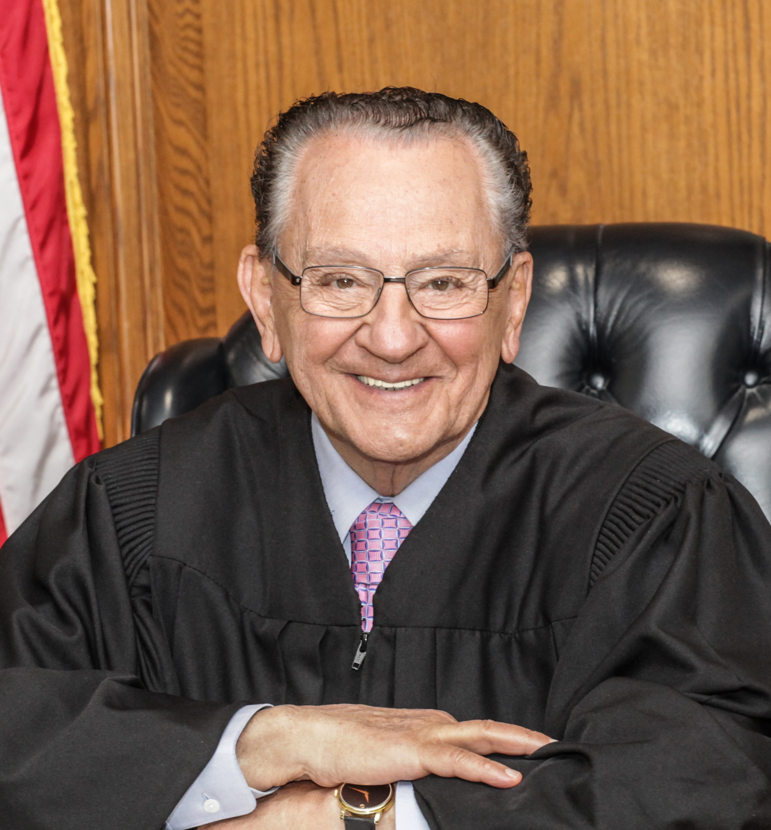

Slide 5
8 If you really keep the royal law found in Scripture, “Love your neighbor as yourself,” you are doing right. 9 But if you show [selfish] favoritism, you sin and are convicted by the law as lawbreakers.
James 2:8-9

Slide 6
Selfish Favoritism
“The practice of more favorable treatment for those who can provide mutual benefit.”

Slide 7
My brothers and sisters, believers in our glorious Lord Jesus Christ must not show favoritism. 2 Suppose a man comes into your meeting wearing a gold ring and fine clothes, and a poor man in filthy old clothes also comes in. 3 If you show special attention to the man wearing fine clothes and say, “Here’s a good seat for you,” but say to the poor man, “You stand there” or “Sit on the floor by my feet,” 4 have you not discriminated among yourselves and become judges with evil thoughts?
James 2:1-4

Slide 8
8 If you really keep the royal law found in Scripture, “Love your neighbor as yourself,” you are doing right.
James 2:8

Slide 9
Imago Dei
Apply of my eye

Slide 10
For this is what the LORD Almighty says: "After the Glorious One has sent me against the nations that have plundered you--for whoever touches you touches the apple of his eye--When he looks at us, he sees not us, but a small picture of himself. He sees value, worth, dignity, and goodness.
Zechariah 2:8

Slide 11
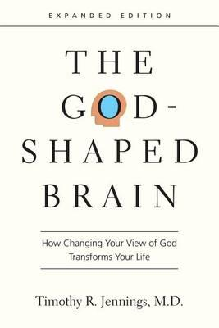
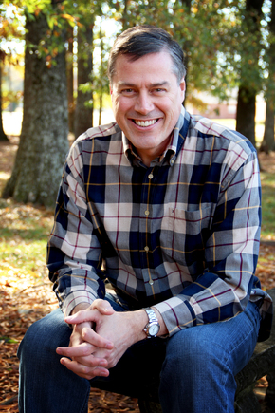
The God-Shaped Brain

Slide 12
“When one trusts God, a change takes place: the prefrontal cortex is imbued with love and truth from the Holy Spirit, restoring God’s balance, leading back to other-centered, peaceful living.

Slide 13
On the other hand, the selfish, fear-controlled brain is hostile to God and instead of submitting to love will be unable to please him. And this entire destructive cascade occurs because of believing lies about God.

Slide 14
Adam immediately demonstrated how utterly infected he was with the “watch out for me first” principle when he blamed Eve in an attempt to save himself, rather than offering himself to protect her…

Slide 15
The acts of sin we so freely commit are symptoms of our sin-infected hearts and minds…. Our biological drive to put self first is so strong that without God’s intervention, human beings are incapable of anything but fear based, survival-driven selfishness.”
Tim Jennings, The God-Shaped Brain p. 37-38

Slide 16
How should the gospel impact by personal interactions?

Slide 17
Recognize the truth about how God views me and treat others with mercy instead of selfishness

