Slide 1
JAMES

Slide 2
Godliness
Graciousness
Growth
Generosity

Slide 3
2 Consider it pure joy, my brothers and sisters, whenever you face trials of many kinds, 3 because you know that the testing of your faith produces perseverance 4 Let perseverance finish its work so that you may be mature and complete, not lacking anything.
- James 1:2-4

Slide 4
How can I live the gospel in everyday life?

Slide 6
5 If any of you lacks wisdom, you should ask God, who gives generously to all without finding fault, and it will be given to you. 6 But when you ask, you must believe and not doubt, because the one who doubts is like a wave of the sea, blown and tossed by the wind. 7 That person should not expect to receive anything from the Lord. 8 Such a person is double-minded and unstable in all they do….
- James 1:5-8

Slide 8
Wisdom
“A mixture of divine and human skill to defend the faith from hostility.”

Slide 9
Connection not Doubt

Slide 10
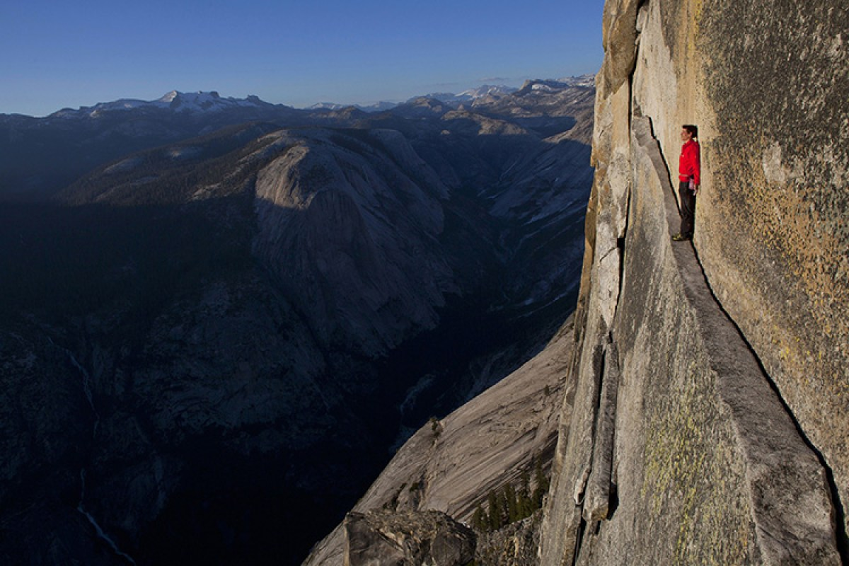
Image Credit: https://twitter.com/alexhonnold

Slide 11
Image credit:
https://www.climbing.com/news/opinion-the-free-solo-documentary-addressed-some-uncomfortable-truths-but-ignored-others/

Slide 12
“between me and the summit lay a blank slab of granite. There were no cracks or edges to hold onto…. I carefully balanced my way upward, but then I reached a foothold that I didn't quite trust. I considered a foot further to the side. That seemed worse. I switched my feet and tried a foot further out - seemed even worse. I started to panic. I knew what I had to do, but I was just too afraid to do it. I just had to stand up on my right foot.”
Alex Honnold

Slide 13
“Doubt is the precursor to fear, and I knew I couldn’t experience my perfect moment if I were afraid.”

Slide 15
12 Blessed is the one who perseveres under trial because, having stood the test, that person will receive the crown of life that the Lord has promised to those who love him. 13 When tempted, no one should say, “God is tempting me.” For God cannot be tempted by evil, nor does he tempt anyone; 14 but each person is tempted when they are dragged away by their own evil desire and enticed.

Slide 16
15 Then, after desire has conceived, it gives birth to sin; and sin, when it is full-grown, gives birth to death. 16 Don’t be deceived, my dear brothers and sisters. 17 Every good and perfect gift is from above, coming down from the Father of the heavenly lights, who does not change like shifting shadows.
James 1:12-17

Slide 17
Environment

Slide 18
“Environment is the invisible hand that shapes human behavior. Despite our unique personalities, certain behaviors tend to arise again and again under certain environmental conditions.”

