Slide 2
This I Believe
Adventists are Weird

Slide 4
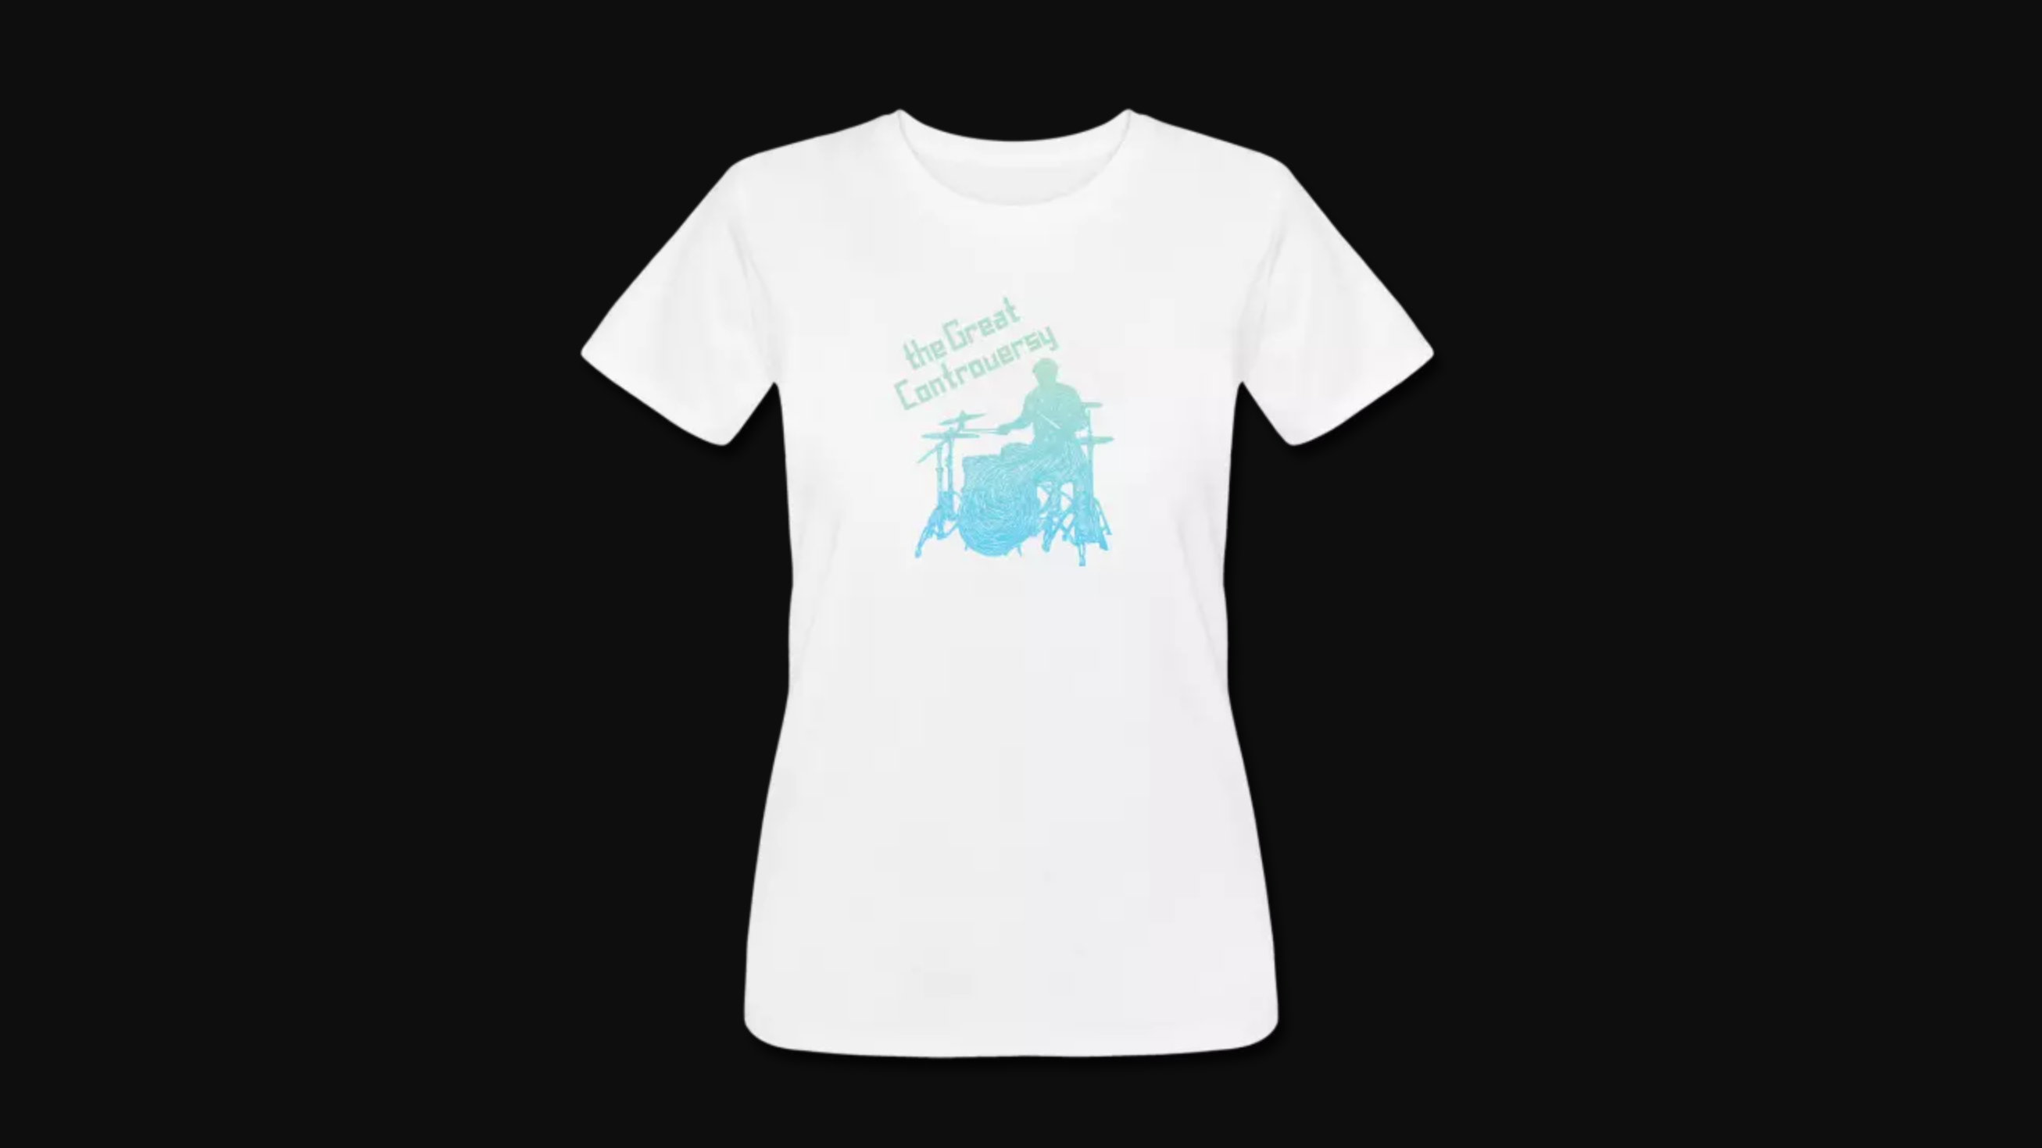

Slide 6
“Hardly anything Adventism believes is uniquely Adventist. So it’s not our doctrines that make us “weird”…. …we evolved and blossomed from the stories that came before us. When we peel back all the layers we arrive at a faith that is remarkably indebted to historic Christian thought. And yet, there’s something eccentric about us. We are Protestants yes. But we are also weird.”
Marcos Torres, Why is Adventism So Weird? Light Bearers. https://lightbearers.org/blog/why-is-adventism-so-weird/

Slide 7
Salvation & Invest. Judgment
Sabbath

Slide 8
God Is Present in the Whole Story

Slide 9
These are the words of the Amen, the faithful and true witness, the ruler of God’s creation. 15 I know your deeds, that you are neither cold nor hot. I wish you were either one or the other! 16 So, because you are lukewarm—neither hot nor cold—I am about to spit you out of my mouth. 17 You say, ‘I am rich; I have acquired wealth and do not need a thing.’ But you do not realize that you are wretched, pitiful, poor, blind and naked.
Revelation 3:14-17

Slide 10
Now and Not Yet

Slide 11
“The human story is not a success story”

Slide 12
“…Jesus went into Galilee, proclaiming the good news of God. ‘The time has come,’ he said. ‘The kingdom of God has come near. Repent and believe the good news!’”
Mark 1:14-15

Slide 13
“Jesus said, ‘My kingdom is not of this world. If it were, my servants would fight to prevent my arrest by the Jewish leaders. But now my kingdom is from another place.’“
John 18:36

Slide 14
In the days of those kings, the God of heaven will set up a kingdom that will never be destroyed, nor will it be left to another people. It will shatter all these kingdoms and bring them to an end, but will itself stand forever.
Daniel 2:44

Slide 15
This is the meaning of the vision of the rock cut out of a mountain, but not by human hands--a rock that broke the iron, the bronze, the clay, the silver and the gold to pieces. "The great God has shown the king what will take place in the future. The dream is true and its interpretation is trustworthy.
Daniel 2:45

Slide 16
“Wherever this fruit [searching the Bible] is seen, it has produced a complete revolution with a large majority of such in their faith and hope”

Slide 17
“the skeptic [sic], the deist, the universalists, the impenitent, and the careless of all classes have been made by the power of the Spirit to see and feel their danger, and to seek for the forgiveness of their sins by repentance toward God and faith in our Lord Jesus Christ.”
William Miller, “From Scripture and History of the Second Coming of Christ about the Year 1843”

Slide 18
wepray40.com

Slide 23
“Adventist attempts to hold to a balanced synthesis of law and grace, faith and works, justification and sanctification, have been clearly anticipated and broadly mentored by the teachings of Wesley and his American children. It was such categories which helped to lay the foundations for the very core of the Adventist [doctrine of Salvation] and one of its distinctive contributions to eschatology—the Pre-Advent, Investigative Judgment.”
Woodrow Whidden, Ph.D Adventist Theology: The Wesleyan Connection

