Slide 1
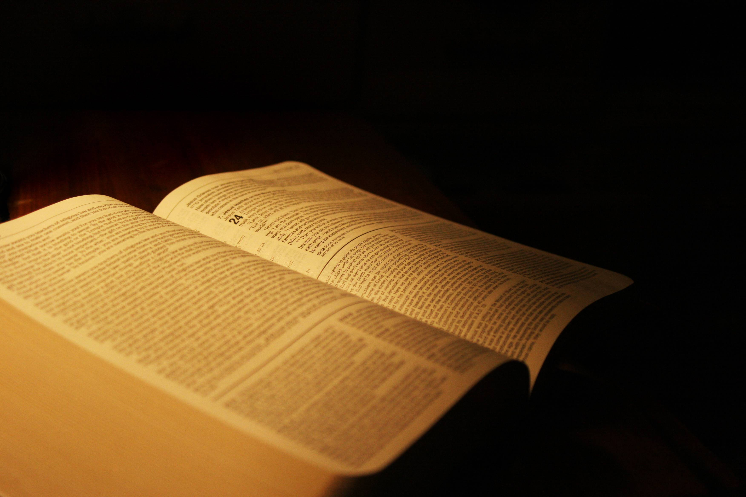
The Scriptures,
A Safeguard

Slide 2
“It is the first and highest duty
of every rational being to learn
from the scriptures what is truth,
and then to walk in the light and encourage others to follow his example.”

Slide 3
John 17:17
“Sanctify them by Your truth.
Your word is truth.”
Jesus

Slide 4
2 Timothy 3:16-17
“All Scripture is given by inspiration of God, and is profitable for doctrine, for reproof, for correction, for instruction in righteousness, that the man of God may be complete, thoroughly equipped for every good work.”
Paul

Slide 5
Isaiah 8:20
“To the law and to the testimony:
if they speak not according to this word,
it is because there is no light in them.”
Isaiah

Slide 6
A Safeguard

Slide 7
A Safeguard:
Noun: something that serves as a protection or defense or that ensures safety.
a permit for safe passage.
a guard or convoy.
a mechanical device for ensuring safety.
verb (used with object): to guard; protect; secure.

Slide 9
A Safeguard Against What?
Against False Teachers
Against Calamity
Against Satan’s Deceptions
Against Excuses
Against Temptations

Slide 11
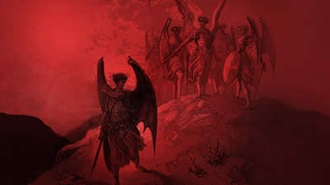
Satan hates the Bible
and want to prevent you personally
from reading it;
for he knows it plainly reveals
his deceptions.

Slide 12
A Safeguard Against What?
Against False Teachers
Against Calamity
Against Satan’s Deceptions
Against Excuses
Against Temptations

Slide 14
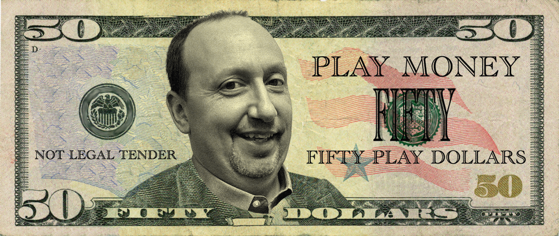

Slide 15
“So closely will the counterfeit resemble
the true that it will be impossible to
distinguish between them
except by the Holy Scriptures.”

Slide 16
Matthew 24:24
“For false christs and false prophets will rise and show great signs and wonders to deceive, if possible, even the elect.”
Jesus

Slide 17
Matthew 10:16
“Behold, I send you out as sheep
in the midst of wolves.”
Jesus

Slide 18
Matthew 7:15
“Beware of false prophets,
who come to you in sheep’s clothing,
but inwardly they are ravenous wolves.”
Jesus

Slide 19
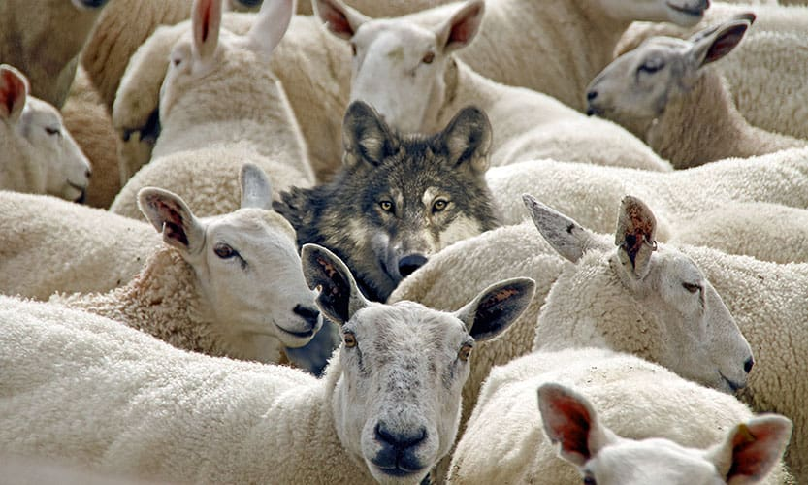

Slide 20
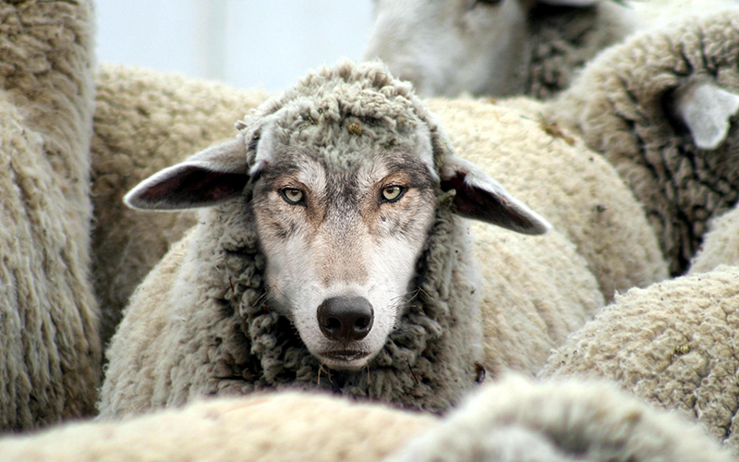

Slide 21
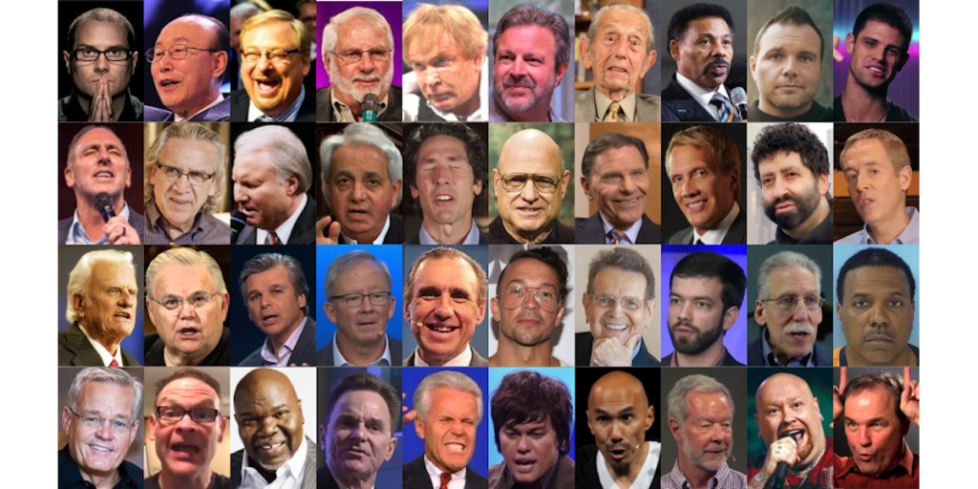

Slide 22
Isaiah 8:20
“To the law and to the testimony:
if they speak not according to this word,
it is because there is NO light in them.”
Isaiah

Slide 23
Matthew 5:17-19
“Do not think that I came to destroy
the Law or the Prophets.
I did not come to destroy but to fulfill.

Slide 24
For assuredly, I say to you,
till heaven and earth pass away,
one jot or one tittle will by no means
pass from the law till all is fulfilled.

Slide 25
Whoever therefore breaks one of the least of these commandments, and teaches men so, shall be called least in the kingdom of heaven; but whoever does and teaches them, he shall be called great in the kingdom of heaven.”
Jesus

Slide 26
Romans 6:16
“Do you not know that to whom you present yourselves slaves to obey, you are that one’s slaves whom you obey, whether of sin leading to death, or of obedience leading to righteousness?”
Paul

Slide 27
Matthew 7:19-21
“Every tree that does not bear good fruit is cut down and thrown into the fire. Therefore by their fruits you will know them.”

Slide 28
“Not everyone who says to Me, ‘Lord, Lord,’ shall enter the kingdom of heaven, but he who does the will of My Father in heaven.”
Jesus

Slide 29
Psalm 40:8
“I delight to do Your will, O my God, And Your law is within my heart.”
David

Slide 30
Everything
MUST
be
tested
By
the
Bible!

Slide 31
“It is the first and highest duty of every rational being to learn from the scriptures what is truth, and then to walk in the light and encourage others to follow his example.”

Slide 32
A Safeguard Against What?
Against False Teachers
Against Calamity
Against Satan’s Deceptions
Against Excuses
Against Temptations

Slide 33
The prophecies of the future
are opened to us just as plainly
as they were opened to the disciples.

Slide 35
The events connected with
the close of probation and the work
of preparation for the time of trouble,
are clearly presented.

Slide 36
Many of us have no understanding
of these important truths and
the time of trouble will find us unready.

Slide 37
“WARNING”
None need be deceived in receiving the Mark of the Beast!
Revelation 13 & 14

Slide 38
Those who endeavor to obey
all the commandments of God
will be opposed and derided.

Slide 39
In order to endure the trial before us,
we must understand the will of God
as revealed in his word;

Slide 40
We can only honor Him as we have a
right conception of His character, government, and purposes,
and act in accordance with them.”

Slide 41
“None but those who have fortified the mind with the truths of the Bible will stand through the last great conflict.”

Slide 42
To every soul will come the test:
SHALL I OBEY GOD RATHER THAN MEN?

Slide 43
Are we prepared to stand firm
in defense of God’s commandments
and the faith of Jesus?

Slide 44
A Safeguard Against What?
Against False Teachers
Against Calamity
Against Satan’s Deceptions
Against Excuses
Against Temptations

Slide 45
2 Timothy 4:1-5
“I charge you therefore before God and the Lord Jesus Christ, who will judge the living and the dead at His appearing and His kingdom:

Slide 46
Preach the word!
Be ready in season and out of season.
Convince, rebuke, exhort,
with all longsuffering and teaching.

Slide 47
For the time will come when they will not endure sound doctrine, but according to their own desires, because they have itching ears, they will heap up for themselves teachers;

Slide 48
and they will turn their ears away from the truth, and be turned aside to fables. But you be watchful in all things, endure afflictions, do the work of an evangelist, fulfill your ministry.”
Paul

Slide 49
Most people don’t want sound doctrine. They want doctrine that sounds good.

Slide 50
They don’t want Bible truth, because it interferes with the desires of the sinful, world-loving heart; and Satan supplies the deceptions that they love.

Slide 51
Biblical doctrine is simply
the teachings of the Bible; likewise,
Christian doctrine is simply
the teachings of Jesus Christ.

Slide 52
What is Sound Doctrine?
A sound argument is one that is both valid – structurally logical – and Truthful - all premises are tested and true.

Slide 53
The Four Laws of Logic
The Law of Identity
The Law of Non-Contradiction
The Law of Excluded Middle
The Law of logical or rational inference

Slide 54
The Four Laws of Logic
The Law of Identity
The Law of Non-Contradiction
The Law of Excluded Middle
The Law of logical or rational inference

Slide 55
A Valid Argument
If A = B
If B = C
Then A must = C
Validity Depends on Structure

Slide 56
A Valid Argument
If All purple vegetables are poisonous.
If Carrots are a purple vegetable.
Then carrots are poisonous.

Slide 57
A Valid Argument
If the soul is immortal
If “absent from the body, means to be present with the Lord”
Then souls go to heaven when they die.

Slide 58
Duet 19:15; Matt 18:16; 2 Cor 13:1
“by the mouth of
two or Three witnesses
every word may be established.”

Slide 59
Exegesis:
The Analysis or interpretation of a specific text - an explanation or interpretation of a specific text, especially a religious one.
Text
Text
Text
_________
Doctrine

Slide 60
Eisegesis:
an interpretation, especially of Scripture, that expresses the interpreter's own ideas, bias, or the like, rather than the meaning of the text.
Doctrine
_________
Text
Text
Text

Slide 61
THEOLOGICAL PING PONG
Text
Text
Text
Text
Text
Text
_________
Doctrine X
_________
Doctrine X
_________
Doctrine X
The Law of Non-Contradiction

Slide 62
2 Timothy 4:3-4
For the time will come when they will not endure sound doctrine, … because they have itching ears, … be turned aside to fables.

Slide 63
2 Peter 2:1
But there were also false prophets among the people, even as there will be false teachers among you, who will secretly bring in destructive heresies, even denying the Lord who bought them, and bring on themselves swift destruction.

Slide 64
2 Corinthians 11:13-15
For such are false apostles, deceitful workers, transforming themselves into apostles of Christ. And no wonder! For Satan himself transforms himself into an angel of light.

Slide 65
Therefore it is no great thing if his ministers also transform themselves into ministers of righteousness, whose end will be according to their works.

Slide 66
2 Timothy 2:15
Be diligent to present yourself approved to God, a worker who does not need to be ashamed, rightly dividing the word of truth.

Slide 68
"How come our LEADERS and
SCHOLARS don’t believe on Jesus?”
“Wouldn’t they receive Him
if He were the Christ?”

Slide 69
Christ’s warning of the leaven of the Pharisees was not just for His time but a warning for future generations.

Slide 71
“Satan is constantly endeavoring to attract attention to man in the place of God.

Slide 72
He leads the people to look to bishops, to pastors, to professors of theology, as their guides, instead of searching the Scriptures to learn their duty for themselves.

Slide 73
Then, by controlling the minds of these leaders, he can influence the multitudes according to his will.”

Slide 74
“They are taught to accept its teachings as interpreted by the church; and there are thousands who dare receive nothing, however plainly revealed in Scripture, that is contrary to their creed or the established teaching of their church.”

Slide 75
[They] can give no other reason for points of faith than that they were instructed by their religious leaders.

Slide 76
The Bible warns us against false teachers, yet the multitude is ready to commit the keeping of their souls to their pastor!

Slide 77
The opinions of learned men…science, creeds or church councils, the voice of the majority…
Not one of these should be regarded
as evidence for or against
any point of religious faith.

Slide 78
“They lack of moral courage to
stand alone on God’s word.
They say, “I’m not a Luther!”

Slide 79
So they follow learned men and because they don’t investigate for themselves, they are becoming hopelessly fastened in the chains of error.

Slide 80
They dare not think differently from their minister and so their individual judgment, their eternal interests,
are sacrificed to the unbelief, the pride and prejudice, of another.

Slide 81
But God will have a people upon the earth to maintain the Bible, and the Bible only, as the standard of all doctrines and the basis of all reforms.

Slide 82
“Before accepting any doctrine or precept, we should demand a plain …
‘THUS SAITH THE LORD’ in its support.”

Slide 83
A Safeguard Against What?
Against False Teachers
Against Calamity
Against Satan’s Deceptions
Against Excuses
Against Temptations

Slide 85
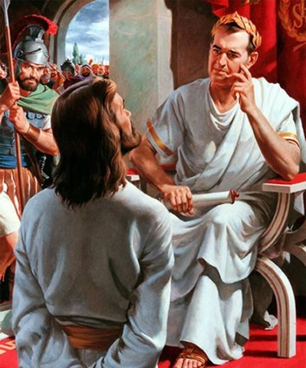
What is Truth?

Slide 86
Proverbs 16:25
There is a way that seems right unto a man, but its end is the ways of death.

Slide 87
“The truth and the glory of God are inseparable; it is impossible for us, with the Bible within our reach, to honor God by erroneous opinions. Many claim that it matters not what one believes, if his life is only right.

Slide 88
But the life is molded by the faith. If light and truth is within our reach, and we neglect to improve the privilege of hearing and seeing it, we virtually reject it; we are choosing darkness rather than light.”

Slide 89
“Ignorance will not excuse young or old.”
“Ignorance is no excuse for error or sin, when there is every opportunity to know the will of God.”

Slide 92
Luke 10:25-26
A lawyer asked Jesus,
"What shall I do to inherit eternal life?”…
And Jesus said, “What is written in the law? What is your reading of it?”

Slide 93
John 7:17
“If any man will do His will,
he shall know of the doctrine.”

Slide 94
Mark 12:24
“You know not the Scriptures,
neither the power of God.”

Slide 95
It is not enough to have good intentions; our soul's salvation is at stake, and we should search the Scriptures for ourself.

Slide 96
“It is the first and highest duty of every rational being to learn from the scriptures what is truth, and then to walk in the light and encourage others to follow his example.”

Slide 97
A Safeguard Against What?
Against False Teachers
Against Calamity
Against Satan’s Deceptions
Against Excuses
Against Temptations

Slide 98
“The Bible should never be studied without prayer.”

Slide 99
Psalm 119:18
“Open Thou mine eyes,
that I may behold wondrous things
out of Thy law.”

Slide 100
The Holy Spirit alone can cause us to feel the importance of what we are reading and prepare our hearts to be:

Slide 101
Charmed with beauty of the scriptures,
Admonished by its warnings,
or Animated and strengthened
by its promises.

Slide 102
“Temptations often appear irresistible because we’ve neglected prayer and study; we cannot remember God's promises to meet Satan with the Scripture weapons.”

Slide 103
Isaiah 59:19
“When the enemy shall come in like a flood, the Spirit of the Lord shall lift up a standard against him.”

Slide 104
John 14:26
“But the Helper, the Holy Spirit, whom the Father will send in My name, He will teach you all things, and bring to your remembrance all things that I said to you.”

Slide 105
But the teachings of Christ must previously have been stored in the mind in order for the Spirit of God to bring them to our remembrance in the time of peril.

Slide 106
Psalm 119:11
“Thy word have I hid in mine heart,
that I might not sin against Thee.”

Slide 107
James 4:7
“Therefore submit to God.
Resist the devil
and he will flee from you.”

Slide 108
1 Corinthians 10:12-13
Therefore let him who thinks he stands take heed lest he fall. No temptation has overtaken you except such as is common to man;

Slide 109
but God is faithful, who will not allow you to be tempted beyond what you are able, but with the temptation will also make the way of escape, that you may be able to bear it.

Slide 110
The Scriptures are A Safeguard
Against False Teachers
Against Calamity
Against Satan’s Deceptions
Against Excuses
Against Temptations

Slide 111
“It is the first and highest duty of every rational being to learn from the scriptures what is truth, and then to walk in the light and encourage others to follow his example.”

Slide 112
Jeremiah 17:8
He shall be as a tree planted by the waters, and that spreads out her roots by the river, and shall not see when heat cometh, but her leaf shall be green; and shall not be careful in the year of drought, neither shall cease from yielding fruit.

Slide 113
Psalm 119:99
“I have more understanding
than all my teachers,
For Your testimonies are my meditation.”

Slide 114
Against Skepticism
“It is Satan’s plan to weaken the faith of God’s people in the Testimonies. Satan knows how to make his attacks.
He works upon minds to excite jealousy and dissatisfaction toward those at the head of the work.
The gifts are next questioned; then, of course, they have but little weight, and instruction given through vision is disregarded.

Slide 115
Against Skepticism
Next follows skepticism in regard to the vital points of our faith, the pillars of our position,
then doubt as to the Holy Scriptures, and
then the downward march to perdition.

Slide 116
Against Skepticism
When the Testimonies which were once believed, are doubted and given up, Satan knows the deceived ones will not stop at this; and he redoubles his efforts till he launches them into open rebellion, which becomes incurable, and ends in destruction. . . . They rise up with bitter feelings against the ones who dare to speak of their errors and reprove their sins.” Testimonies, vol., 4, p. 211
Other quotes taken from
“The Great Controversy” Chapter 37

