Slide 1
JOHN 8:12
Then Jesus spoke to them again, saying, “I am the light of the world. He who follows Me shall not walk in darkness, but have the light of life.”

Slide 2
JOHN 12:46
I have come as a light into the world, that whoever believes in Me should not abide in darkness.

Slide 3
JOHN 20:31
but these are written that you may believe that Jesus is the Christ, the Son of God, and that believing you may have life in His name.

Slide 4
HEBREWS 11:6
And without faith it is impossible to please God, because anyone who comes to him must believe that he exists and that he rewards those who earnestly seek him.

Slide 5
JAMES 2:17
So also faith by itself, if it does not have works, is dead.

Slide 6
EPHESIANS 2:10
For we are His workmanship, created in Christ Jesus for good works, which God prepared beforehand that we should walk in them.

Slide 7
Christians in general, use the term "to testify" or "to give one's testimony" to mean "to tell the story of how one became a Christian".
Commonly it may refer to a specific event in a Christian's life in which God did something deemed particularly worth sharing.

Slide 8
New Living Translation 2 CORINTHIANS 5:17
This means that anyone who belongs to Christ has become a new person.
The old life is gone; a new life has begun!

Slide 9
King James Bible PSALM 77:13
Thy way, O God, is in the sanctuary: who is so great a God as our God?

Slide 10
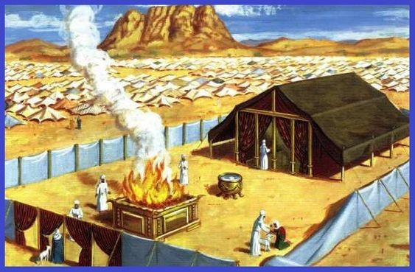

Slide 11
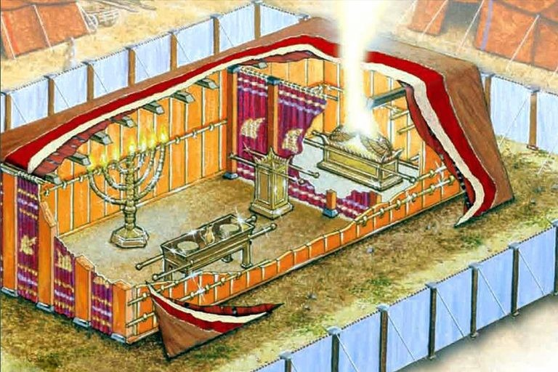

Slide 12
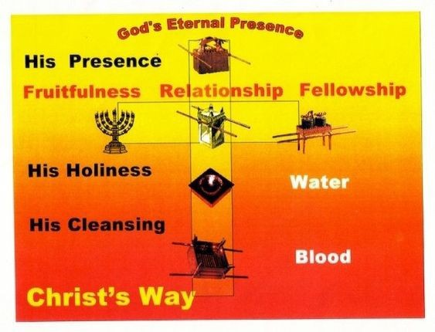

Slide 13
If you will go to work as Christ designs that His disciples shall, and win souls for Him, you will feel the need of a deeper experience and a greater knowledge in divine things, and will hunger and thirst after righteousness. You will plead with God, and your faith will be strengthened, and your soul will drink deeper drafts at the well of salvation.
Encountering opposition and trials will drive you to the Bible and prayer. You will grow in grace and the knowledge of Christ, and will develop a rich experience.
STEPS TO CHRIST

Slide 14
When the love of Christ is entered in the heart, like sweet fragrance it cannot be hidden. Its holy influence will be felt by all with whom we come in contact. The spirit of Christ in the heart is like a spring in the desert, flowing to refresh all and making those who are ready to perish, eager to drink of the water of life.
STEPS TO CHRIST

Slide 15
Love to Jesus will be manifested in a desire to work as He worked for the blessing and uplifting of humanity. It will lead to love, tenderness, and sympathy toward all the creatures of our heavenly Father's care.
STEPS TO CHRIST

