Slide 1
From
Selfishness
To
Selflessness

Slide 3
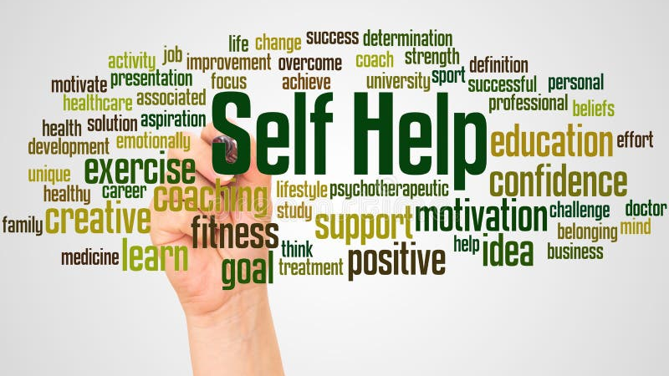

Slide 5
Self-Help:
the act of providing for or
helping oneself
without assistance
from others.

Slide 6
Self-Esteem:
a realistic respect for or favorable
impression of oneself;
Or an inordinately or exaggeratedly
favorable impression of oneself.
self-respect

Slide 9
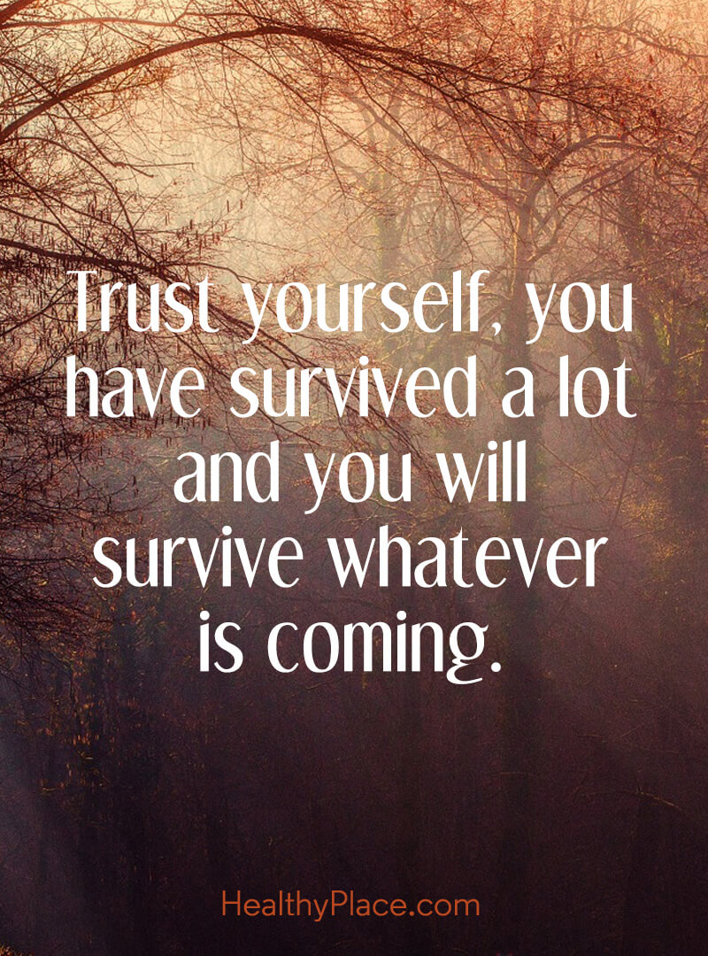

Slide 10
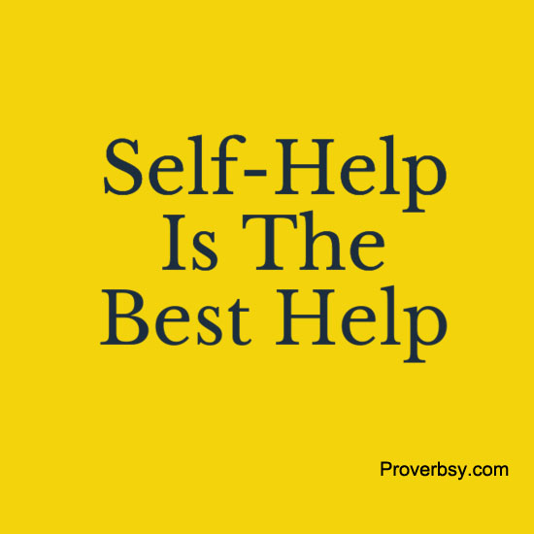

Slide 11
Is the problem of our generation
that we don’t love ourselves enough
Or
That we love ourselves too much?

Slide 12
From
Selfishness
To
Selflessness

Slide 15
SELFLESS: having little or no concern for oneself,
especially with regard to fame, position, money, etc.
Altruistic, charitable, generous, humanitarian,
loving, magnanimous, noble, humble, self-sacrificing.

Slide 16
Philippians 2:5-11
“Let this mind be in you which was also in Christ Jesus, who, being in the form of God, did not consider it robbery to be equal with God, but made Himself of no reputation,
taking the form of a bondservant,
and coming in the likeness of men.

Slide 17
And being found in appearance as a man,
He humbled Himself and became obedient to the point of death, even the death of the cross.

Slide 18
Therefore, God also has highly exalted Him and given Him the name which is above every name, that at the name of Jesus every knee should bow, of those in heaven, and of those on earth, and of those under the earth, and that every tongue should confess that Jesus Christ is Lord, to the glory of God the Father.”

Slide 20
Titus 2:11-14
“For the grace of God that brings salvation
has appeared to all men, teaching us that,
denying ungodliness and worldly lusts,
we should live soberly, righteously,
and godly in the present age,

Slide 21
looking for the blessed hope and
glorious appearing of our great God and Savior Jesus Christ, who gave Himself for us,
that He might redeem us from every
lawless deed and purify for Himself His own special people, zealous for good works.”

Slide 22
Matthew 16:24-27
“Then Jesus said to His disciples,
“If anyone desires to come after Me,
let him deny himself,
and take up his cross, and follow Me.
For whoever desires to save his life will lose it, but whoever loses his life for My sake
will find it.

Slide 23
For what profit is it to a man if he gains
the whole world, and loses his own soul?
Or what will a man give in exchange
for his soul? For the Son of Man will come
in the glory of His Father with His angels,
and then He will reward each
according to his works.”

Slide 24
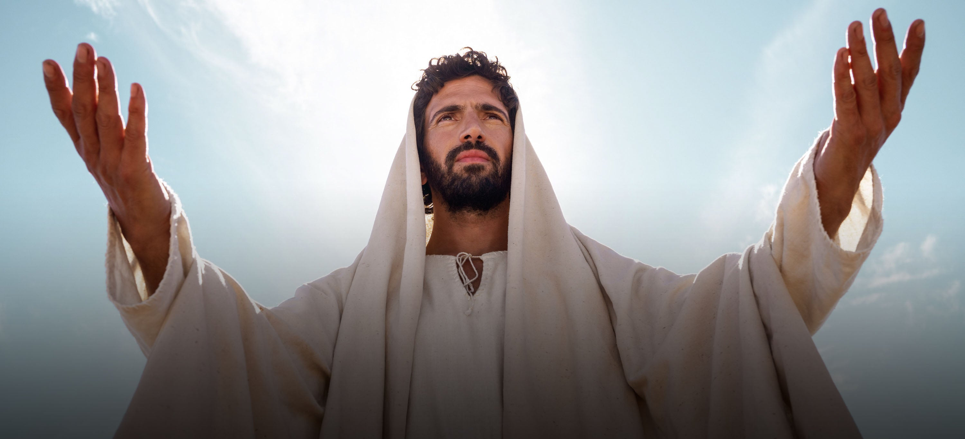

Slide 26
SELFISH:
devoted to or caring only
for oneself;
concerned primarily with
one's own interests, benefits,
welfare, etc., regardless of others.

Slide 27
Egocentric, greedy,
narcissistic, self-centered,
narrow-minded, vain.

Slide 28
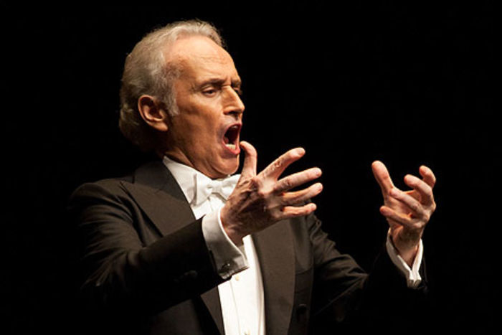

Slide 29
Titus 1:15-16
“To the pure all things are pure,
but to those who are defiled and unbelieving nothing is pure; but even their mind
and conscience are defiled.
They profess to know God, but in works they deny Him, being abominable, disobedient, and disqualified for every good work.”

Slide 30
2 Timothy 3:2-5
“For men will be lovers of themselves,
lovers of money, boasters, proud, blasphemers, disobedient to parents, unthankful, unholy, unloving, unforgiving, slanderers,

Slide 31
without self-control, brutal, despisers of good, traitors, headstrong, haughty,
lovers of pleasure rather than lovers of God, having a form of godliness but denying its power. And from such people turn away!”

Slide 33
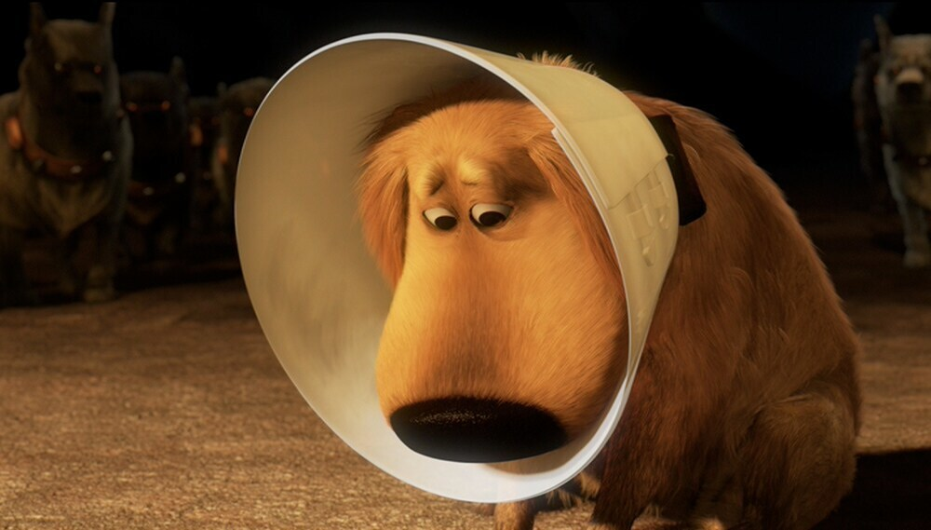

Slide 34
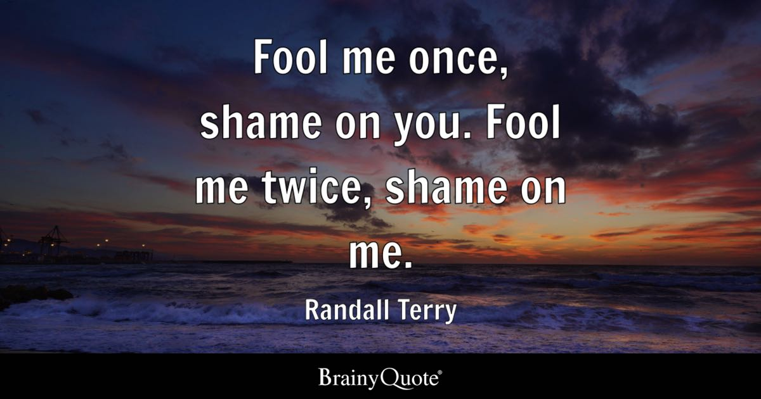

Slide 35
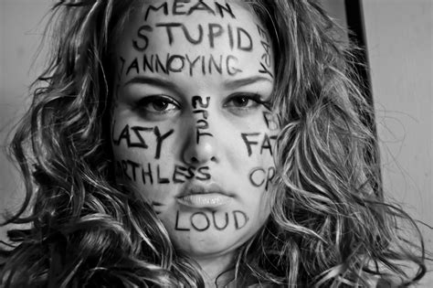

Slide 38
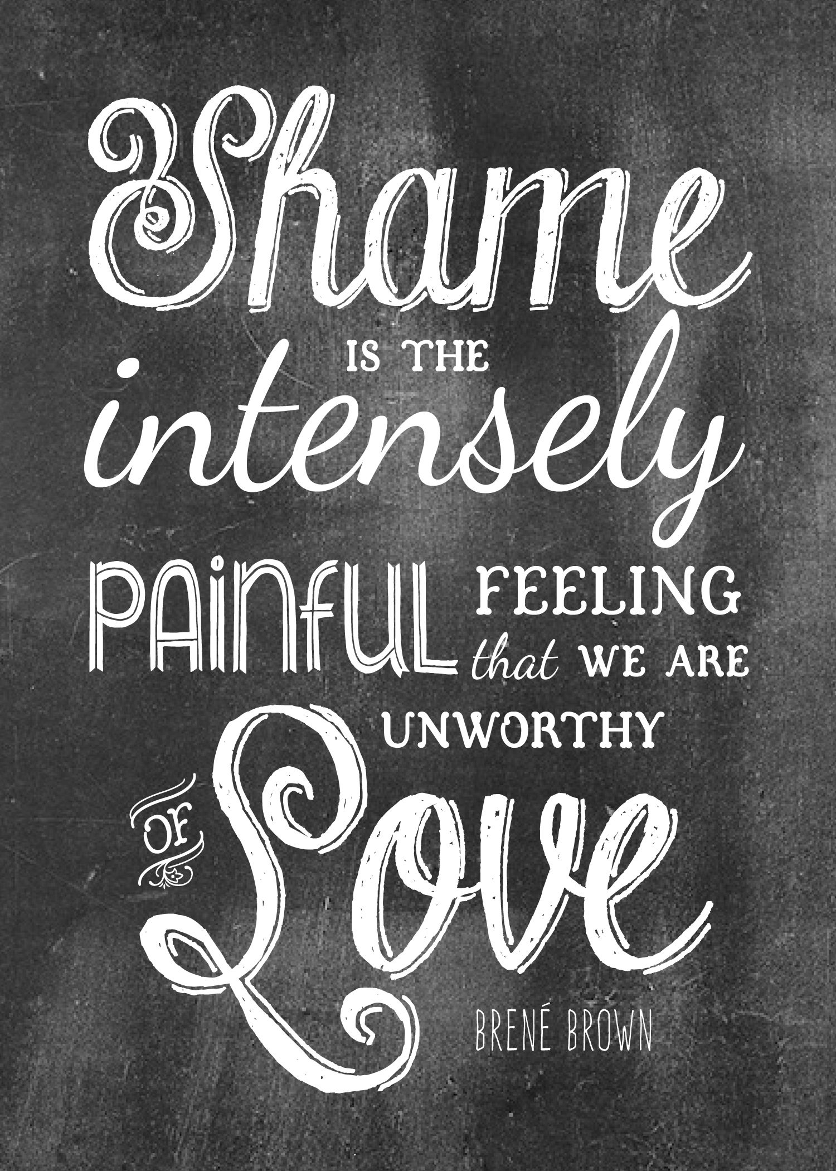

Slide 39
SHAME: (as a noun)
the painful feeling arising from the consciousness of something dishonorable, improper, ridiculous, etc., done by oneself or another. a fact or circumstance bringing disgrace or regret.

Slide 40
Disgrace, contempt, guilt,
humiliation, remorse, contrition,
dishonor, reproach,
self-disgust, self-reproach, self-reproof.

Slide 41
As oppose to (the verb):
to publicly humiliate
or cause to feel shame.
Bullying

Slide 42
SHAMELESS:
lacking any sense of shame: immodest; audacious. insensible to disgrace. showing no shame.

Slide 43
John 8:11
“She said, “No one, Lord.”
And Jesus said to her,
“Neither do I condemn you;
go and sin no more.”

Slide 44
1 Corinthians 6:5
“I say this to your shame.
Is it so, that there is not a wise man
among you, not even one,
who will be able to judge between
his brethren?”

Slide 45
1 Corinthians 4:14
“I do not write these things to shame you,
but as my beloved children I warn you.”

Slide 46
Ezra 9:6
“And I said: “O my God, I am too ashamed
and humiliated to lift up my face to You,
my God; for our iniquities have risen
higher than our heads, and
our guilt has grown up to the heavens.”

Slide 47
Psalm 83:16
“Fill their faces with shame,
that they may seek Your name, O Lord.”

Slide 48
Psalm 97:7
“Let all be put to shame who serve
carved images, who boast of idols.
Worship Him, all you gods.”

Slide 49
Proverbs 11:2
“When pride comes, then comes shame;
But with the humble is wisdom.”

Slide 50
Proverbs: 10:5
“He who gathers in summer is a wise son;
He who sleeps in harvest
is a son who causes shame.”

Slide 51
Proverbs 13:18
“Poverty and shame will come to him who disdains correction, but he who regards a rebuke will be honored.”

Slide 52
From
Selfishness
To
Selflessness

Slide 54
Christ is our example in all things.
We need less self.
We need more humility.
We need to have the mind of a servant.
We need to be reminded of our duty…
our commitments… our promises to God.

Slide 56
Shame and guilt are going to be involved because we all fall short.
You can either look at it in its proper place and use it as a motivation for change
or you can blame other to appease your guild and remain shameless… without a conscience.

Slide 57
