Slide 1
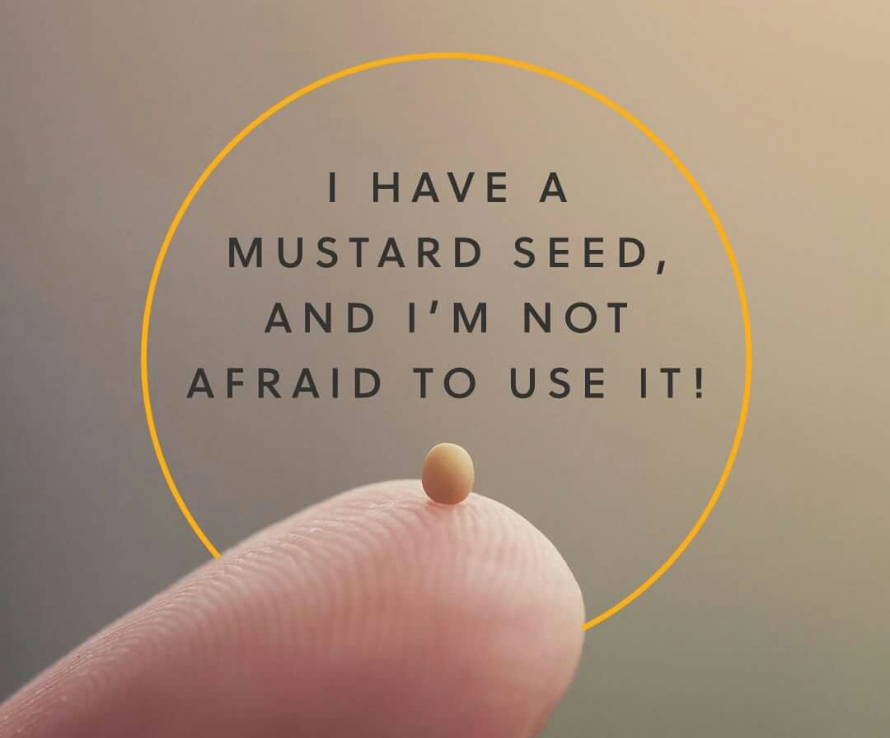

Slide 3
“Now faith is the substance of things hoped for, the evidence of things not seen.”
Hebrews 11:1
What is faith?

Slide 4
Ellen White, Education, Pg. 253
“Faith is trusting God—believing that He loves us and knows best what is for our good. Thus, instead of our own, it leads us to choose His way. In place of our ignorance, it accepts His wisdom; in place of our weakness, His strength; in place of our sinfulness, His righteousness. Our lives, ourselves, are already His; faith acknowledges His ownership and accepts its blessing. Truth, uprightness, purity, have been pointed out as secrets of life's success. It is faith that puts us in possession of these principles.”

