Slide 1
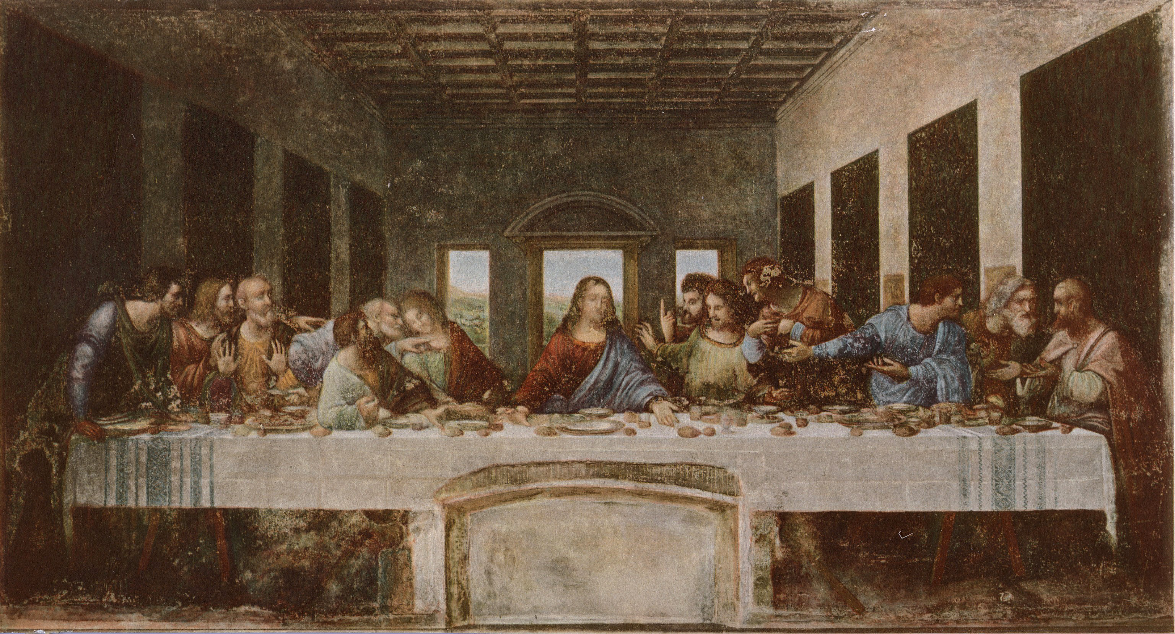
In Remembrance
Lest we forget

Slide 3
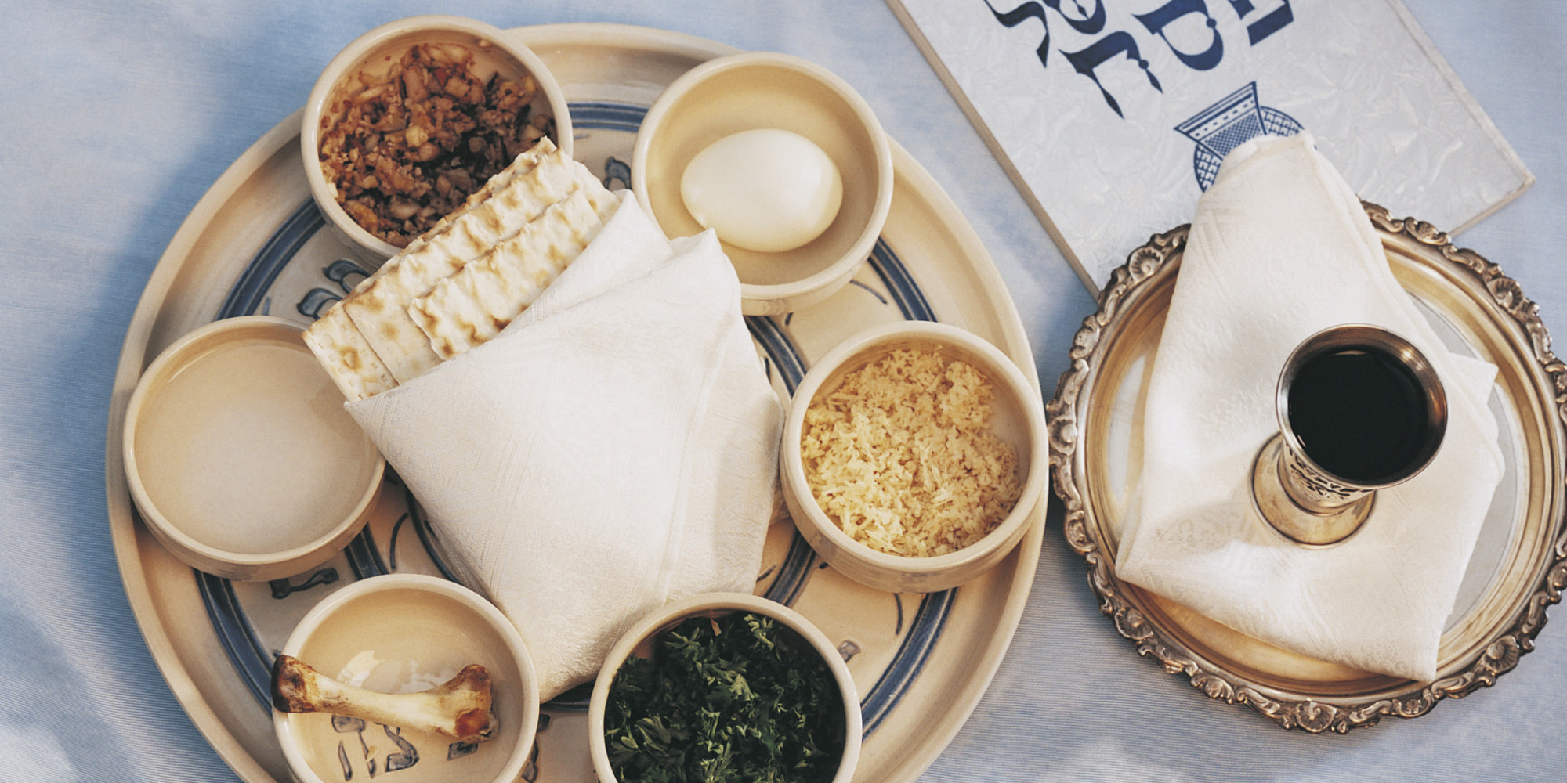

Slide 4
9 Questions

Slide 5
What did the feasts, including the Passover, prefigure?

Slide 6
Hebrews 10:1
“For the law, having a shadow of the good things to come, and not the very image of the things, can never with these same sacrifices, which they offer continually year by year, make those who approach perfect.

Slide 7
Could these offerings take away sin?

Slide 8
Hebrews 10:4
“For it is not possible that the blood of bulls and goats could take away sins.”

Slide 9
What about the Ten Commandments?

Slide 10
Hebrews 8:8-10
“…“Behold, the days are coming, says the Lord, when I will make a new covenant with the house of Israel and with the house of Judah; because they did not continue in My covenant, and I disregarded them, says the Lord.

Slide 11
Hebrews 8:8-10
…I will put My laws in their mind and write them on their hearts; and I will be their God, and they shall be My people.”

Slide 12
Having God’s commandments in our hearts, should we also keep Christ and His sufferings in mind?

Slide 13
1 Corinthians 15:2-4
“… that word which I preached to you… that Christ died for our sins according to the Scriptures, and that He was buried, and that He rose again the third day according to the Scriptures,”

Slide 14
Is it enough to simply believe in the death of Christ?

Slide 15
1 Thessalonians 4:14
“For if we believe that Jesus died and rose again, even so God will bring with Him those who sleep in Jesus.”

Slide 16
By what act do we commemorate the resurrection of Christ?

Slide 17
Colossians 2:12
“buried with Him in baptism, in which you also were raised with Him through faith in the working of God, who raised Him from the dead.”

Slide 18
By what act do we commemorate the death of Christ?

Slide 19
1 Corinthians 11:26
“For as often as you eat this bread and drink this cup, you proclaim the Lord’s death till He comes.”

Slide 20
What should always precede both?

Slide 21
Acts 2:38
“Peter said, “Repent, and let every one of you be baptized in the name of Jesus Christ for the remission of sins…”

Slide 22
Acts 20:20-21
“… proclaimed it to you, and taught you publicly and from house to house, testifying to Jews, and also to Greeks, repentance toward God and faith toward our Lord Jesus Christ.”

Slide 23
If one refuses to obey God, can he be profited by partaking of the communion?

Slide 24
1 Corinthians 11:27
“Therefore whoever eats this bread or drinks this cup of the Lord in an unworthy manner will be guilty of the body and blood of the Lord.”

Slide 25
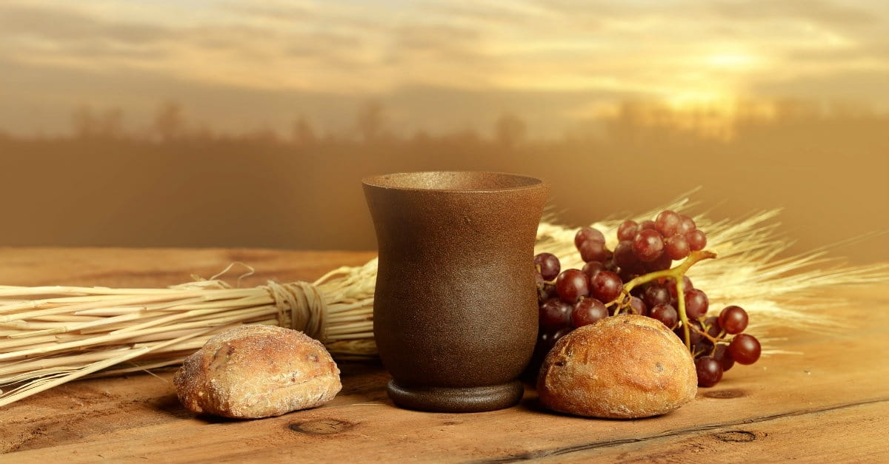

Slide 26
8 Important Take Aways

Slide 27
Communion is NOT just a tradition,
it is a command from God.
It is a direct commandment of Jesus reaffirmed by Paul

Slide 28
Communion is an ordinance to remember Christ’s death for our sins and the covenant the we have with Him until He come again to take us home.

Slide 29
It’s a time to remember and a renewal our commitment to Christ.
To remember our part to play in God’s everlasting covenant.

Slide 30
This is a most solum and reverent service. As Jesus commanded, we are (in symbolic form) showing respect to the body and blood of Jesus in connection with His great sacrifice for humanity.

Slide 31
Make Proper Preparations.
We should confess ALL our sins, make an effort for true repentance to God,
And reconcile with our fellow man.
(confess any wrongs done or said)
The ordinance of humility is by designed to do this very thing.

Slide 32
6. All are welcome to participate who
are Baptized (circumcised) believers who have “put on the Lord Jesus.”
Open communion means all Christians regardless of denomination.

Slide 33
7. Who then cannot Participate?
Unbaptized children
Non-Christians
Those in open sin, anyone who refuses to obey the commandment of God.

Slide 34
In not making these proper preparations You will bring judgment upon yourself for disrespecting the Body and Blood of Jesus Himself.

Slide 36
3 Final Points

Slide 37
The Disciples Argue About Greatness

Slide 38
Luke 22:24-30
“Now there was also a dispute among them, as to which of them should be considered the greatest.

Slide 39
And He said to them, “The kings of the Gentiles exercise lordship over them, and those who exercise authority over them are called ‘benefactors.’ But not so among you; on the contrary, he who is greatest among you, let him be as the younger, and he who governs as he who serves.

Slide 40
For who is greater, he who sits at the table, or he who serves? Is it not he who sits at the table? Yet I am among you as the One who serves.”

Slide 41
“But you are those who have continued with Me in My trials. And I bestow upon you a kingdom, just as My Father bestowed one upon Me, that you may eat and drink at My table in My kingdom, and sit on thrones judging the twelve tribes of Israel.”

Slide 42
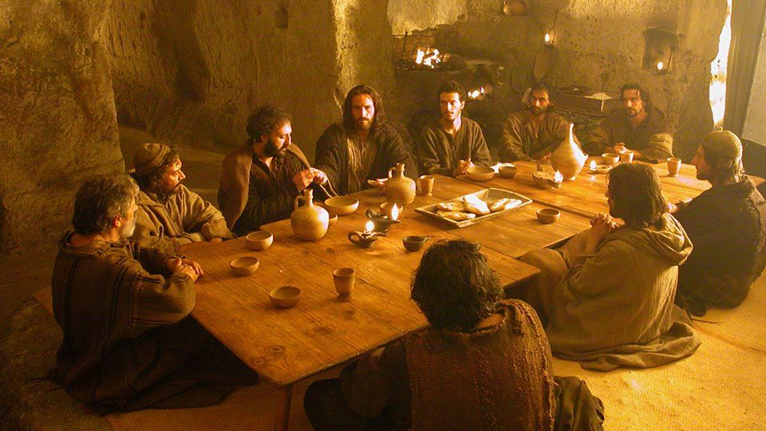

Slide 43
Jesus Washes The Disciples’ Feet

Slide 44
John 13:2-17
“And supper being ended, … Jesus, … rose from supper and laid aside His garments, took a towel and girded Himself.

Slide 45
After that, He poured water into a basin and began to wash the disciples’ feet, and to wipe them with the towel with which He was girded. …

Slide 46
So when He had washed their feet, taken His garments, and sat down again, He said to them, “Do you know what I have done to you? You call Me Teacher and Lord, and you say well, for so I am.

Slide 47
If I then, your Lord and Teacher, have washed your feet, you also ought to wash one another’s feet. For I have given you an example, that you should do as I have done to you.

Slide 48
Most assuredly, I say to you, a servant is not greater than his master; nor is he who is sent greater than he who sent him. If you know these things, blessed are you if you do them.”

Slide 49
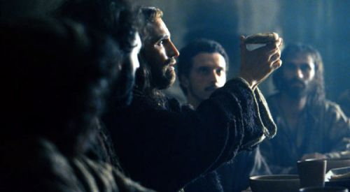

Slide 50
A NEW COMMANDMENT

Slide 51
John 13:2-17:34-35
“A new commandment I give to you, that you love one another; as I have loved you, that you also love one another.
By this all will know that you are My disciples, if you have love for one another.”

Slide 52
In Remembrance
of Jesus

