Slide 1
1844
Certainty & Significance

Slide 2
177 years ago today…
“We started, and while passing through a large field I was stopped about midway of the field. Heaven seemed opened to my view, and I saw distinctly and clearly that instead of our High Priest coming out of the Most Holy of the heavenly sanctuary to come to this earth on the tenth day of the seventh month, at the end of the 2300 days, He for the first time entered on that day the second apartment of that sanctuary; and that He had a work to perform in the Most Holy Place before coming to the earth.” –Hiram Edson
Notes:
Hiram Edson’s vision - October 23, 1844

Slide 3
Inspired Council
“But such subjects as the sanctuary, in connection with the 2300 days, the commandments of God and the faith of Jesus, are perfectly calculated to explain the past Advent movement and show what our present position is, establish the faith of the doubting, and give certainty to the glorious future. These, I have frequently seen, were the principal subjects on which the messengers should dwell.” -EW 63.2

Slide 4
How did the Great Disappointment happen?
What one verse is most responsible for beginning the Advent Movement?
“Unto two thousand and three hundred days, then shall the sanctuary be cleansed.” –Daniel 8:14
William Miller understands this prophecy to end in 1844
Notes:
But was Miller correct in the date he discovered?

Slide 5
Certainty
Did Jesus move to the Most Holy Place on October 22, 1844?
When do the 2300 days of Daniel 8 begin?
When do they end?
What event are they pointing to?
“Unto two thousand and three hundred days; then shall the sanctuary be cleansed.” –Daniel 8:14
Notes:
Did Jesus move to the MHP on October 22, 1844? To answer that, we are going to consider the following questions.
Based on OT sanctuary service we know Christ would move to the MHP at some point to perform the Day of Atonement work
Daniel 7:9,10 tells us there is a judgment in heaven, and also says God’s throne has wheels – symbolizing his move from HP to MHP
So we know Jesus would move from the HP where he went as His ascension and sat down by His Father to the MHP to complete this work at some point.
But is October 22, 1844, the correct date for that, or is it just a face-saving attempt by Adventists to cover the Great Disappointment?

Slide 6
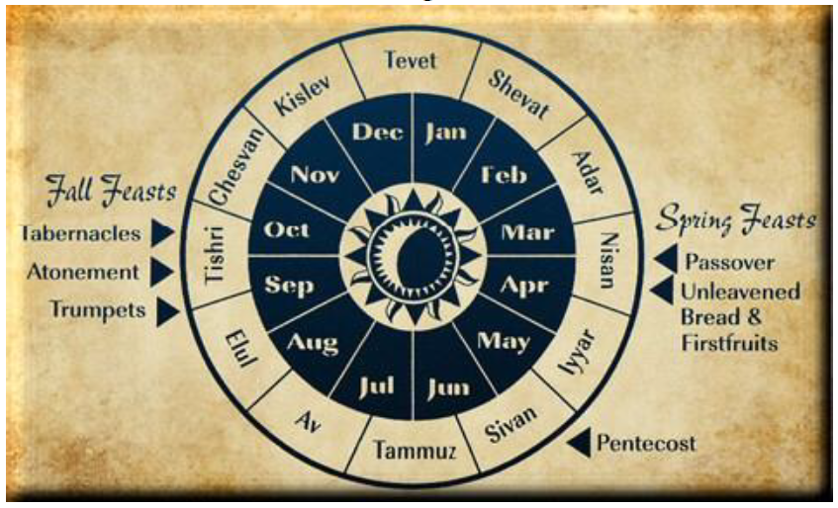
Annual Feasts Type & Antitype
Notes:
How did William Miller and the Millerites come up with the date of October 22, 1844?
Sanctuary model – annual feasts type & antitype (along with 2300 day prophecy)
Miller noted that the spring feasts antitypical fulfillment had occurred on the literal day of the typical events.
Wouldn’t we expect the same from the antitypical Day of Atonement?
Feast of Trumpets observed on the 1st day of the 7th month
The trumpets were blown ten days before the Day of Atonement, warning everyone of the solemn day of judgment that was to come
In the antitype, the message was loudly proclaimed in the 10 years prior to 1844.
Like the time leading up to the cross when Christ’s followers loudly proclaimed that Jesus was the King and the Messiah come to earth, the messengers misunderstood the event of 1844, which actually enabled them to proclaim the event with energy. Afterward through further study of scripture, the actual events came to be understood.

Slide 7
The 2300 Days – when did it start?
Daniel 8 Observations
What type of animals do we see?
Ram & goat…sanctuary animals
Which kingdom comes first?
Medo-Persia
Why might this be different than chapters 2 & 7?
The 2300 days begin during Medo-Persia’s reign
Notes:
Have people read Daniel 8:1-12 and discuss
Note that the ram and goat are seen in Daniel 8, which are sanctuary animals.
The only time the ram and goat were sacrificed in the same service was on the Day of Atonement, so Daniel 8 is strongly alluding to the sanctuary service and the Day of Atonement.
Medo-Persia reigned from 539-331 BC, so we have those parameters for the beginning of the 2300 days
Note that the 2300 days cannot be literal considering the context and what is covered in Daniel 8

Slide 8
The 2300 Days – when did it start?
How do we know the starting date?
Two Hebrew words for “vision” in Daniel 8 & 9 – Hazon & Mareh
Hazon = The ram, goat, and little horn desecrating sanctuary/what Daniel hears
Mareh = 2300 days/“the vision of the evenings and mornings”
Vision of the evenings and mornings is the “mareh” (vs 26a)
Daniel doesn’t understand the mareh (vs 27)
Gabriel returns in 9:23 to explain the mareh, and his explanation begins with the 70 weeks. The 70 weeks and the 2300 days, therefore, have the same starting point.
“Seventy weeks are determined…” 9:24
Notes:
Daniel 8:13,14
Daniel 8:26,27…notice that “mareh” is used to specifically refer to the 2300 days portion of the vision
The 2300 days could also be translated the 2300 evenings and mornings
“Seventy weeks are determined upon thy people…” The word determined is the Hebrew phrase “cut off”, so the 70 weeks are cut off from the larger 2300 days
We find that Artaxerxes decree to Ezra, which was enforced, for Jerusalem to be restored and rebuilt was in the 7th year of his reign (Ezra 7:6-9), and this is confirmed In the Canon of Ptolemy, so we can very accurate date this to 457 BC.

Slide 9
The 2300 Days – when did it start?
When did the 70 weeks start?
“…from the going forth of the command to restore and rebuild Jerusalem…” –Daniel 9:25
When was the command given?
7th year of King Artaxerxes (Ezra 7:6-9)
“For Ezra had prepared his heart to seek the Law of the Lord, and to do it, and to teach statutes and ordinances in Israel.” –Ezra 7:10
Recommended Resource: “When Did the 2300 Days of Daniel 8:14 Begin and End?” -Richard Davidson, available on audioverse
Notes:
The reason God was able to use Ezra to carry out this fulfillment of prophecy is found in Ezra 7:10.
This is the same reason God could use Daniel to reveal this prophecy to originally – Daniel “purposed in his heart” not to defile himself.
The key is a heart surrendered to God – to seek His will and to be faithful to it. Not to be hearers of the word only, but also doers.
The 7th year of Artaxerxes reign, when this decree was carried out was in 457 BC, which is confirmed in the Canon of Ptolemy.
Something very interesting to note is that it is highly likely that Artaxerxes’ command went into effect on the Day of Atonement in 457 BC

Slide 10
Notes:
Having established that the 2300 days began in 457 (likely on the Day of Atonement), we can affirm the Millerites’ conclusion that this prophetic time period ended on the Day of Atonement in 1844.
After Miller initially suggested sometime between the spring of 1843 and 1844 for this event, at campmeeting on August 12, 1844, Samuel Snow announced that he had received new light, and clearly explained the calculation of October 22, 1844.

Slide 11
Certainty
Did Jesus move to the Most Holy Place on October 22, 1844?
When do the 2300 days of Daniel 8 begin?
When do they end?
What event are they pointing to?
“Unto two thousand and three hundred days; then shall the sanctuary be cleansed.” –Daniel 8:14
Notes:
Did Jesus move to the MHP on October 22, 1844? To answer that, we are going to consider the following questions.
Based on OT sanctuary service we know Christ would move to the MHP at some point to perform the Day of Atonement work
Daniel 7:9,10 tells us there is a judgment in heaven, and also says God’s throne has wheels – symbolizing his move from HP to MHP
So we know Jesus would move from the HP where he went as His ascension and sat down by His Father to the MHP to complete this work at some point.
But is October 22, 1844, the correct date for that, or is it just a face-saving attempt by Adventists to cover the Great Disappointment?

Slide 12
Right Date, Wrong Event
“The question, What is the sanctuary? is clearly answered in the Scriptures. The term “sanctuary,” as used in the Bible, refers, first, to the tabernacle built by Moses, as a pattern of heavenly things; and, secondly, to the “true tabernacle” in heaven, to which the earthly sanctuary pointed. At the death of Christ the typical service ended. The “true tabernacle” in heaven is the sanctuary of the new covenant. And as the prophecy of Daniel 8:14 is fulfilled in this dispensation, the sanctuary to which it refers must be the sanctuary of the new covenant. At the termination of the 2300 days, in 1844, there had been no sanctuary on earth for many centuries. Thus the prophecy, “Unto two thousand and three hundred days; then shall the sanctuary be cleansed,” unquestionably points to the sanctuary in heaven.” -GC 417.1

Slide 13
Significance
How important is Christ’s work in the sanctuary?
What does it mean for my life today?

Slide 14
Importance
“The subject of the sanctuary was the key which unlocked the mystery of the disappointment of 1844. It opened to view a complete system of truth, connected and harmonious, showing that God’s hand had directed the great advent movement and revealing present duty as it brought to light the position and work of His people.” -GC 423.1
Notes:
The sanctuary truth is the “central pillar” (GC 409) of the Advent movement, which God raised up to finish the work in earth’s last days.
The sanctuary sets the framework for the rest of our doctrines – it must be the lens through which we do our theology.
Our sanctuary understanding including 1844 and the MHP ministry of Christ is our unique contribution to theology.

Slide 15
Importance
“The intercession of Christ in man’s behalf in the sanctuary above is as essential to the plan of salvation as was His death upon the cross. By His death He began that work which after His resurrection He ascended to complete in heaven. We must by faith enter within the veil, ‘whither the forerunner is for us entered.’ Hebrews 6:20.” –GC 489.1

Slide 16
Living in the Day of Atonement
“We are now living in the great day of atonement. In the typical service, while the high priest was making the atonement for Israel, all were required to afflict their souls by repentance of sin and humiliation before the Lord, lest they be cut off from among the people. In like manner, all who would have their names retained in the book of life should now, in the few remaining days of their probation, afflict their souls before God by sorrow for sin and true repentance. There must be deep, faithful searching of heart…There is earnest warfare before all who would subdue the evil tendencies that strive for the mastery…Everyone must be tested and found without spot or wrinkle or any such thing.” -GC 489.3

Slide 17
Living in the Day of Atonement
“There must be a purifying of the soul here upon the earth, in harmony with Christ’s cleansing of the sanctuary in heaven.” -Mar 249.4
“Christ is waiting with longing desire for the manifestation of Himself in His church. When the character of Christ shall be perfectly reproduced in His people, then He will come to claim them as His own.” -COL 69.1
Notes:
Talk about the times we are living in
Whatever your thoughts are on COVID, masks, vaccinations, etc – there is no questioning that COVID has changed the world in a way that points to Jesus’ soon coming as we see the liberties people are willing to give up in the name of “safety”, whether real or imagined.
Brother and sister with diseases
Friend’s dad died in ultralight crash
Christ is waiting for us to allow our soul temple’s to be cleansed by Him, so the work of Atonement can be completed, and we can be reunited with Him – forever free from this world of sickness and sin.
Let Him finish His work in you today.

