Slide 1
“The Great Architect”

Slide 2
Architecture
Definition: The art or science of building; specifically: the art or practice of designing and building structures and especially habitable ones.

Slide 3
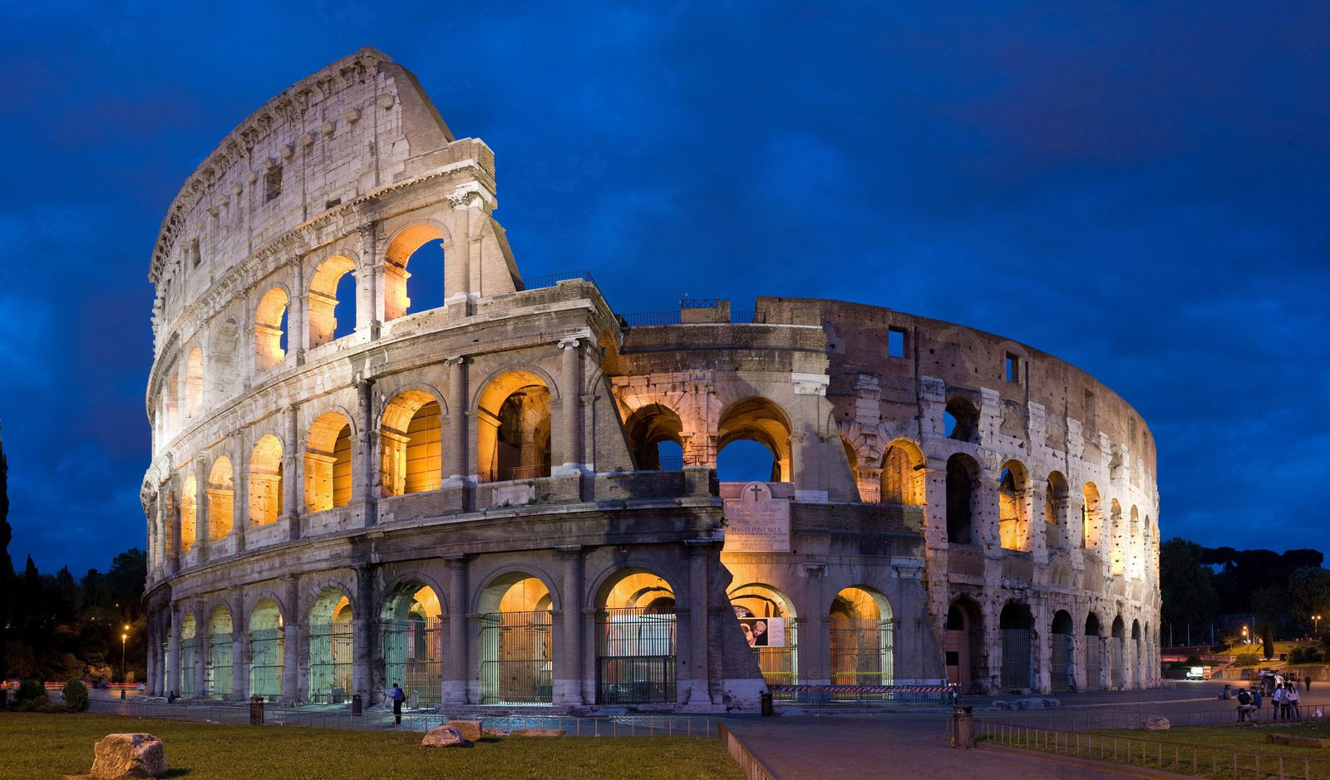

Slide 8
Where does it come from?
The word Architecture comes from
the Greek word “Arkhitekton”,
meaning “Chief Builder”.

Slide 9
Four ways
God will reveal his will for your life

Slide 10
People
God can reveal his will for you through people
“Plans fail for lack of counsel, but with many advisers they succeed” Proverbs 15:22

Slide 11
Circumstances
God can reveal his will for you through circumstances
“In the beginning God created the Heavens and the earth” Genesis 1:1

Slide 12
Prayer
God can reveal himself to you through prayer
“Call to me and I will answer you, and will tell you great and hidden things that you have not known.” Jeremiah 33:3

Slide 13
Prayer
“do not be anxious about anything, but in everything by prayer and supplication with thanksgiving let your requests be made known to God. And the peace of God, which surpasses all understanding, will guard your hearts and your minds in Christ Jesus. Philippians 4:6,7

Slide 14
God’s Word
4. God can reveal himself to you through his word
“Your word is a lamp to my feet
and a light to my path.”
Psalm 119:105

Slide 15
God’s Word
4. God can reveal himself to you through his word
“‘Man shall not live by bread alone, but by every word that comes from the mouth of God.’”
Matthew 4:4

Slide 16
God’s Word
“This Book of the Law shall not depart from your mouth, but you shall meditate on it day and night, so that you may be careful to do according to all that is written in it. For then you will make your way prosperous, and then you will have good success.”
Joshua 1:8

Slide 17
Four ways
God will reveal his will for your life
People
Circumstances
Prayer
God’s Word

