Slide 1
Walking with Christ
Walking in Light

Slide 5
Do you remember your first walk with Jesus?

Slide 6
Do you still walk with Him today?

Slide 7
Walking with Jesus is not only one time event.
It is every day challenge.

Slide 8
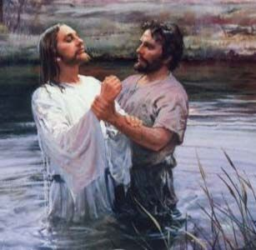

Slide 9
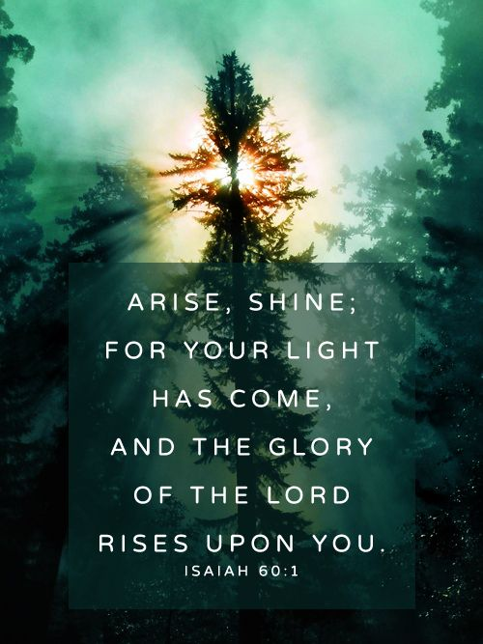

Slide 11
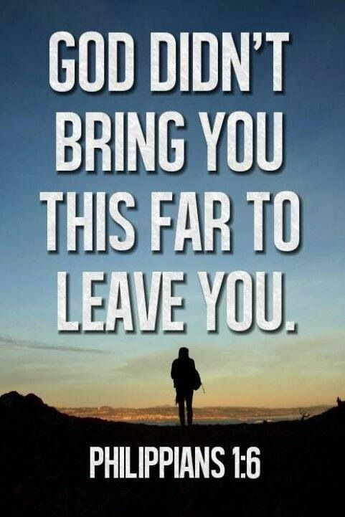

Slide 12
Jesus gave 3 assurance power for church to make it trough hard time.

Slide 13
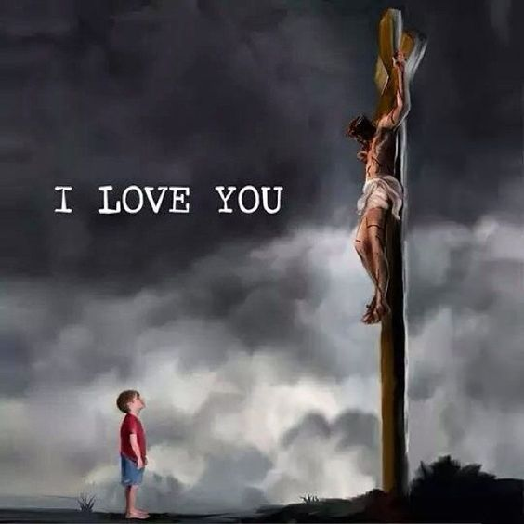

Slide 14
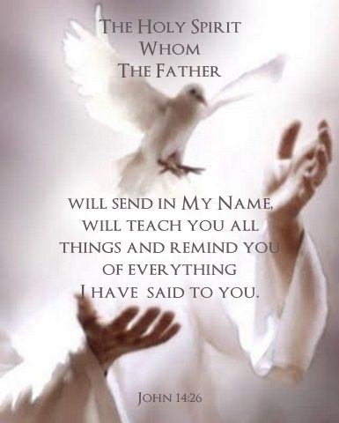

Slide 15
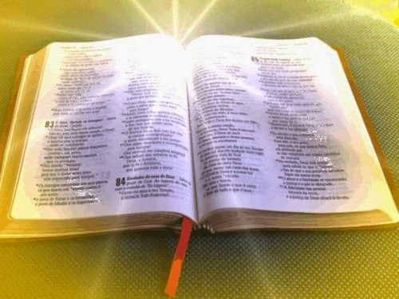

Slide 16
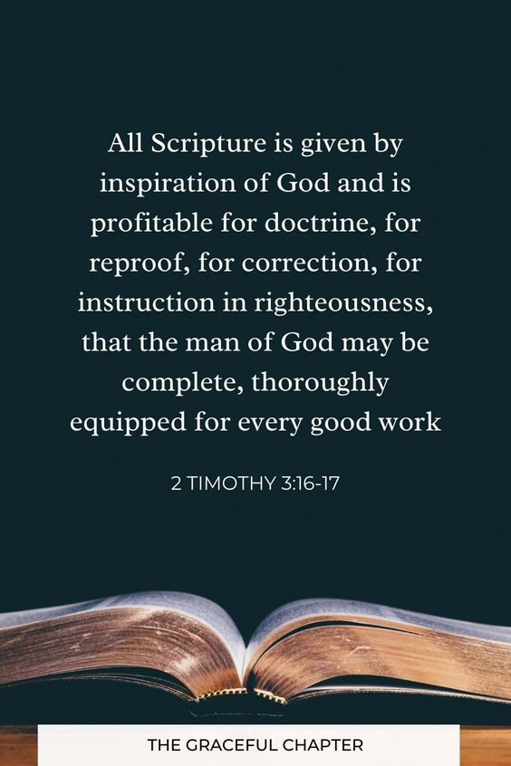

Slide 20
Almost every relationship has some issues.

Slide 24
Wretched
A person who is in a very unhappy or unfortunate state

Slide 25
Miserable :
Sad
Unhappy
Upset
Broken-hearted

Slide 26
Poor
Blind
Naked
This represent
Spiritual
condition

Slide 27
Can we understand
and except this
message?

Slide 28
How we come to this situation?

Slide 29
PRIDE and SELFISHNESS

Slide 30
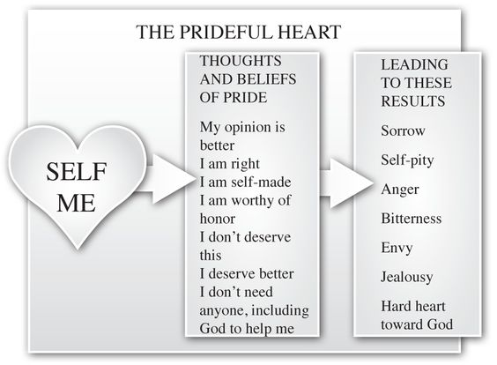

Slide 31
Jesus
is only solution
Depends and trust Jesus

Slide 35
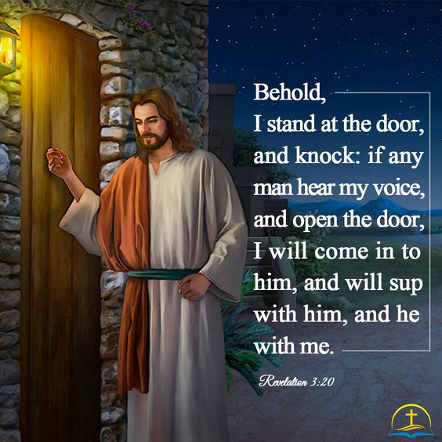

Slide 36
Some challenges can be big on front off our ayes.
But the Lord our God is bigger than that.

Slide 37
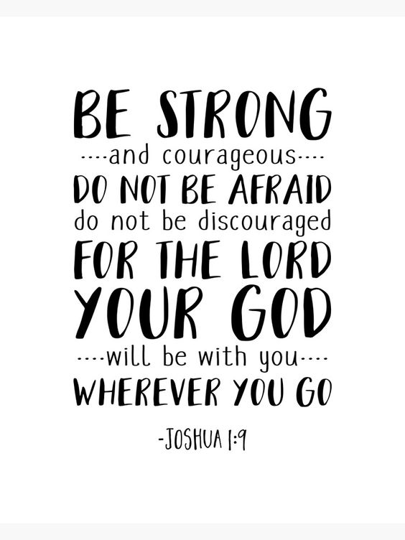

Slide 38
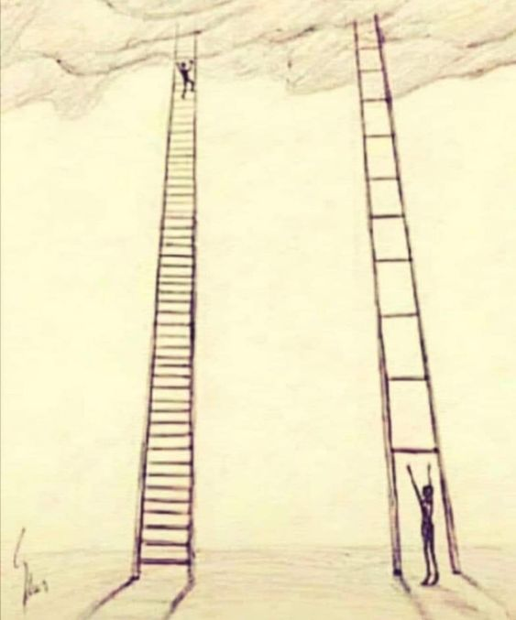

Slide 39
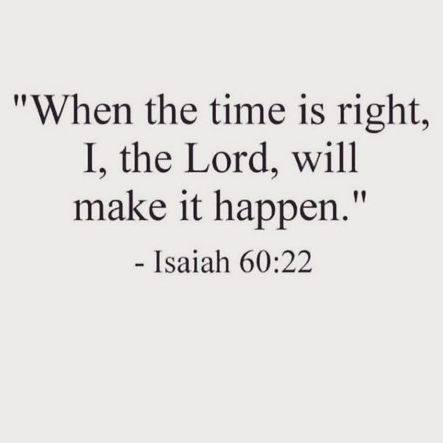

Slide 40
WHEN WE WAITING: PRAY STUDY WORSHIP AND FELLOWSHIP TELL MESSAGE TO THE WORLD HAVE A PATIANCE

Slide 41
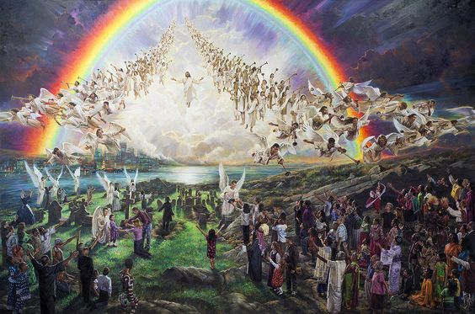

Slide 42
