Slide 1
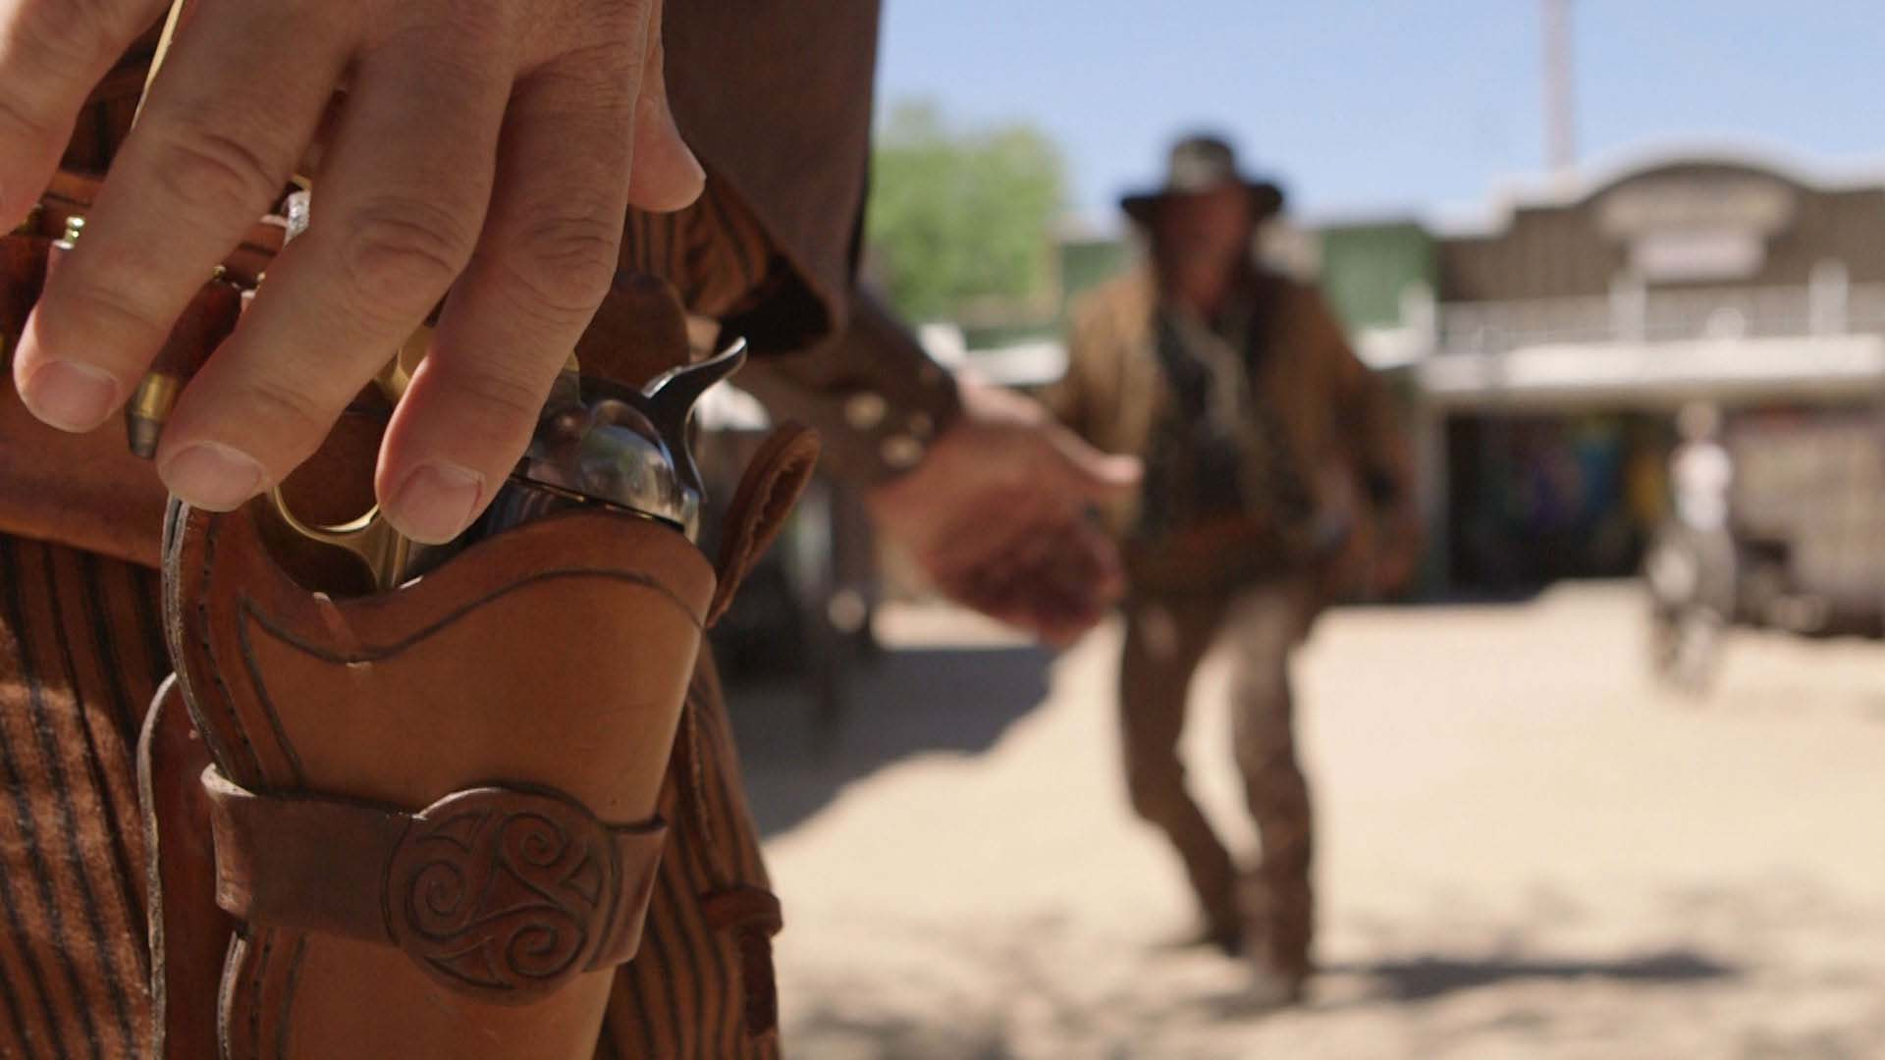

Slide 2


Slide 3


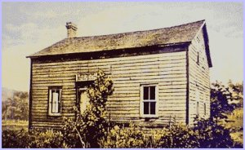
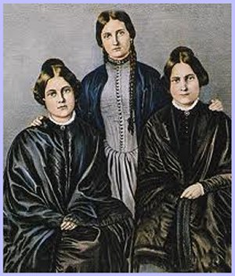
The Birth of Modern Spiritualism
Fox sisters, Hydesville, New York
Mysterious Rappings March 31, 1848
Notes:
The Birth of Modern Spiritualism took place with the Fox sisters on a homestead in Hydesville, New York
The Fox family who moved to a homestead in Hydesville, New York State, USA were disturbed by noises, knockings, movements of objects and other unusual phenomena. The two children Catherine and Margaretta discovered that if they spoke out then the mysterious noises seemed to respond and it became clear that the phenomena were not just random manifestations of energy but were under the control of some invisible intelligence. In a world where such happenings were feared and where religion labelled them as evil, these happenings soon gained the attention of neighbors and family friends. The news of these happenings spread far and wide, at times many bystanders came to marvel at the unexplained knockings and noises.
On March 31, 1848, the two sisters, Margaretta and Catherine Fox, established intelligent, two way communication with a spirit person who was responsible for producing the phenomena.
A committee of investigation was formed and communicated with the spirit who had been harassing the Fox family. The committee listened out for the response signal knocks and they established that the communicator was Charles Rosna, who had been murdered and buried beneath the cellar of the homestead. An excavation of the cellar later proved that there was indeed the remains of a body buried there.
Margaretta later confessed that these rappings were contrived.

Slide 4
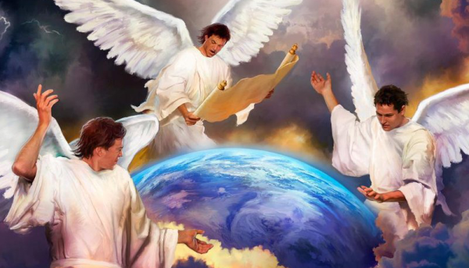

Notes:
1844 was the last time prophecy.
the 1st Angel's message,
the 2nd Angel's message,
the 3rd Angel's message…it's all there.
I've got to sum this up…
The 3 Angel's message is nothing more than the message of Noah. Get in the Ark!
Get into the ARK before it's too late! Why? Because the Seal of God is found in the ARK and those who are outside of the ARK will be marked for death.
The angels with the 7 Last Plagues are seen coming out of the Most Holy Place. Why? Because those who receive the plagues are those who rejected what was found in the Most Holy Place. Our message is to get into the ARK.

Slide 5


Revelation 14:6
Then I saw another angel flying in the midst of heaven, having the everlasting gospel to preach to those who dwell on the earth: to every nation, tribe, tongue, and people

Slide 6
Revelation 14:7
“Fear God and give glory to Him, for the hour of His judgment has come; and worship Him who made heaven and earth, the sea and springs of water.”

Slide 7


Slide 8
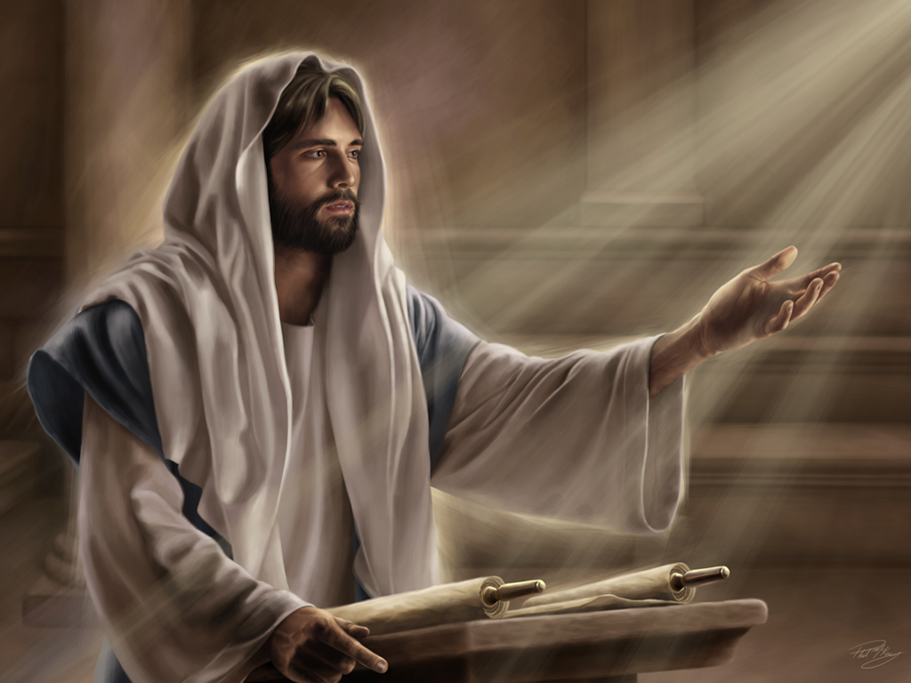

Slide 9
John 3:16
“For God so loved the world that He gave His only begotten Son, that whoever believes in Him should not perish but have everlasting life.

Slide 10
Romans 6:23
“For the wages of sin is death,
but the gift of God is eternal life in Christ Jesus our Lord.”

Slide 11
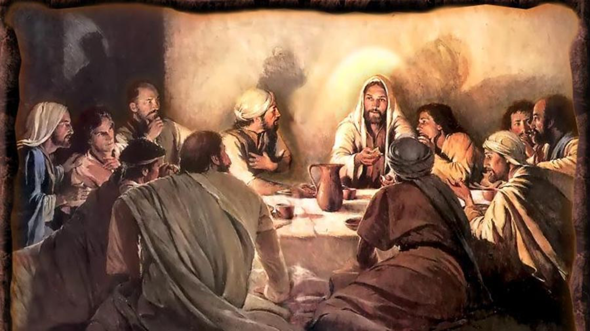

Slide 12
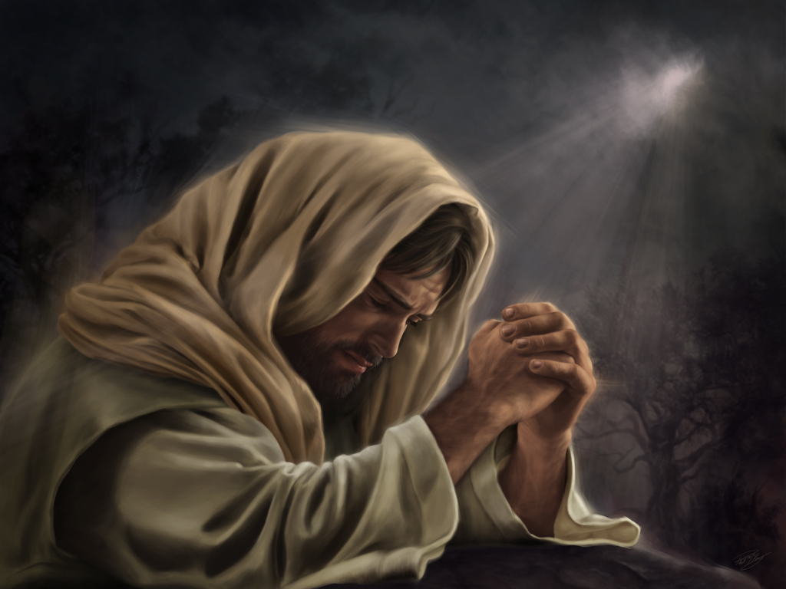


Slide 13
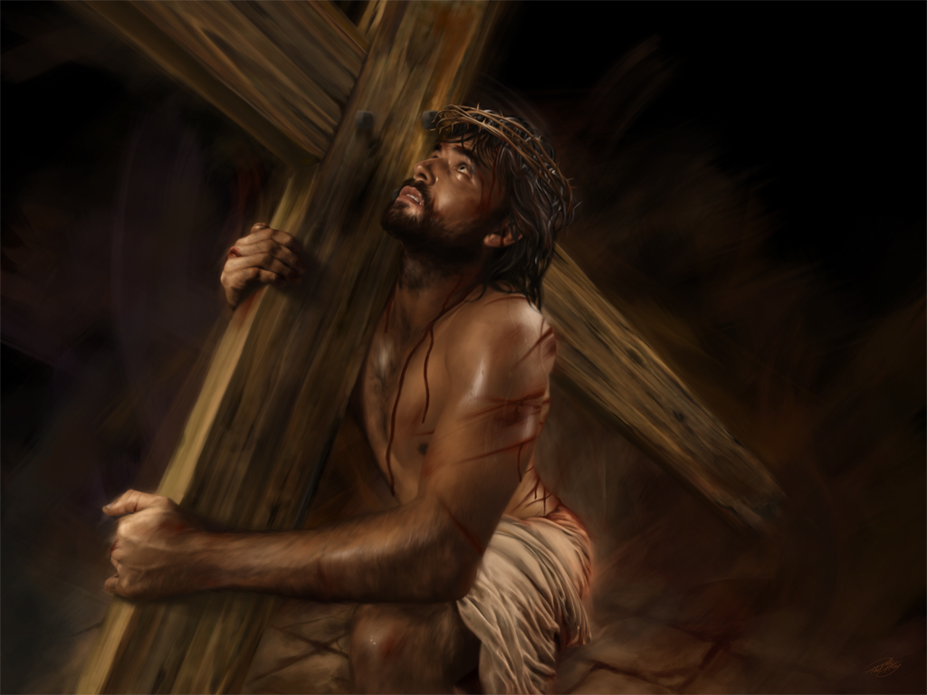

Slide 14
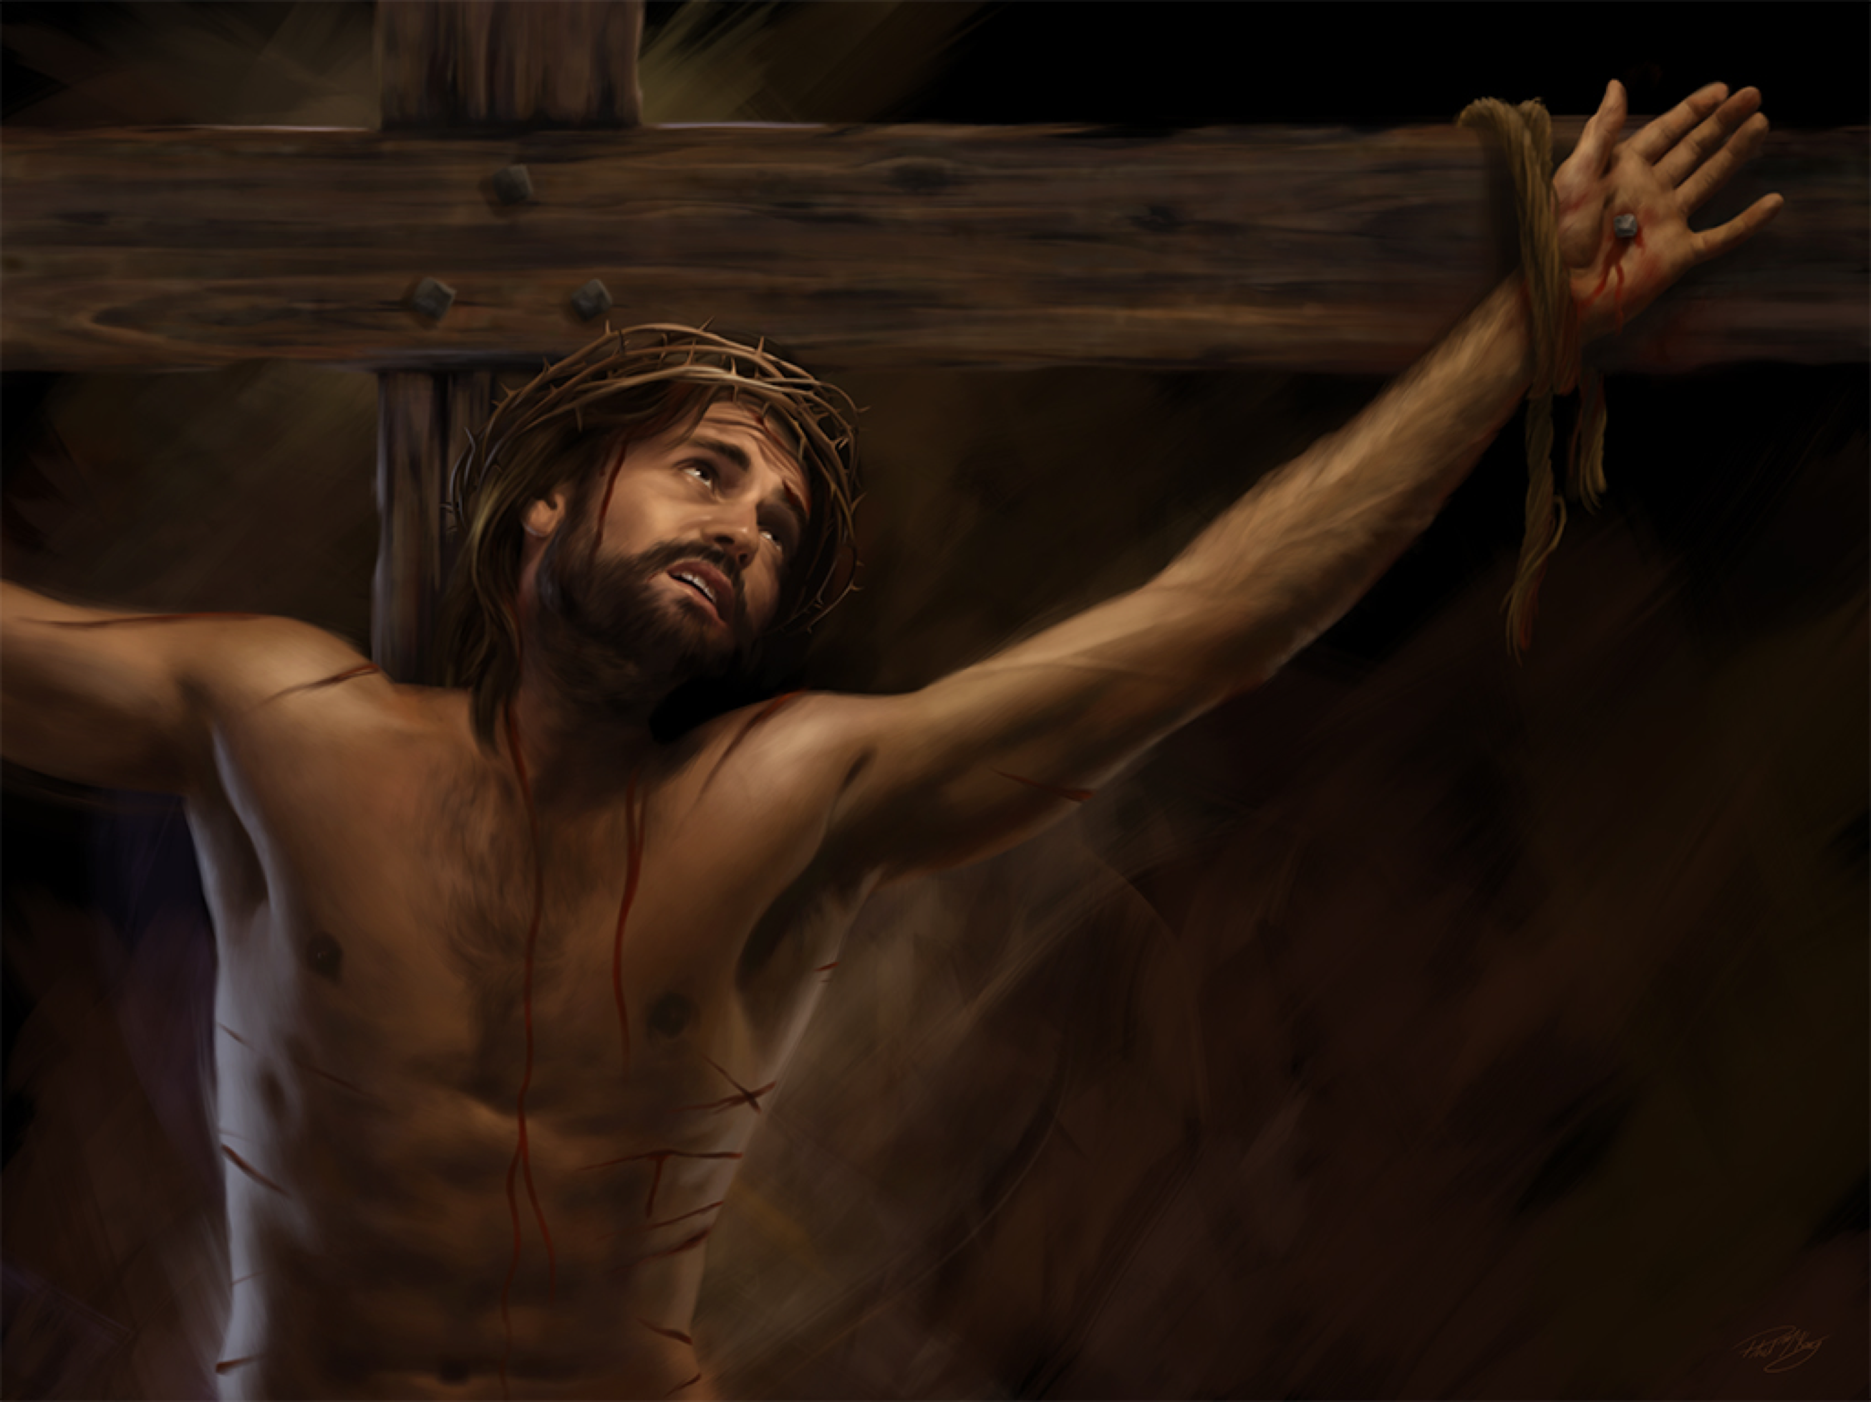

Slide 15
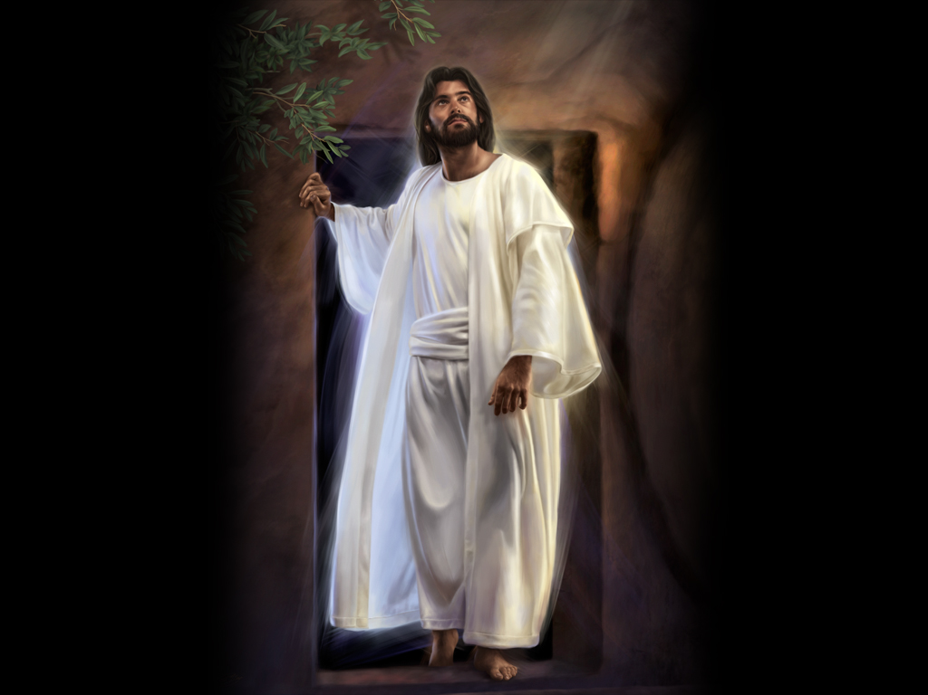

Slide 16

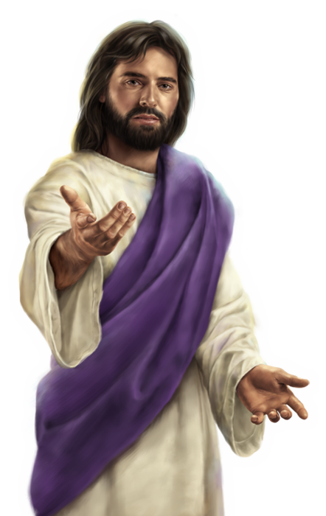

Slide 17
John 14:3
“And if I go and prepare a place for you, I will come again and receive you to Myself; that where I am, there you may be also.”

Slide 18
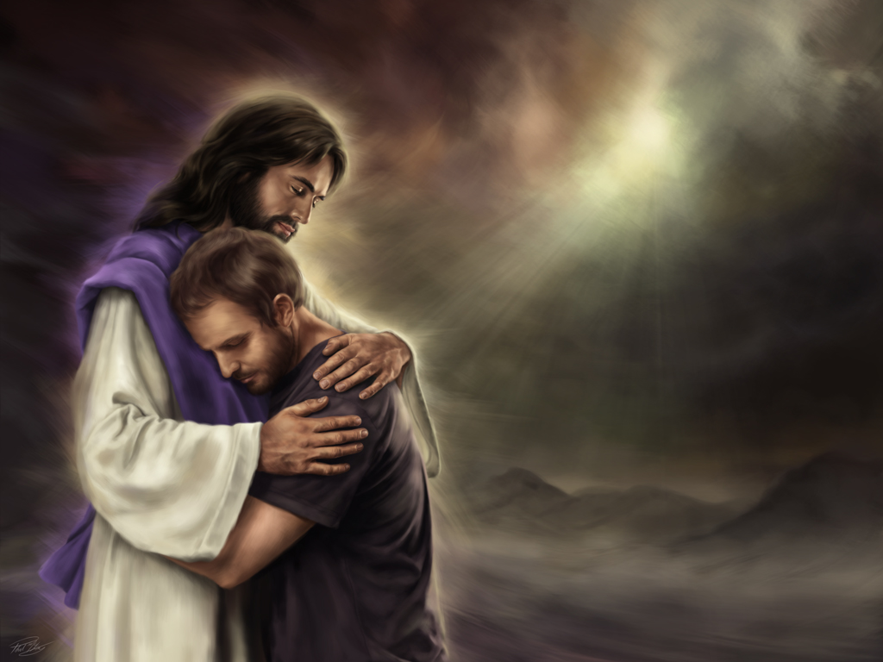

Slide 19
1 Thessalonians 4:16
“For the Lord Himself will descend from heaven with a shout, with the voice of an archangel, and with the trumpet of God. And the dead in Christ will rise first.”

Slide 20
John 5:28, 29
“Do not marvel at this;
for the hour is coming in which all who are in the graves will hear His voice and come forth—

Slide 21
John 5:28, 29
—those who have done good,
to the resurrection of life,
and those who have done evil,
to the resurrection of condemnation.”

Slide 22
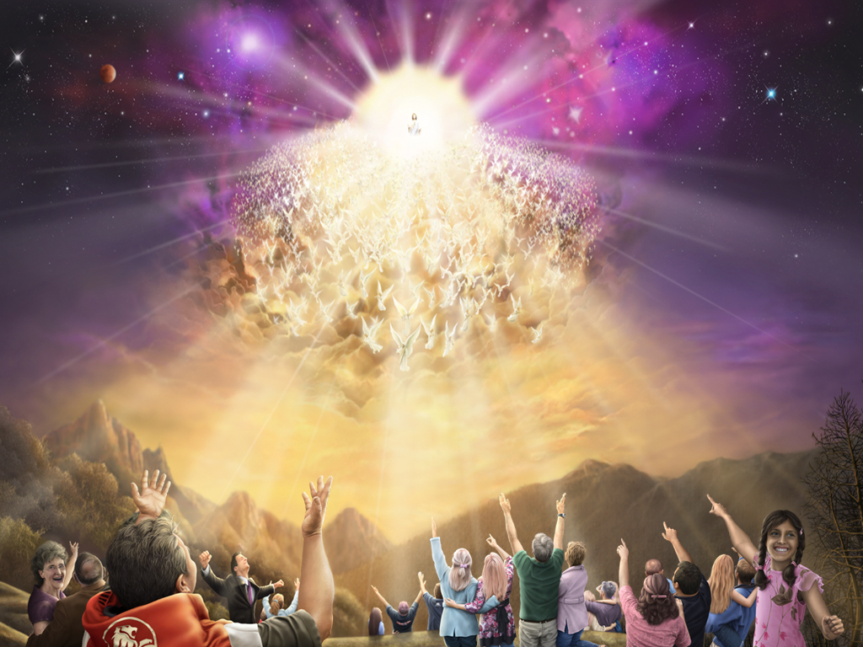

Slide 23
Notes:
1844 was the last time prophecy.
the 1st Angel's message,
the 2nd Angel's message,
the 3rd Angel's message…it's all there.
I've got to sum this up…
The 3 Angel's message is nothing more than the message of Noah. Get in the Ark!
Get into the ARK before it's too late! Why? Because the Seal of God is found in the ARK and those who are outside of the ARK will be marked for death.
The angels with the 7 Last Plagues are seen coming out of the Most Holy Place. Why? Because those who receive the plagues are those who rejected what was found in the Most Holy Place. Our message is to get into the ARK.

Slide 24
Revelation 14:8
“Babylon is fallen, is fallen, that great city, because she has made all nations drink of the wine of the wrath of her fornication.”

Slide 25
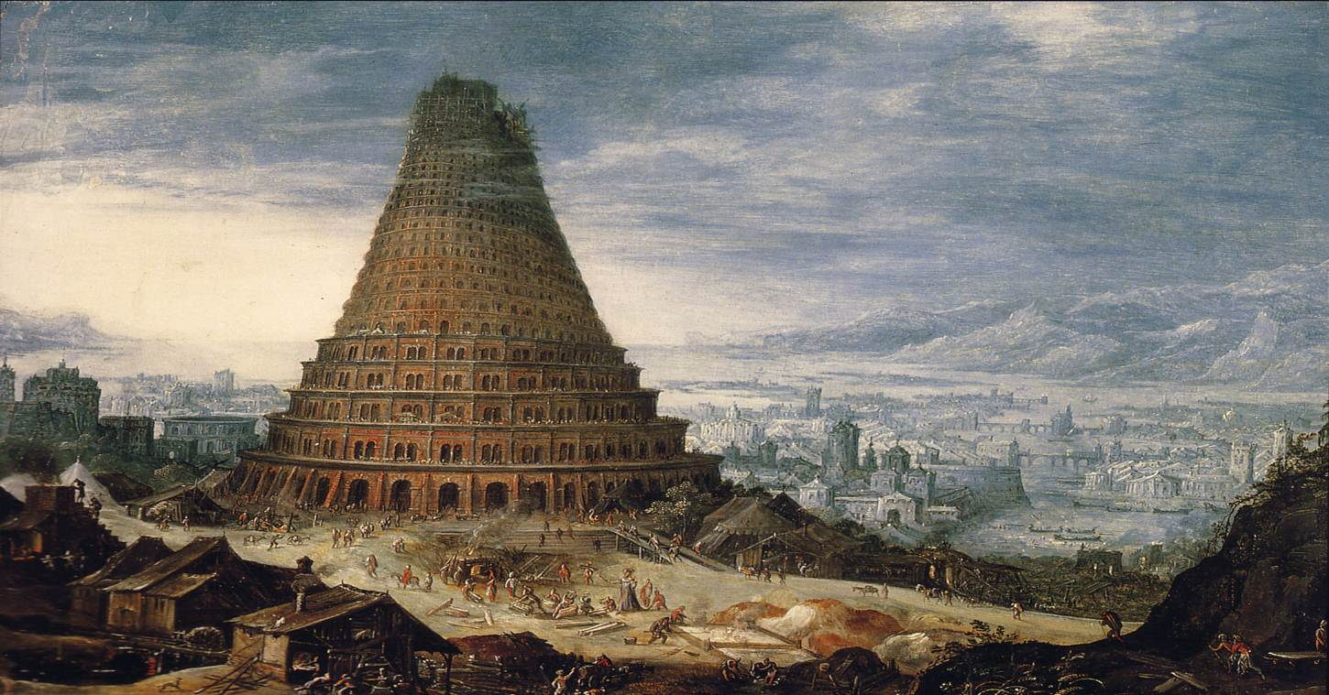

Slide 26
Notes:
1844 was the last time prophecy.
the 1st Angel's message,
the 2nd Angel's message,
the 3rd Angel's message…it's all there.
I've got to sum this up…
The 3 Angel's message is nothing more than the message of Noah. Get in the Ark!
Get into the ARK before it's too late! Why? Because the Seal of God is found in the ARK and those who are outside of the ARK will be marked for death.
The angels with the 7 Last Plagues are seen coming out of the Most Holy Place. Why? Because those who receive the plagues are those who rejected what was found in the Most Holy Place. Our message is to get into the ARK.

Slide 27
Revelation 14:9-11
“If anyone worships the beast and his image, and receives his mark on his forehead or on his hand, he himself shall also drink of the wine of the wrath of God

Slide 28
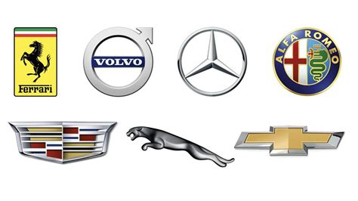
“The Mark” of “The Beast”

Slide 29
Revelation 14:12
Here is the patience of the saints; here are those who keep the commandments of God
and the faith of Jesus.”

Slide 30
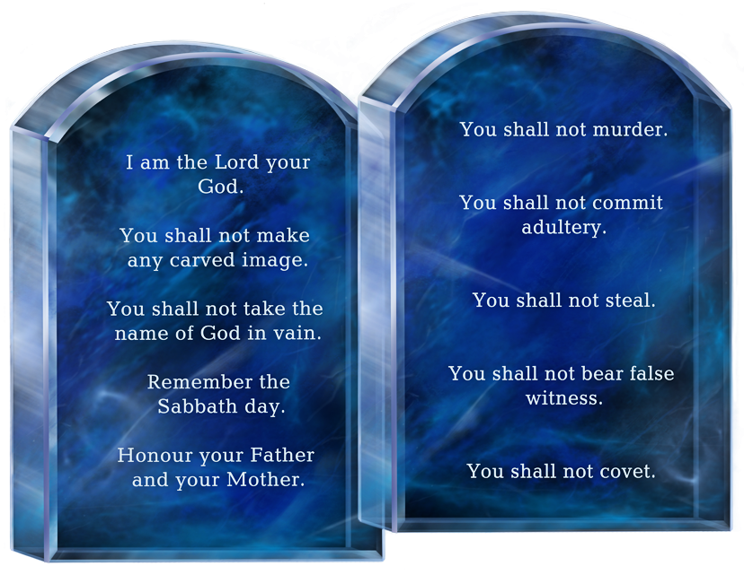

Slide 31
Notes:
1844 was the last time prophecy.
the 1st Angel's message,
the 2nd Angel's message,
the 3rd Angel's message…it's all there.
I've got to sum this up…
The 3 Angel's message is nothing more than the message of Noah. Get in the Ark!
Get into the ARK before it's too late! Why? Because the Seal of God is found in the ARK and those who are outside of the ARK will be marked for death.
The angels with the 7 Last Plagues are seen coming out of the Most Holy Place. Why? Because those who receive the plagues are those who rejected what was found in the Most Holy Place. Our message is to get into the ARK.

Slide 32
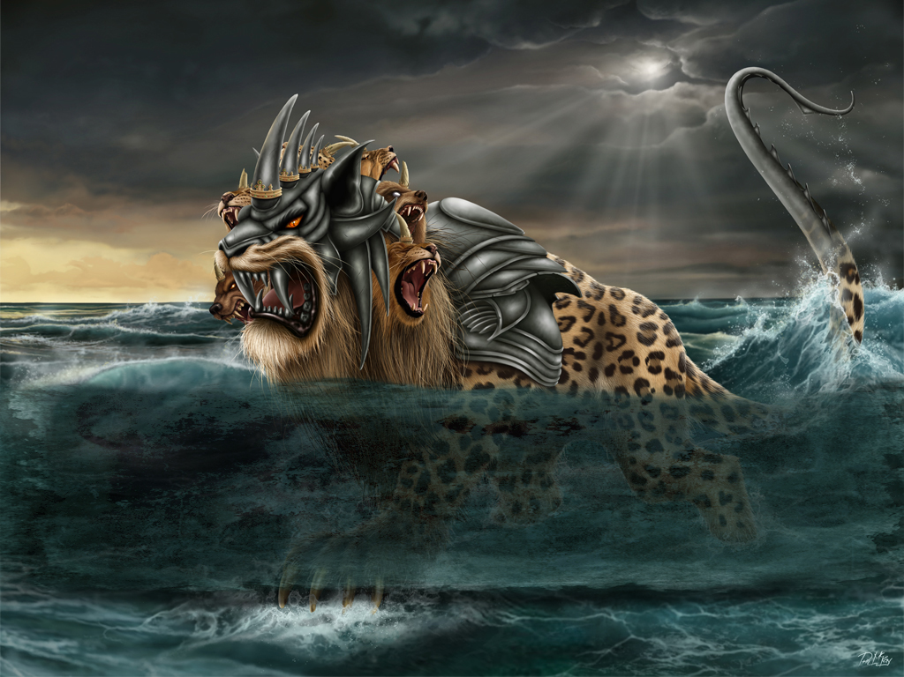
The Sea Beast

Slide 33
Revelation 13:2
The dragon gave him his power, his throne, and great authority.

Slide 34
Revelation 12:9
So the great dragon was cast out,
that serpent of old,
called the Devil and Satan,
who deceives the whole world;

Slide 35
Revelation 13:2
The dragon gave him his power, his throne, and great authority.

Slide 36
Revelation 13:4
So they worshiped the dragon who gave authority to the beast; and they worshiped the beast, saying,
“Who is like the beast?
Who is able to make war with him?”

Slide 37
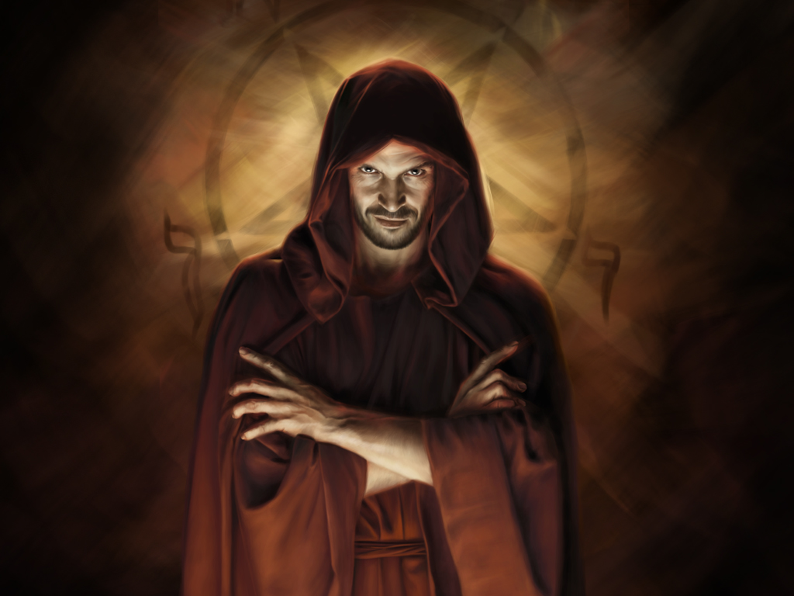

Slide 38
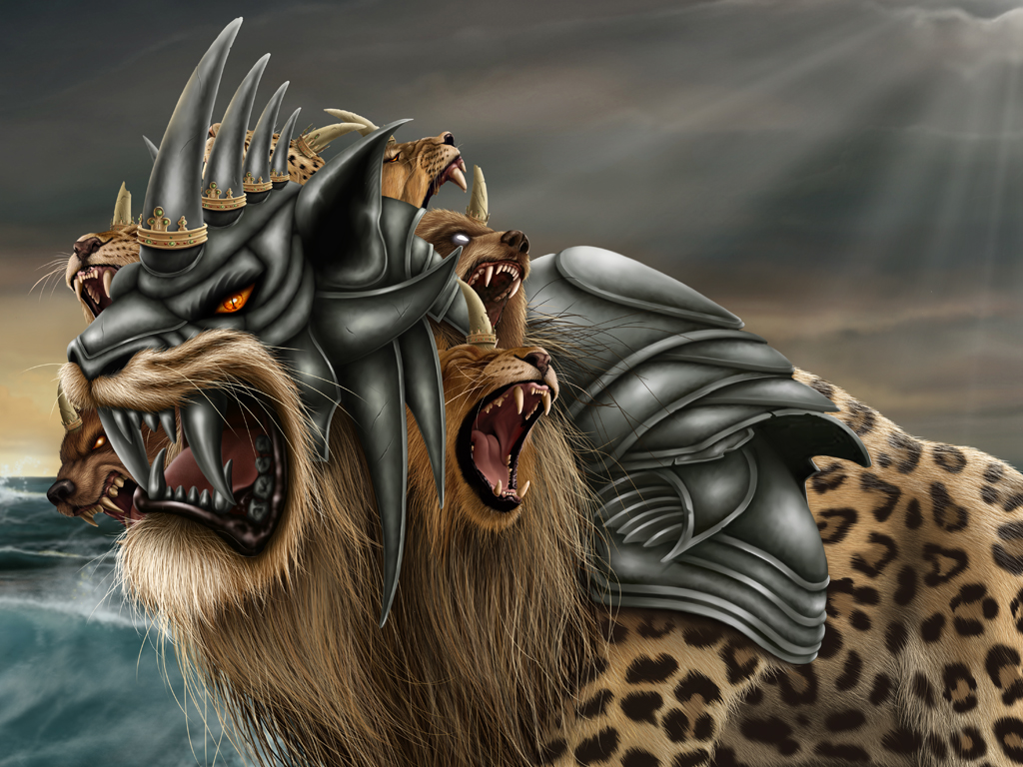

Slide 39
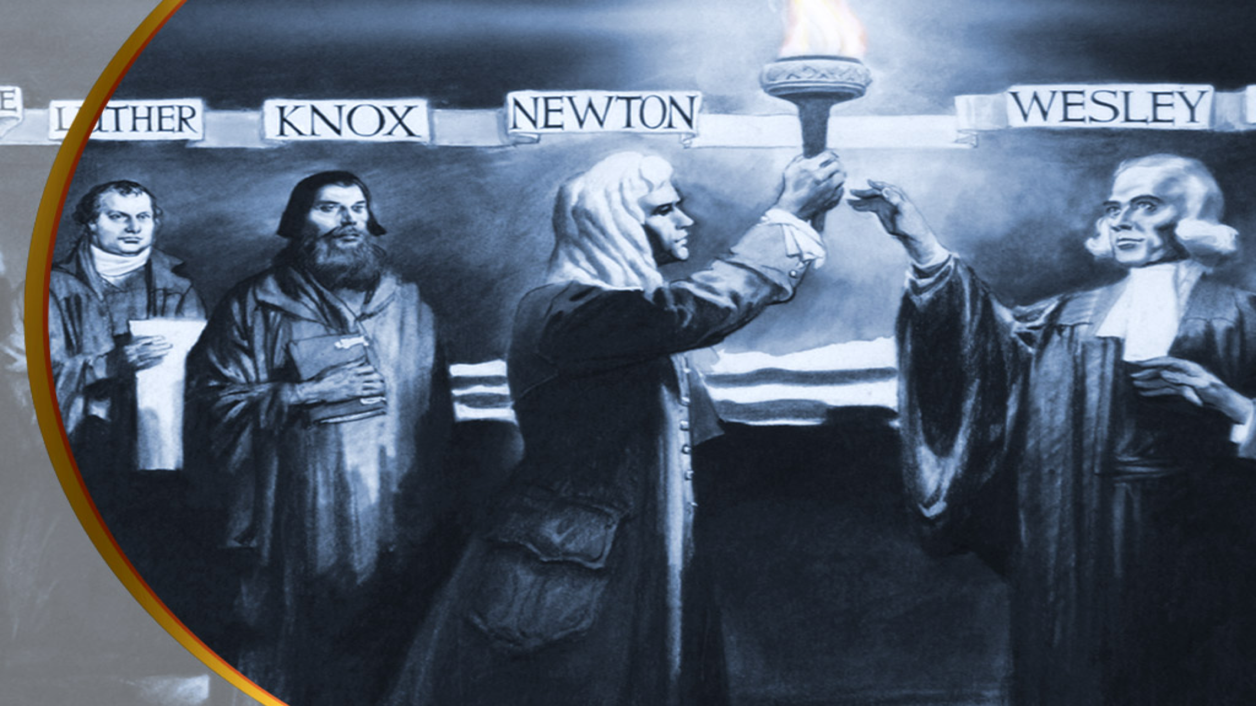
Notes:
#2 Compromise

Slide 40
John Wycliffe
(1328-1384), De Papa Ch. 2
“The pope is
antichrist here on earth.”

Slide 41
John Wycliffe
(1328-1384), De Papa Ch. 2
"Why is it necessary in unbelief to look for another Antichrist?...In Daniel 7, the Antichrist is forcefully described as a horn arising in the time of the fourth kingdom... wearing out the saints of the most high." (Froom, vol.2, p.445)

Slide 42
Martin Luther
(1483-1546), Martyn, p. 372-3
“O, how much pain it has caused me, though I had the Scriptures on my side . . . That I should dare to make a stand alone against the pope, and hold him forth as antichrist.”

Slide 43
John Knox
(1505-1572)
“That tyranny which the Pope himself has for so many ages exercised over the church" and that he should be acknowledged as
"the very Antichrist, and son of perdition,
of whom Paul speaks."
(Knox, 'The Zurich Letters', p.199)

Slide 44
Foundation of Many Churches
The ‘Morland Confession’ 1508
The ‘Helvetic Confession’ 1536
The ‘Savoy Declaration’ 1658
The ‘Baptist Confession’ 1689
‘Philadelphia Confession of Faith’ 1742

Slide 45


Slide 46
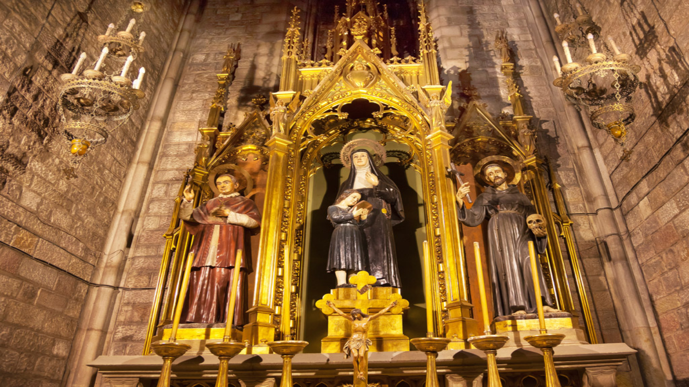
Her Own Words
Notes:
#2 Compromise

Slide 47
Ferraris’ Ecclesiastical Dictionary
“The Pope is of so great dignity and so exalted that he is not a mere man, but as it were God,
and the vicar of God.”

Slide 48
The Catholic National, July 1895
“The Pope is not only the representative of Jesus Christ,
but he is Jesus Christ Himself,
hidden under the veil of flesh.”

Slide 49
Pope Leo XIII,
(1878-1903) Encyclical Letters p. 304
“We hold upon this earth
the place of God Almighty.”

Slide 50
The Oration of Christopher Marcellus in fourth session of the fifth Lateran Council, Labbe and Cossart’s History of the Councils, published in 1672, Vol. XIV, Col. 109
“For thou art the shepherd,
thou art the director,
thou art the husbandman;
finally thou art another God on earth.”

Slide 51
The Catholic Priest, p.78
“Thou art a priest forever: says the ordaining bishop… He is no longer a man, a sinful child of Adam, but an ‘Alter Christus’, another Christ … Forever a priest of the Most High,
with power over the Almighty.”

Slide 52

“who opposes and exalts himself above all that is called God
or that is worshiped,
so that he sits as God in the temple of God, showing himself that he is God.”

Slide 53
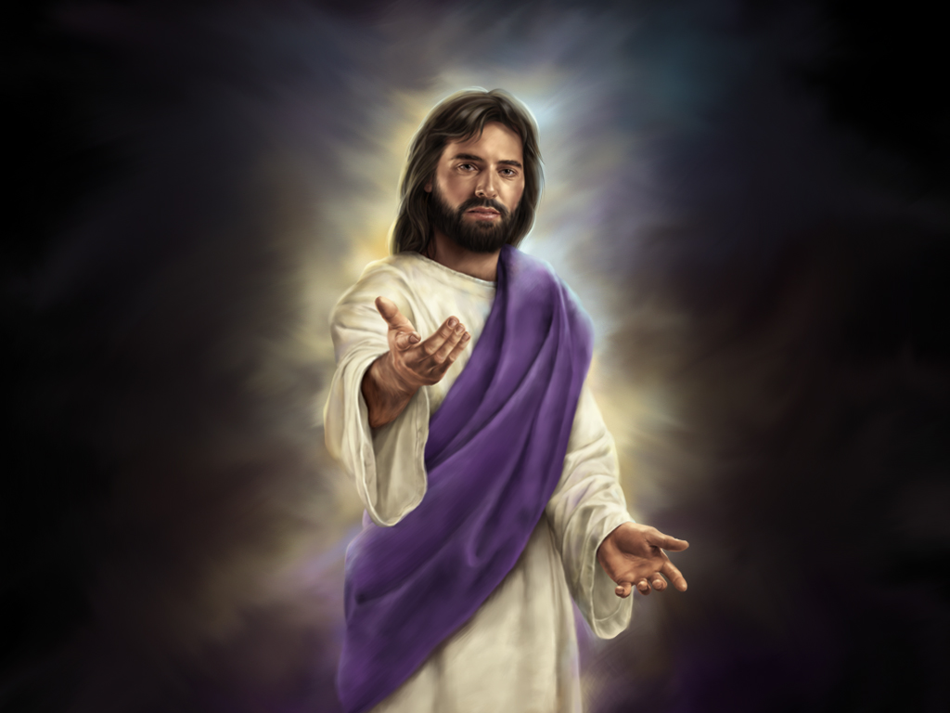
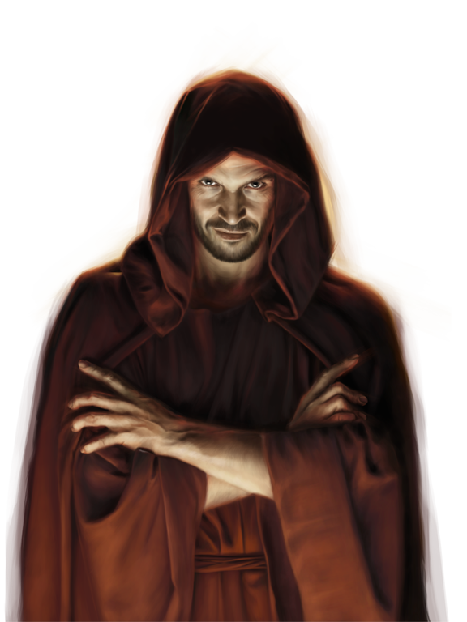

Slide 54
1 Timothy 4:1
“Now the Spirit expressly says that in latter times some will depart from the faith, giving heed to deceiving spirits and doctrines of demons,”

Slide 55
2 Timothy 3:13
“But evil men and impostors will grow worse and worse, deceiving and being deceived.”

Slide 56
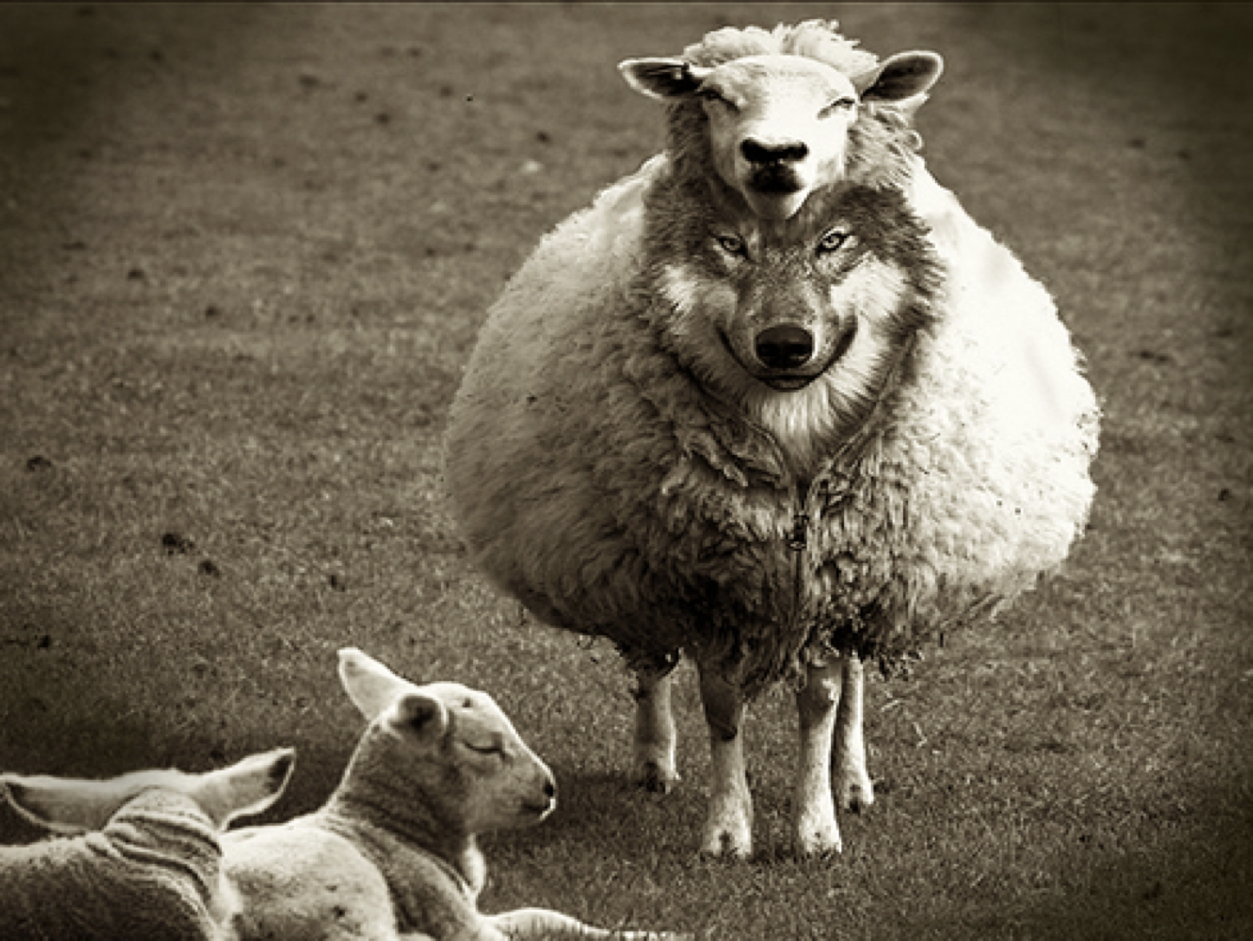

Slide 57
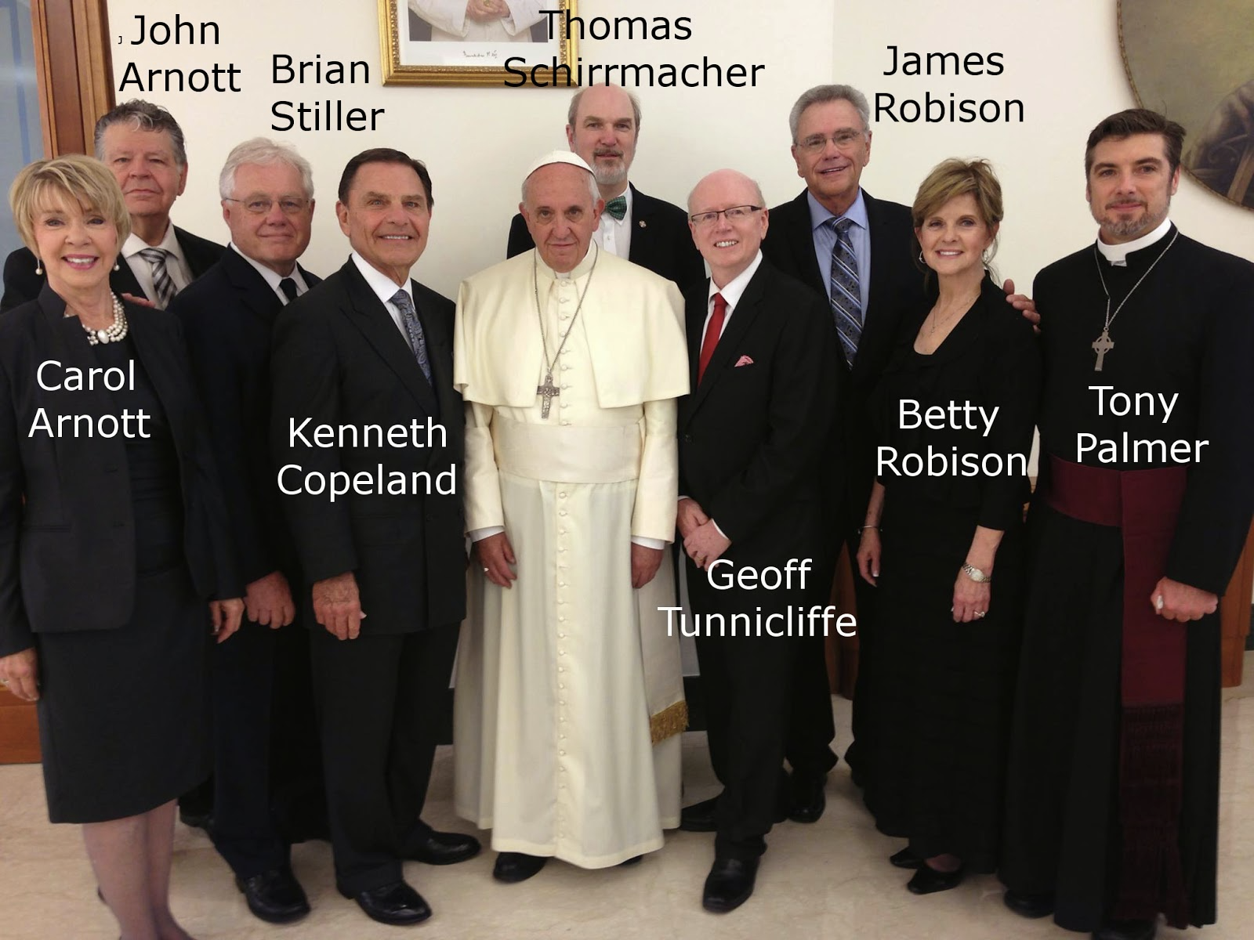

Slide 58
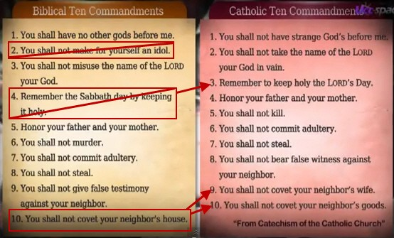
Notes:
What are the odds that there is a dog?
What are the odds that it’s not a Chihuahua?

Slide 59
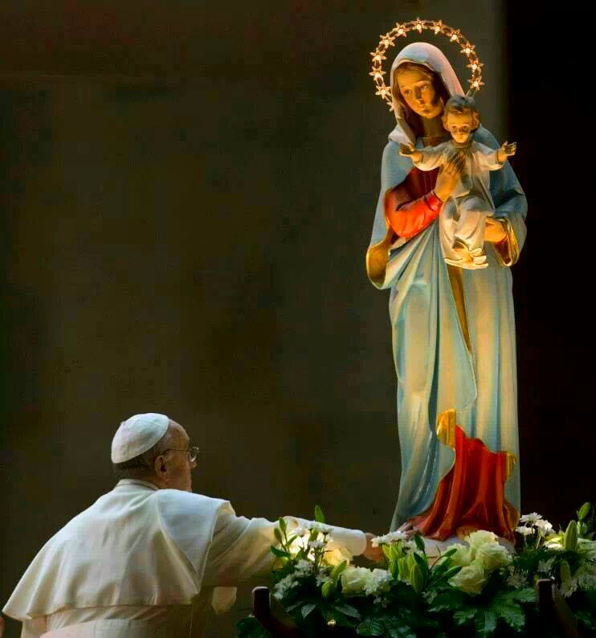
Notes:
Rather the Bible plainly calls man “mortal.”
For instance Job 4:17
“Can a mortal be more righteous than God? Can a man be more pure than his Maker? “
MAN is mortal – That’s a Biblical Fact!

Slide 60
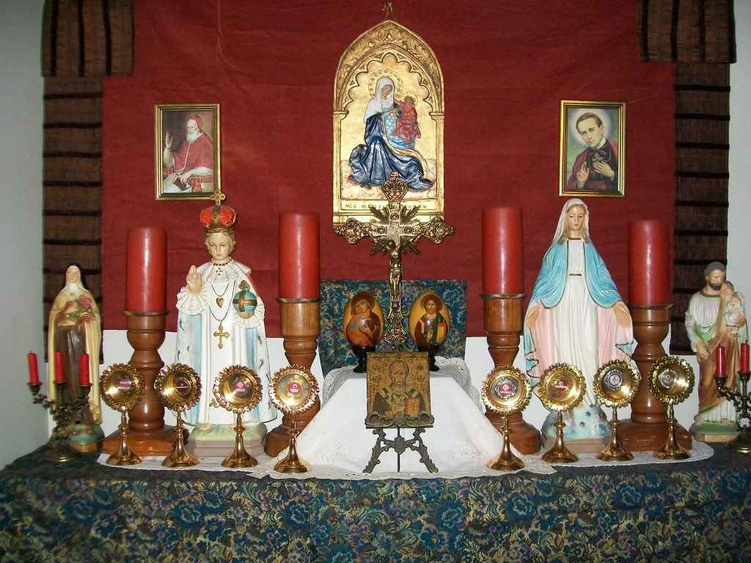

Slide 61
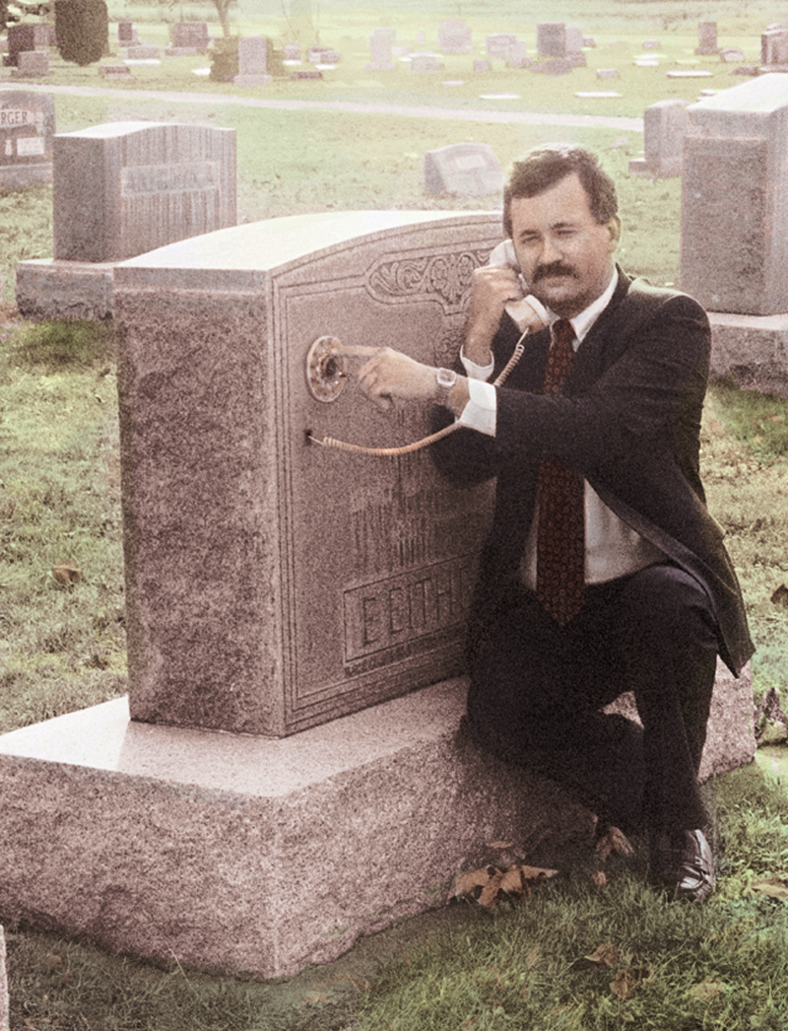
FRIEND OR FOE?
Notes:
That you can somehow communicate with the dead.

Slide 62




Notes:
Popular TV shows on this subject today are getting the highest ratings.
Shows like Ghost Hunters, Dead Zone, Crossing Over, and Etreme Paranormal…
Ghost Hunters is an American paranormal reality television series (2004-2013). The program features paranormal investigators Jason Hawes and Grant Wilson who investigate places that are reported to be haunted.
The Dead Zone was an American-Canadian science fiction/suspense series (2002-2007)starring Anthony Michael Hall as Johnny Smith, who discovers he has developed psychic abilities after a coma. The show, credited as "based on characters" from Stephen King's 1979 novel of the same name
John Edward, is an American television personality and professional psychic medium. He is best known for his TV shows Crossing Over with John Edward (1999-2004). He questions audience members with what is presented as information being communicated by their deceased friends and relatives. Edward says he receives images and clues from "the other side" which the audience must assist him in interpreting.
Extreme Paranormal is an American paranormal documentary TV special follows the missions of three paranormal investigators that go to extremes in order to make contact with spirits during their investigations. In Extreme Paranormal, paranormal investigators, Shaun, Nathan, and Jason explore local legends, seeking the truth by provoking spirits and recreating tragdies during their investigations. Unlike other paranormal groups, this extreme team puts themselves in harm's way with their aggressive tactics by taunting ghosts, summoning the dead, performing rituals, challenging curses, and daring demons to attack them.

Slide 63



Notes:
There are tons of books in bookstores on this subject today.
Notice the Focus as expressed in the titles: “One with the Light” – “Returning From the Light”
One asks the Question: “Have you been Contacted by a loved one Who has died?”
Then it says: A new field of research – After-Death Communication – confirms that life and love are eternal.
NEXT

Slide 64


Notes:
There are tons of books in bookstores on this subject today.
Notice the Focus as expressed in the titles: “One with the Light” – “Returning From the Light”
One asks the Question: “Have you been Contacted by a loved one Who has died?”
Then it says: A new field of research – After-Death Communication – confirms that life and love are eternal.
NEXT

Slide 65
Leviticus 19:31
“Give no regard to mediums
and familiar spirits;
do not seek after them,
to be defiled by them:
I am the Lord your God.”

Slide 66
Leviticus 20:6
“And the person who turns to mediums and familiar spirits,
to prostitute himself with them,
I will set My face against that person and cut him off from his people.”

Slide 67
Leviticus 20:27
“A man or a woman who is a medium, or who has familiar spirits,
shall surely be put to death;
they shall stone them with stones. Their blood shall be upon them.’”

Slide 68
Isaiah 8:19
“…should not a people seek their God?
Should they seek the dead on behalf of the living?”

Slide 70
Mark 12:27
“He is not the God of the dead,
but the God of the living.
You are therefore
greatly mistaken.”

Slide 71

The Nature of Man?
Inherent Immortality?
Notes:
Many wonder, Is the soul immortal?

Slide 72
Words Have Meaning
Mortal: a human being subject to death, often contrasted with a divine being.
Immortal: living forever; never dying or decaying; noun: an immortal being, esp. a god

Slide 73
Words Have Meaning
Inherent: existing in something as a permanent, essential, or characteristic attribute
“Immortal Soul”
Babylonians, Egyptians, Pagans, Greeks (anthropological dualism), Roman Church

Slide 74
Immortal/ Immortality
#1

Slide 75
Romans 2:5
“But in accordance with your hardness and your impenitent heart you are treasuring up for yourself wrath in the day of wrath and revelation of the righteous judgment of God,

Slide 76
Romans 2:6, 7
who “will render to each one according to his deeds”:
eternal life to those who by patient continuance in doing good seek for glory, honor, and immortality;

Slide 77
Romans 2:8, 9
but to those who are self-seeking and do not obey the truth, but obey unrighteousness—indignation and wrath, tribulation and anguish, on every soul of man who does evil, of the Jew first and also of the Greek.”

Slide 78
Ezekiel 18:4, 20
“The soul who sins shall die.”

Slide 79


Slide 80


Slide 81
Job 4:17
“Can a mortal be more righteous
than God?
Can a man be more pure
than his Maker?”

Slide 82
Words Have Meaning
Is the soul subject to death?
Mortal: a human being subject to death, often contrasted with a divine being.

Slide 83

Genesis 3:22

Slide 84
Immortal/ Immortality
#2

Slide 85
2 Timothy 1:10
“but has now been revealed by the appearing of our Savior Jesus Christ, who has abolished death and brought life and immortality to light through the gospel,”

Slide 86
Romans 6:23
“For the wages of sin is death,
but the gift of God is eternal life in Christ Jesus our Lord.”

Slide 87
Genesis 3:22
“Then the Lord God said,
“Behold, the man has become like one of Us, to know good and evil.
And now, lest he put out his hand
and take also of the tree of life,
and eat, and live forever”—

Slide 88
Genesis 3:23
therefore the Lord God sent him out of the garden of Eden to till the ground from which he was taken.

Slide 89
Genesis 3:24
So He drove out the man;
and He placed cherubim at the east of the garden of Eden, and a flaming sword which turned every way,
to guard the way to the tree of life.”

Slide 90

Genesis 3:24

Slide 91
1 John 3:15
“Whoever hates his brother is a murderer, and you know that no murderer has eternal life abiding in him.”

Slide 92
Immortal/ Immortality
#3

Slide 93
1 Timothy 1:17
“Now to the King eternal, immortal, invisible, to God who alone is wise,
be honor and glory forever and ever. Amen.”

Slide 94
Immortal/ Immortality
#4

Slide 95
1 Timothy 6:15, 16
“which He will manifest in His own time, He who is the blessed and only Potentate, the King of kings and Lord of lords,

Slide 96
1 Timothy 6:15, 16
who alone has immortality, dwelling in unapproachable light, whom no man has seen or can see, to whom be honor and everlasting power. Amen.”

Slide 97
Immortal/ Immortality
#5

Slide 98
1 Corinthians 15:51-53
“Behold, I tell you a mystery:
We shall not all sleep, but we shall all be changed—

Slide 99
Death Is Like a Sleep
Job Job 14:12
David Psalm 13:3
Jesus Mark 5:39; John 11:11
Matthew Matthew 27:51
Notes:
Rather the Bible plainly calls man “mortal.”
For instance Job 4:17
“Can a mortal be more righteous than God? Can a man be more pure than his Maker? “
MAN is mortal – That’s a Biblical Fact!

Slide 100
Death Is Like a Sleep
Luke Acts 7:60; 13.36
Paul 1 Corinthians 15:6,18,20,51
1 Thessalonians 4:13,15
Peter 2 Peter 3:4
Notes:
Rather the Bible plainly calls man “mortal.”
For instance Job 4:17
“Can a mortal be more righteous than God? Can a man be more pure than his Maker? “
MAN is mortal – That’s a Biblical Fact!

Slide 101
Death Is Like a Sleep
The Bible teaches that death is like a sleep that lasts until Christ’s second coming.
Bible writers declare death “sleep” 62 times
Cemetery: Gk. Koimeterion; sleeping place
Notes:
The Bible calls death a “sleep” over 60 times (Deut. 31:14,16; Job 14:10,12; Psalm 13:3; 1 Kings 2:1, 10; Dan. 12:2; Matt. 27:52; Mark 5:39, etc.).
Incidentally, “cemetery” in Greek (koimeterion) means “sleeping place.”

Slide 102
1 Corinthians 15:51-53
in a moment, in the twinkling of an eye, at the last trumpet. For the trumpet will sound, and the dead will be raised incorruptible, and we shall be changed.

Slide 103
1 Corinthians 15:51-53
For this corruptible must put on incorruption,
and this mortal must put on immortality.”

Slide 104
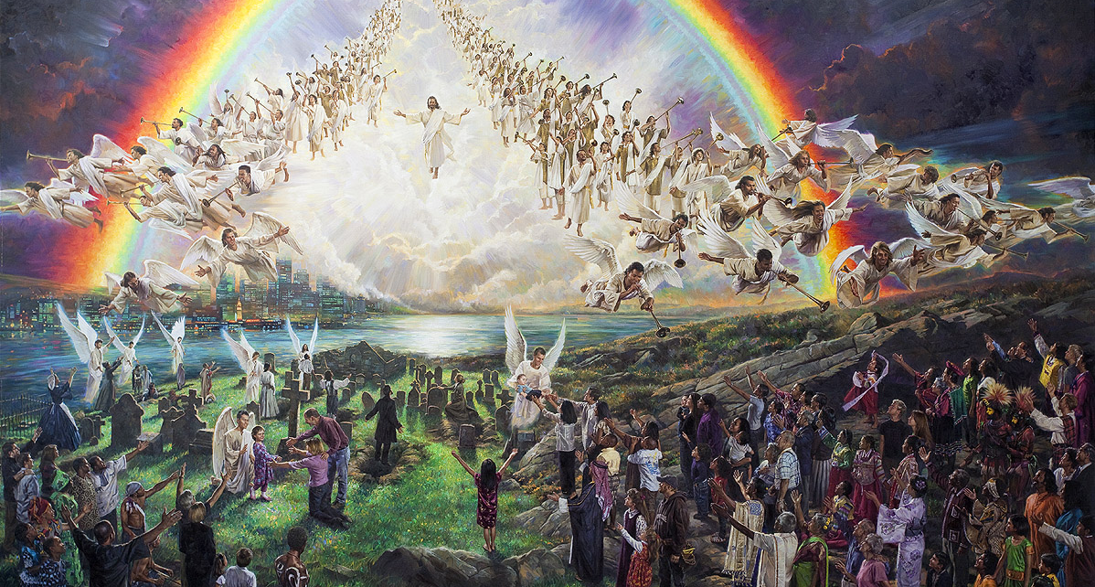

Slide 105


Conclusion
We do not currently posses immortality
or we would not be seeking it.
God is immortal and therefore can give immortality.
The Bible is clear, immortality is given on condition of the gospel at the second coming of Jesus.
Notes:
Rather the Bible plainly calls man “mortal.”
For instance Job 4:17
“Can a mortal be more righteous than God? Can a man be more pure than his Maker? “
MAN is mortal – That’s a Biblical Fact!

Slide 106
Conclusion
The Bible uses the word “soul” over 1500 times but never once uses the term “immortal soul”, “undying soul” or “eternal soul.”
Notes:
Rather the Bible plainly calls man “mortal.”
For instance Job 4:17
“Can a mortal be more righteous than God? Can a man be more pure than his Maker? “
MAN is mortal – That’s a Biblical Fact!

Slide 107

Where did belief in Immortal Soul originate?
Notes:
Where did belief in the immortal soul originate?

Slide 108
Is Man by Nature Immortal?
Sermon by Amos Phelps (1805-1874),
a Methodist-Congregationalist clergyman
and professor of Yale University
Notes:
And the devil has continued to propagate this lie ever since!
Pagan Greek philosophy taught that the soul is immortal. The ancient Egyptians believed in the immortal soul.
Ancestor worship is based on the immortality of the soul. Spiritualism teaches that the soul is immortal; hence, the dead are not really dead and can communicate with the living.

Slide 109
Is Man by Nature Immortal?
“This doctrine can be traced through the muddy channels of a corrupted Christianity, a perverted Judaism, a pagan philosophy, A superstitious idolatry, to the great instigator of mischief in the Garden of Eden. The protestants borrowed it from the Catholics, the Catholics…
Notes:
And the devil has continued to propagate this lie ever since!
Pagan Greek philosophy taught that the soul is immortal. The ancient Egyptians believed in the immortal soul.
Ancestor worship is based on the immortality of the soul. Spiritualism teaches that the soul is immortal; hence, the dead are not really dead and can communicate with the living.

Slide 110
Is Man by Nature Immortal?
from the Pharisees, the Pharisees from the pagan, and the pagans from the old Serpent, who first preached the doctrine amid the lowly bowels of Paradise to an audience all too willing to hear and heed the new and fascinating theology –
‘You shall NOT surely die.’”
Notes:
And the devil has continued to propagate this lie ever since!
Pagan Greek philosophy taught that the soul is immortal. The ancient Egyptians believed in the immortal soul.
Ancestor worship is based on the immortality of the soul. Spiritualism teaches that the soul is immortal; hence, the dead are not really dead and can communicate with the living.

Slide 111
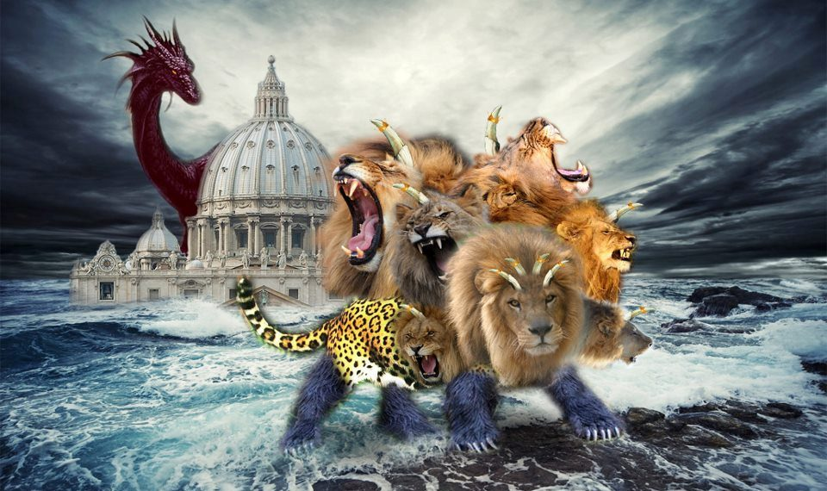
Notes:
Let’s go back to the Beast for a moment.
Here we see another meaning to the questions of why this beast is “Composite” This is how the Anti-Christ is part Babylon, Medo-Persia, Greece & Rome.
The false doctrines it teaches stem back through the ages through all of the previous kingdoms.

Slide 112

Man is Mortal
Pope Leo X issued a dogma:
“We do condemn… all who assert that the… soul is mortal.”
Fifth Lateran Council–Dec.19, 1513
Notes:
Man is Mortal
“The pagan doctrine of the immortality of the human soul crept into the back door of the church in the early centuries.”
William E. Gladstone

Slide 113
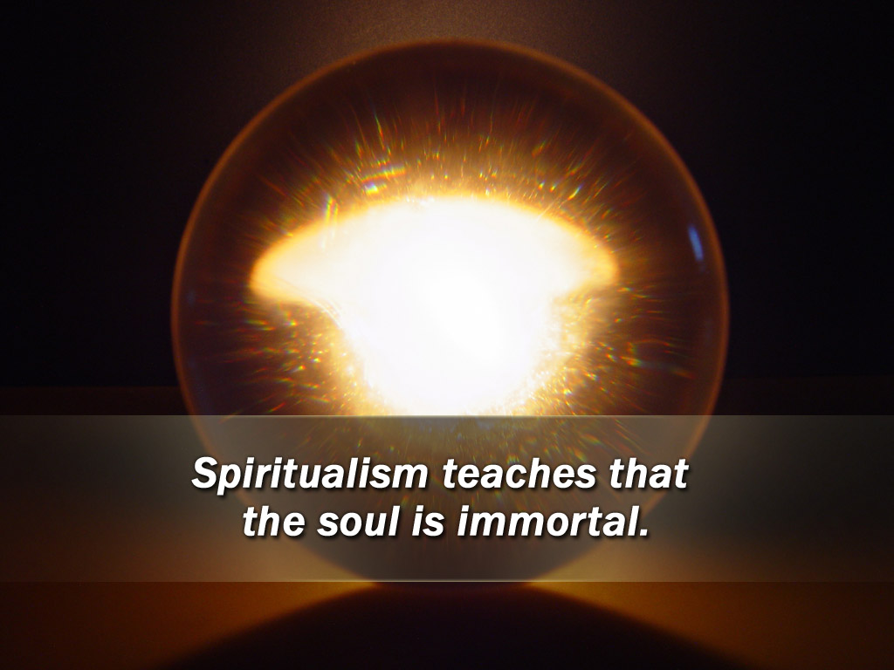
Notes:
Spiritualism teaches that the soul is immortal.

Slide 114
E.W. Sprague, Spiritualist
“Spiritualism says that the dead know more than the living. ‘And the serpent said unto the woman, ye shall not surely die.’ (Gen. 3:4)...” In this, as in many other passages,
the Devil told the truth and the Lord is in error.”
Notes:
And the devil has continued to propagate this lie ever since!
Pagan Greek philosophy taught that the soul is immortal. The ancient Egyptians believed in the immortal soul.
Ancestor worship is based on the immortality of the soul. Spiritualism teaches that the soul is immortal; hence, the dead are not really dead and can communicate with the living.

Slide 115
Ecclesiastes 9:5
“For the living know that they will die;
But the dead know nothing,
And they have no more reward,
For the memory of them is forgotten.
Notes:
And the devil has continued to propagate this lie ever since!
Pagan Greek philosophy taught that the soul is immortal. The ancient Egyptians believed in the immortal soul.
Ancestor worship is based on the immortality of the soul. Spiritualism teaches that the soul is immortal; hence, the dead are not really dead and can communicate with the living.

Slide 116
Ecclesiastes 9:6
Also their love, their hatred, and their envy have now perished;
Nevermore will they have a share
In anything done under the sun.”
Notes:
And the devil has continued to propagate this lie ever since!
Pagan Greek philosophy taught that the soul is immortal. The ancient Egyptians believed in the immortal soul.
Ancestor worship is based on the immortality of the soul. Spiritualism teaches that the soul is immortal; hence, the dead are not really dead and can communicate with the living.

Slide 117
Ecclesiastes 9:10
Whatever your hand finds to do,
do it with your might;
for there is no work or device or knowledge or wisdom in the grave where you are going.”
Notes:
And the devil has continued to propagate this lie ever since!
Pagan Greek philosophy taught that the soul is immortal. The ancient Egyptians believed in the immortal soul.
Ancestor worship is based on the immortality of the soul. Spiritualism teaches that the soul is immortal; hence, the dead are not really dead and can communicate with the living.

Slide 119
The Last Message to a dying World

Slide 122
Do you love my Jesus?
Do you trust in Him alone?

